Slide 1
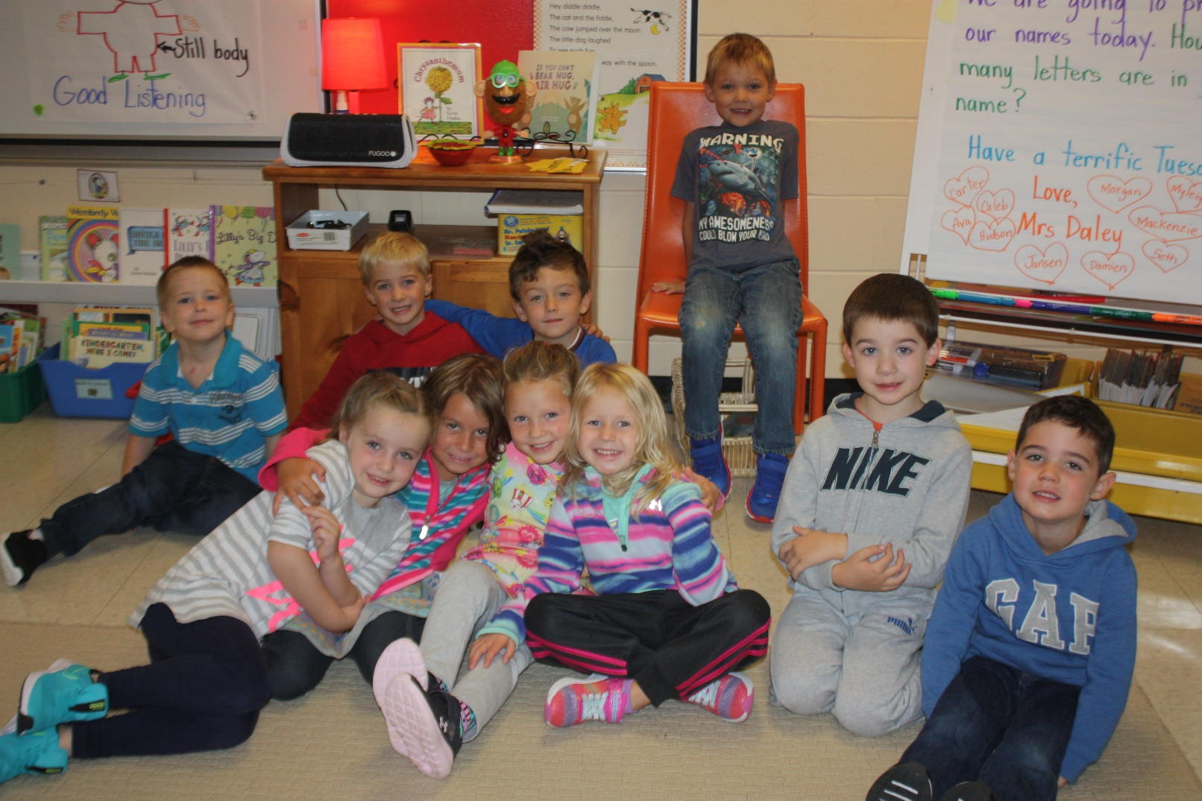
Welcome to our Primary Classroom- A classroom of energized, engaged and joyful learning!
2020-21

Slide 2
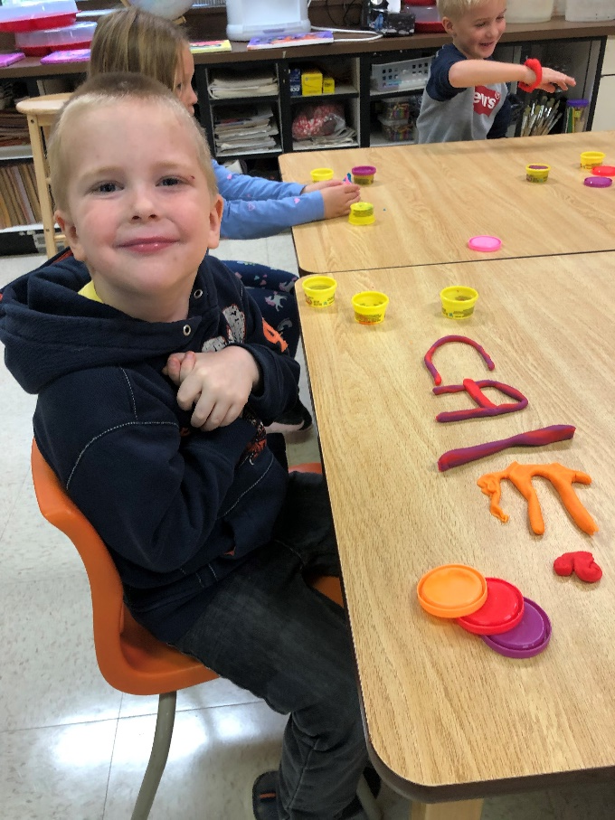
Our Daily schedule
8:05 Bell Rings to come in to school
8:05-8:20 Announcements/Morning jobs
8:20-9:50 Literacy
9:50-10:05 Recess
10:05-11:35 Math
11:35-12:20 Lunch and Recess
12:20-12:50 Mindful Moments (SEL) with Mrs. Lee
12:50-1:50 Play Shop (Exploration)
Music, art, and phys. ed are all integrated into the day as well as being a part of Exploration (we are calling it Play Shop)

Slide 3
Take Me outside for learning
Over the last few years I have been bringing my class outside more frequently for learning. This year I plan to do it on a regular basis. I believe that learning outdoors contributes to providing children with the best possible education. Our cognitive, social, emotional and physical health is affected by time spent outside, especially in a natural space which we have plenty of right here at Janeville Elementary.
I ask that your children be dressed in suitable clothing for the weather. This includes rain gear, hats, mittens, warm jackets, and boots.

Slide 4
Tidbits of info
Every Wednesday is a half day (Bell Rings at 11:35)
Please call the school or send me a text if your child will be absent from school
Please send a written note in after your child has been absent (even if you have texted me)
There is no secretary in the office in the afternoon
Nutritious snacks and water bottle are allowed in the classroom
Call or text me anytime 506-545-8729
It’s cool in the mornings so light gloves and hats are always good to have. In the winter, extra mitts in school bag are awesome

Slide 5
The Primary Communicator – please check it on a regular basis! ☺

Slide 6
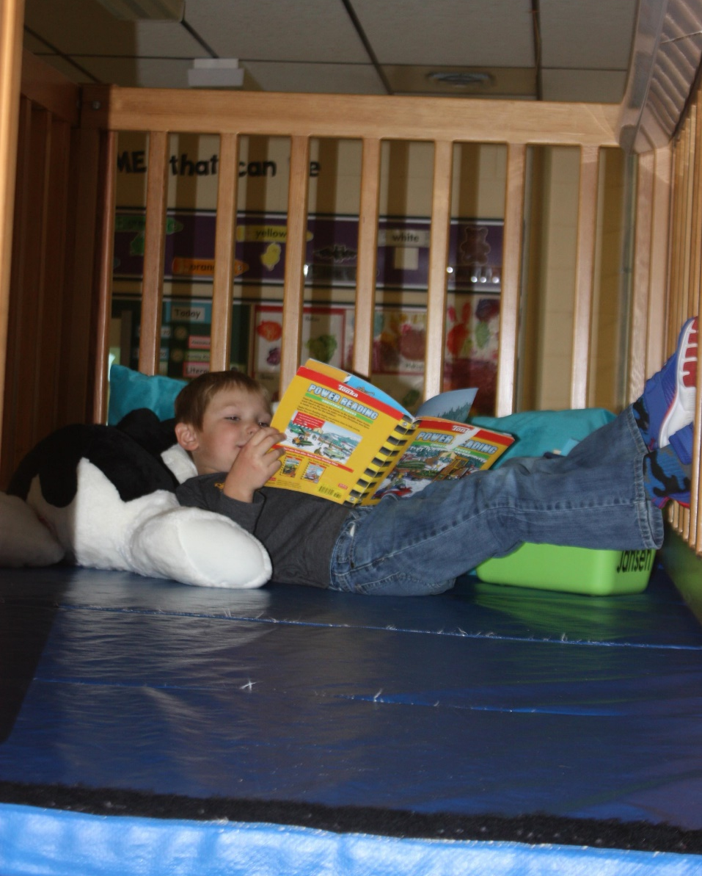
Read! Read! And Read some more! Please read to your child every night.

Slide 7
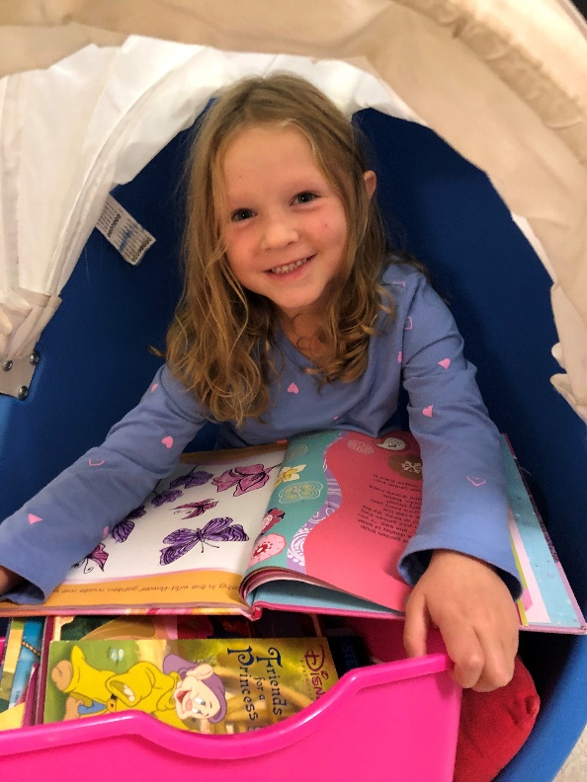
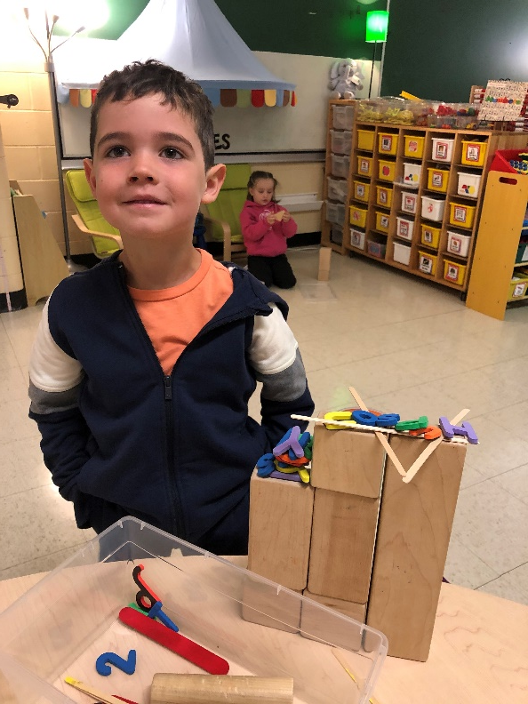
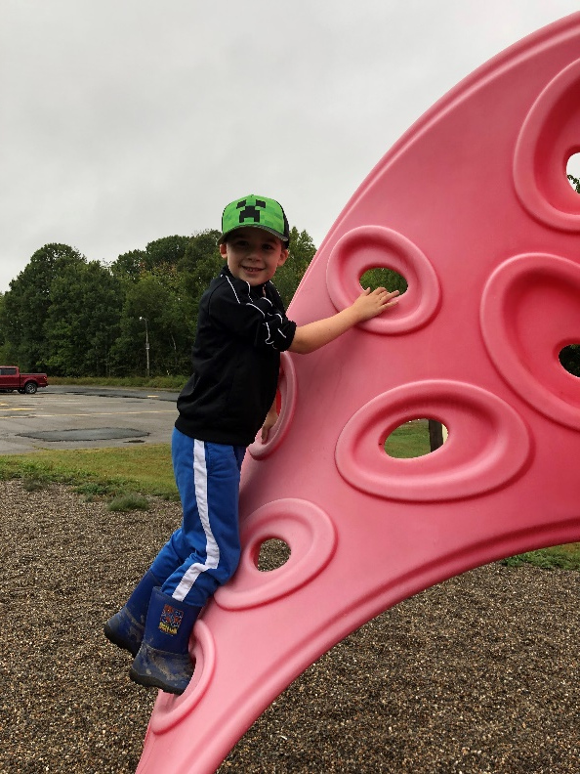
My goals as a teacher
I want the kids to find joy and pleasure in reading so that they’ll choose to read even when they don’t have to.
I want to build a community of persistence, joy, resilience, flexibility & empathy (Be Brave, Be Kind, Be Awesome).
I want the kids to ‘catch’ number sense through an exploration with numbers. Howden (1989) describes number sense as a “…good intuition about numbers and their relationships. It develops gradually as a result of exploring numbers, visualizing them in a variety of contexts, and relating them in ways that are not limited by traditional algorithms.”

Slide 8
Be Kind, Be Brave & Be Awesome
The expectations in our classroom are for the children to be kind, brave and awesome. What this looks like and sounds like:
Saying please & thank you
Not giving up
Trying out best
Helping and sharing
Saying good job!
Smiling at someone
Asking someone to play
Making a card for someone
Having fun
Being safe
Working the whole time
Etc…

Slide 9
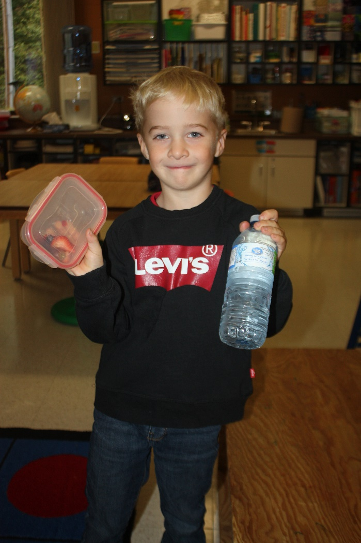
Nutritious Snacks & Water Bottles Names on containers if possible ☺

Slide 10
Please familiarize yourself with our school website and look at my teacher page: je.nbed.nb.ca

Slide 11
Follow along on our learning journey on Instagram: @janevilleprimary
School Website: je.nbed.nb.ca
School Twitter: @janevilleschool

