Slide 1
Grade 4 & 5 2021
Janeville Elementary School

Slide 2
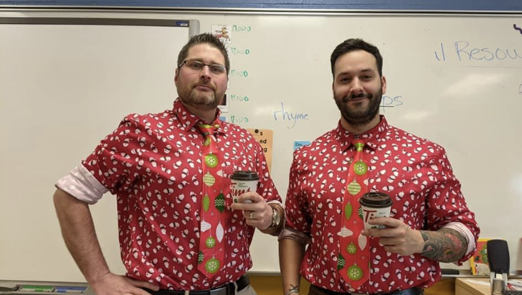
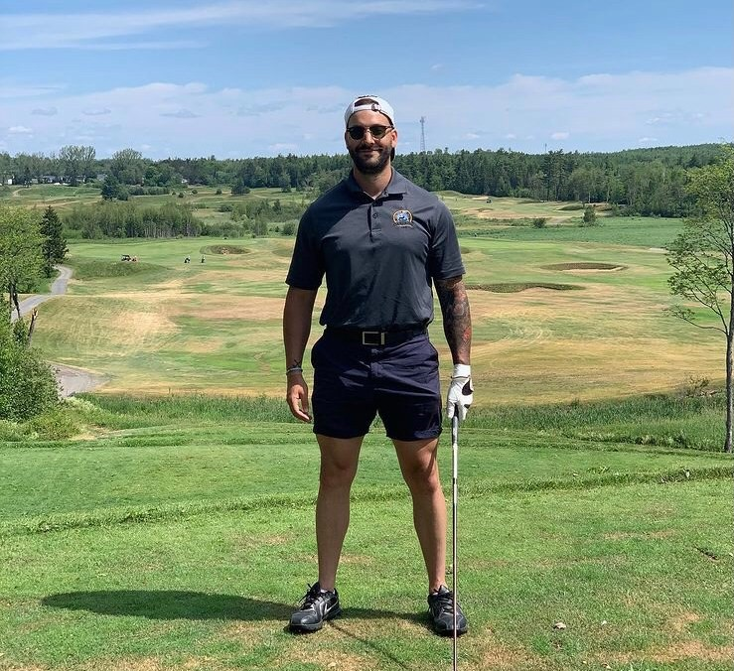
About Me!
My name is Tyler Lavigne and I will be the grade 4/5 teacher until at least January. I am originally from Bathurst and have spent most of my life in the community.
This is my first year teaching so this is a very special year for me and I am looking forward to learning with your children throughout the year. I completed my undergrad at St. Thomas University in 2014 and returned to school in 2020 to complete by B. Ed. At UNB.
During the 6 year gap, I was in Calgary, AB working as a personal trainer. This is where I found my passion for working with people however, I wanted a bit of a change and an opportunity to return home. Growing up with a teacher for a mother, it seemed like an obvious choice.
In my spare time, I enjoy golfing in the summers and playing hockey in the winters. Being active and moving has always been my comfort zone and I hope to instill this value in your children by getting them outside and moving throughout the year.

Slide 3
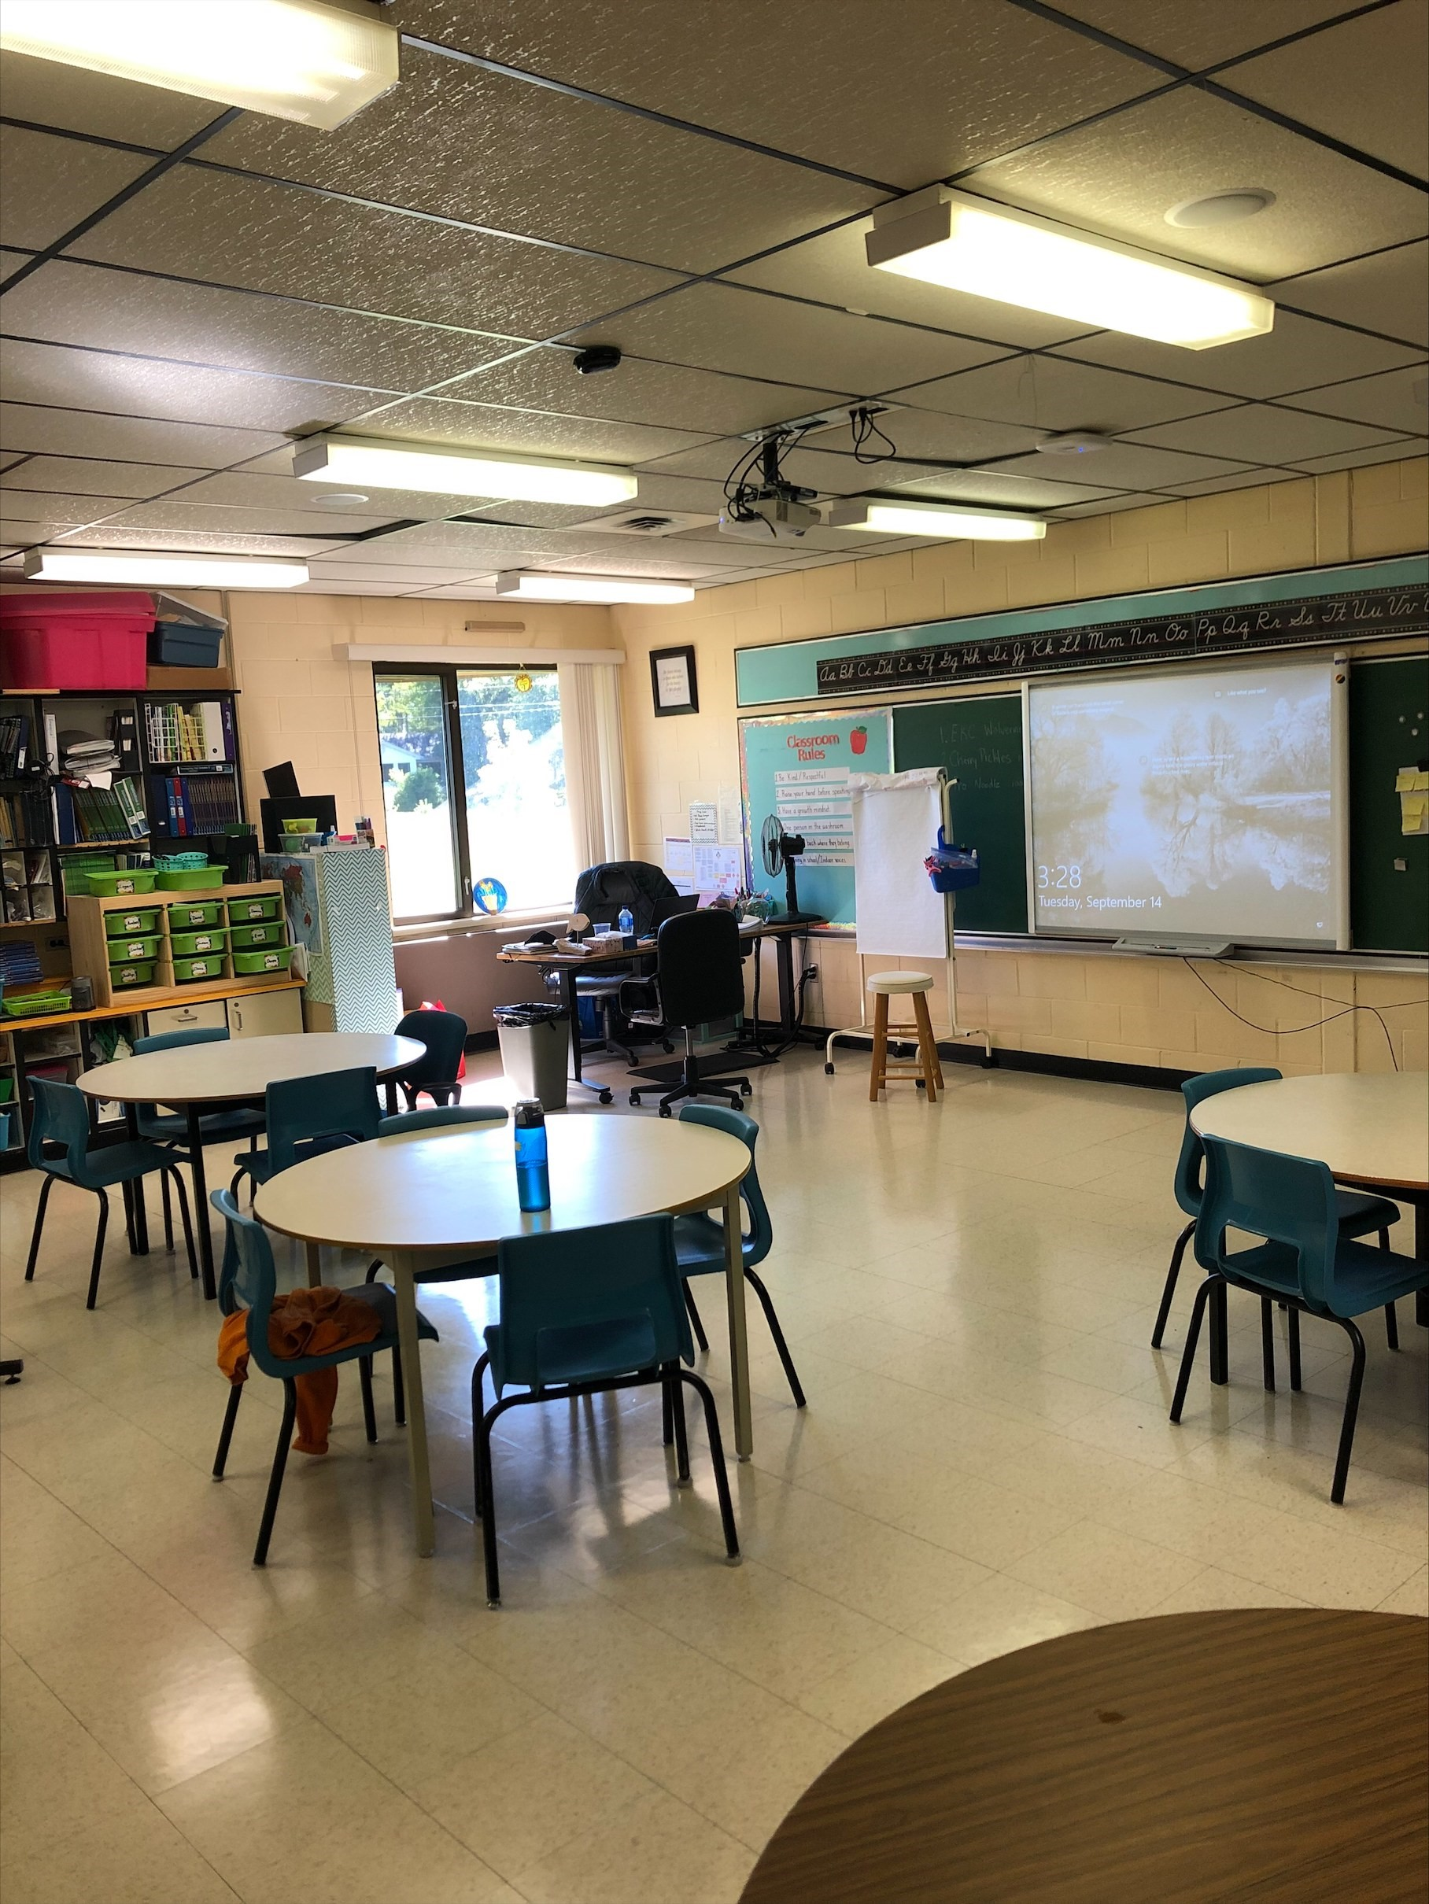
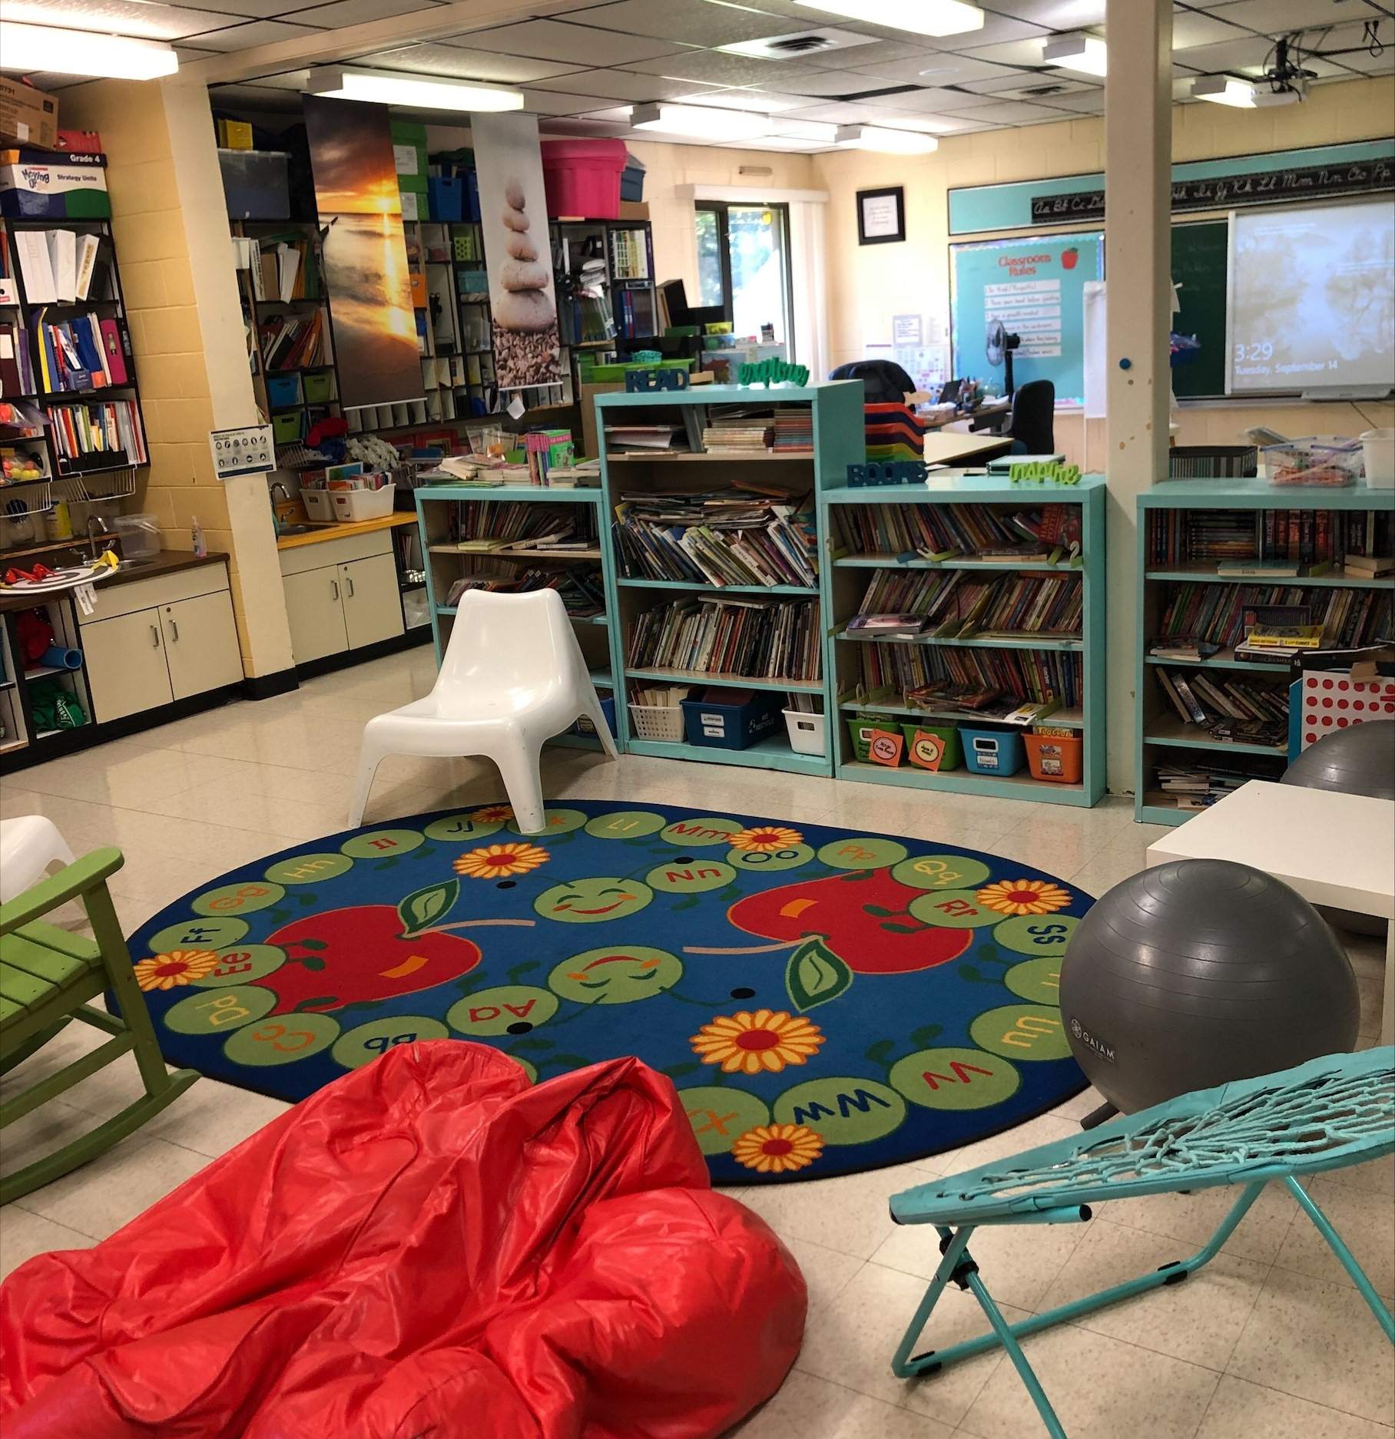
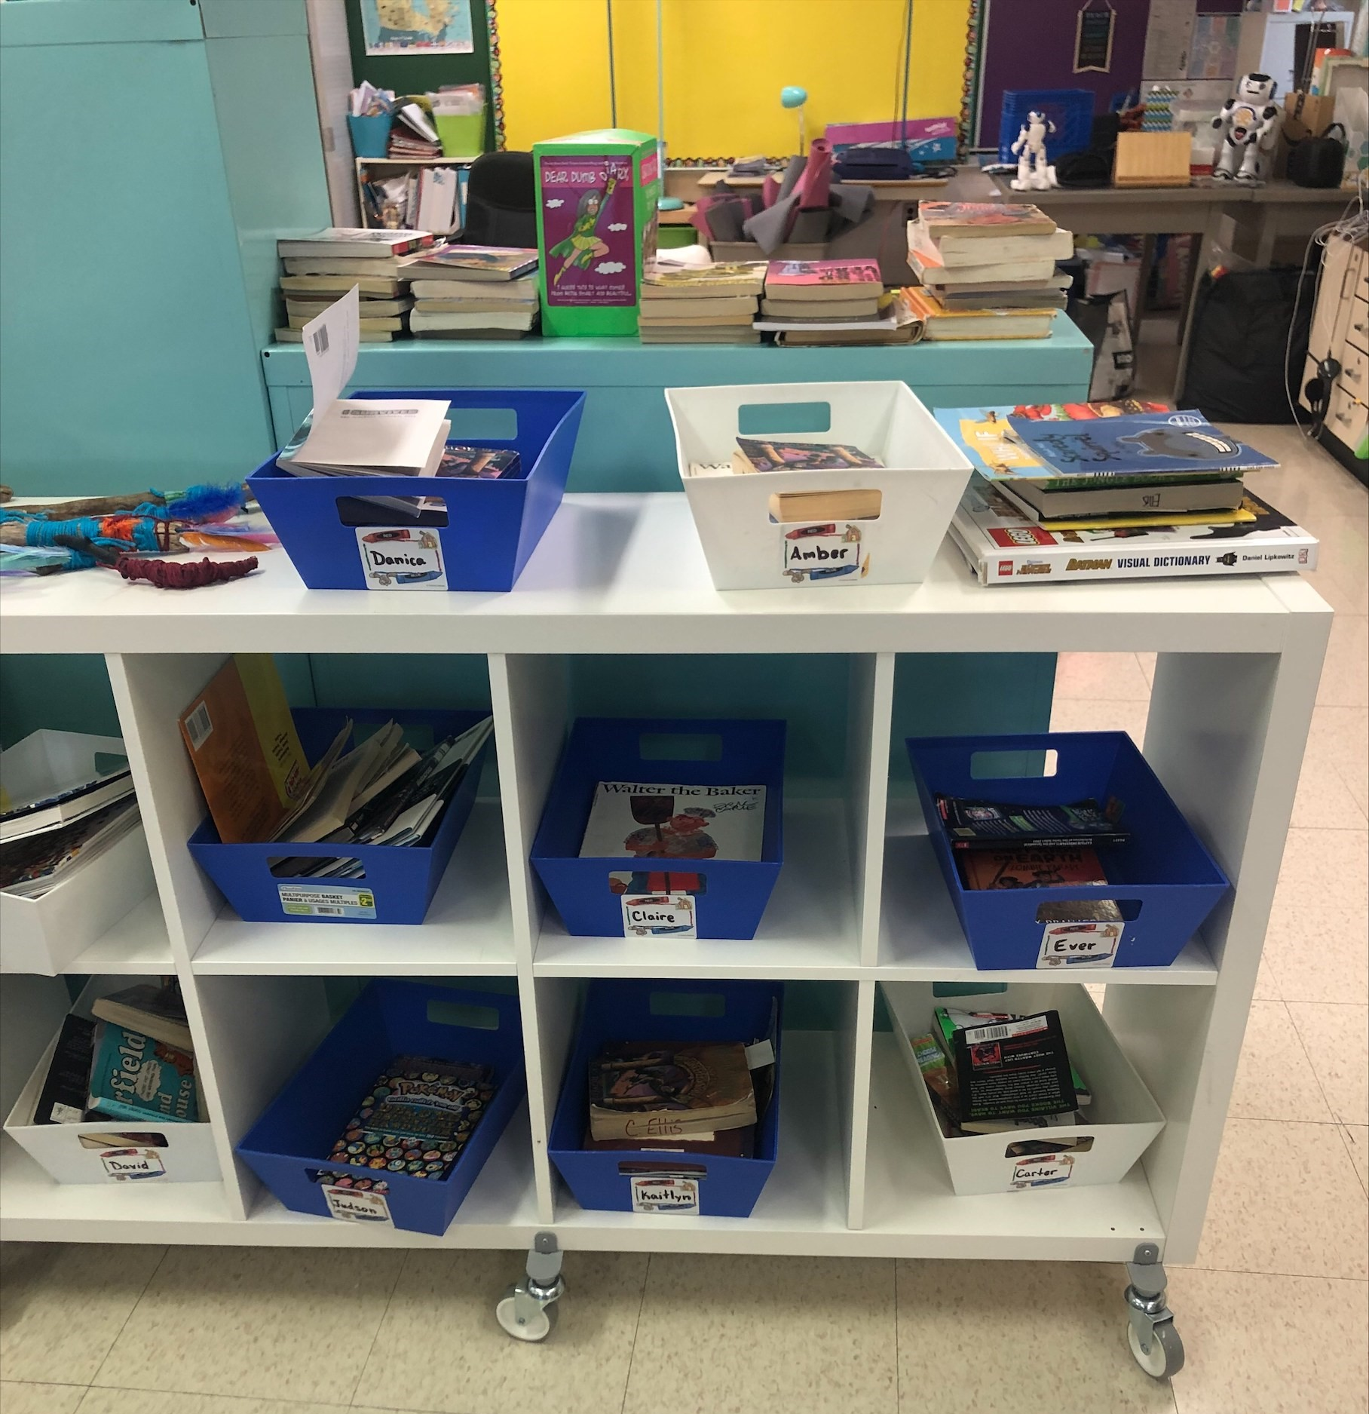
Our Classroom
Sitting area
Reading area
I believe students work best through collaboration and it is important for them to work together on projects. They will all sit with each other throughout the year and learn to work with a wide variety of different people.
I also want students to become engaged readers and are given the choice of what the read during reading blocks and have the choice of a wide variety of books. I will encourage students to read what they are interested in and to share with the class what they are reading about.
Book Boxes

Slide 4
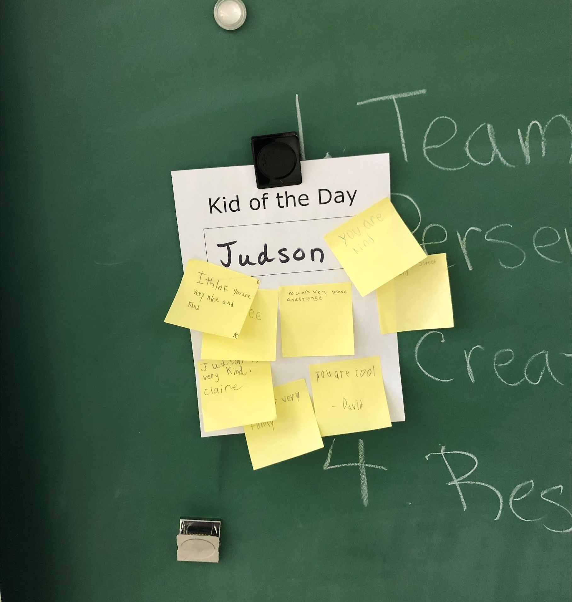
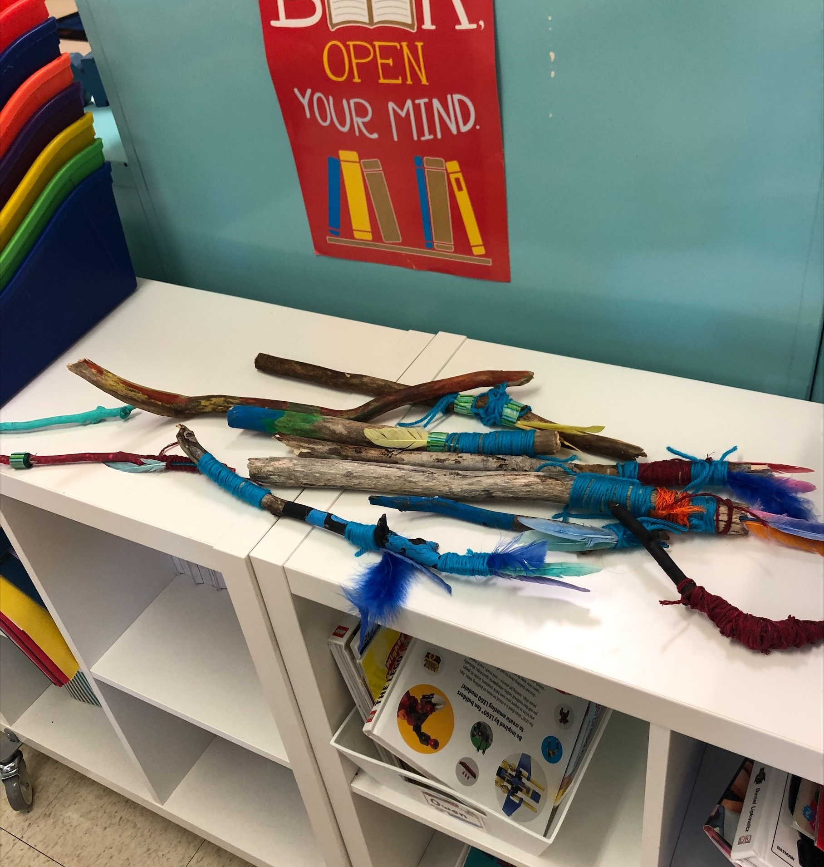
Everyday we have a kid of the day and everyone writes a quick note about something they like about the KOTD, a positive message, or a compliment!
The kids also made talking sticks that will be used throughout the year to help with listening skills and being respectful!

Slide 5
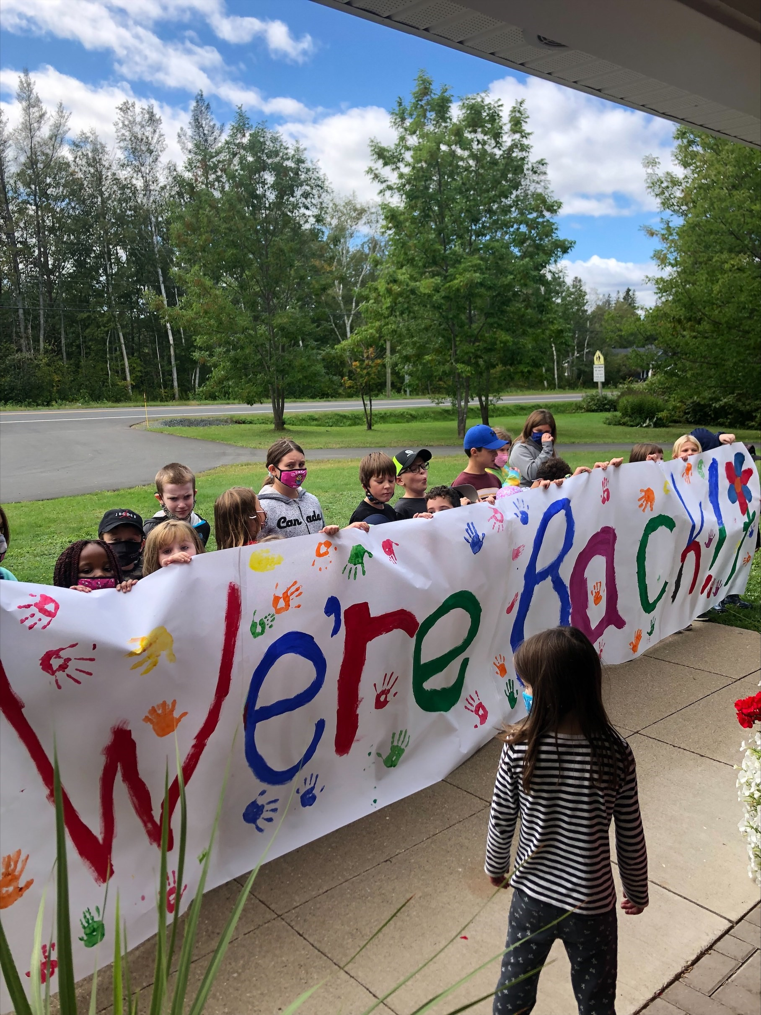
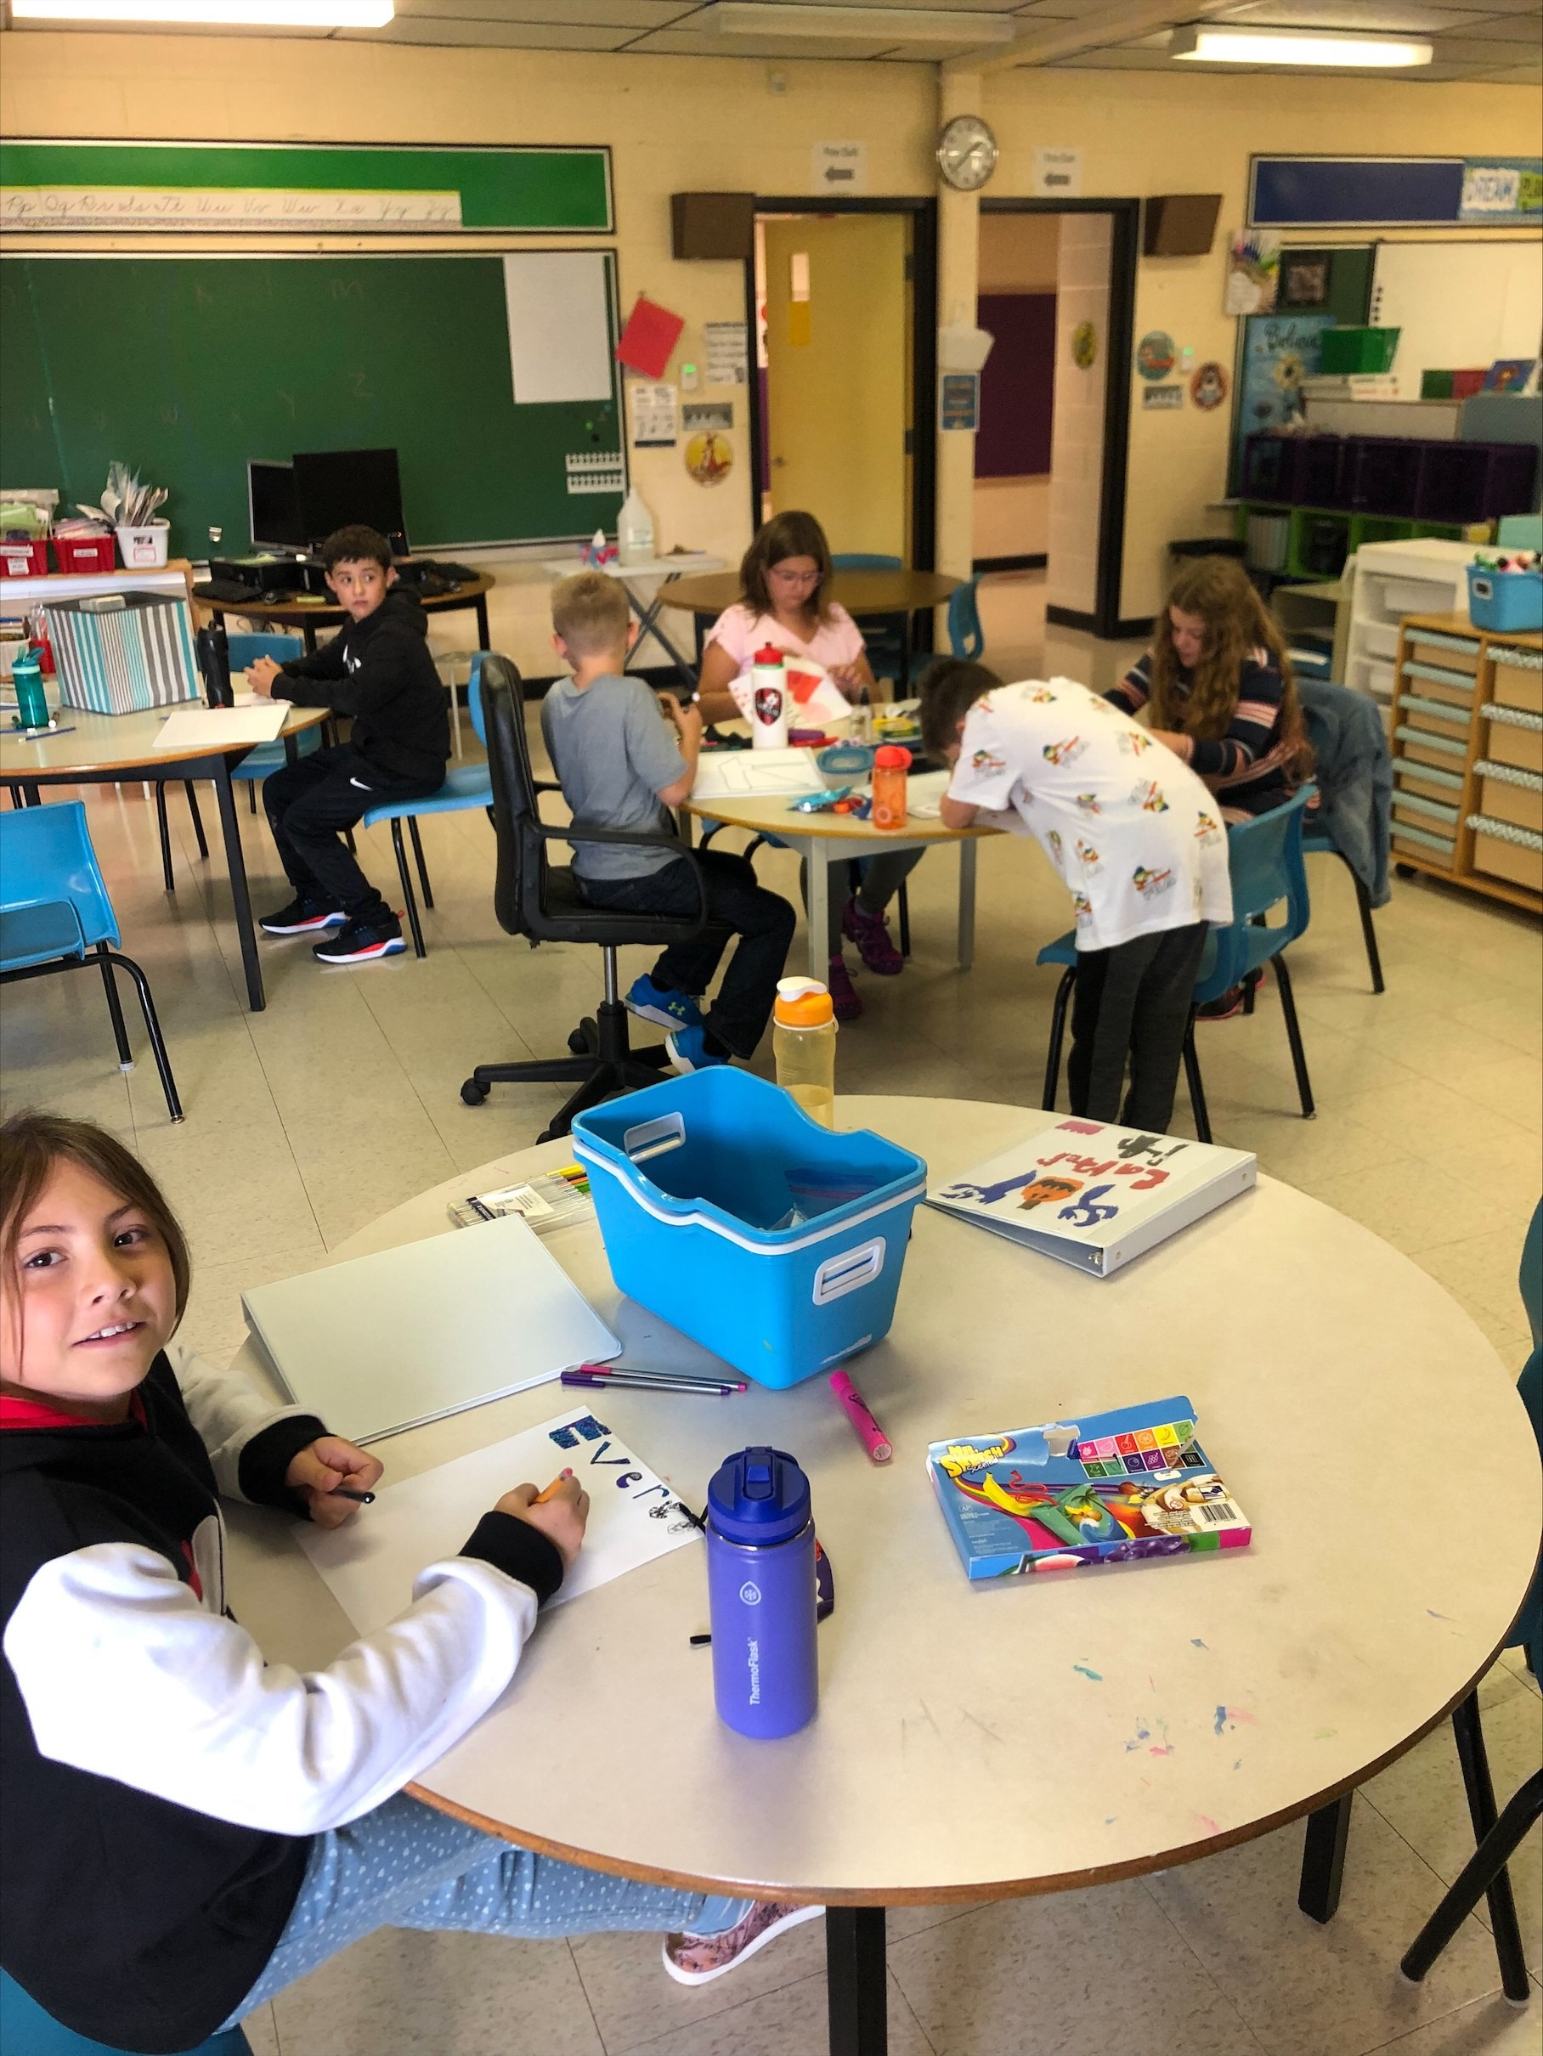
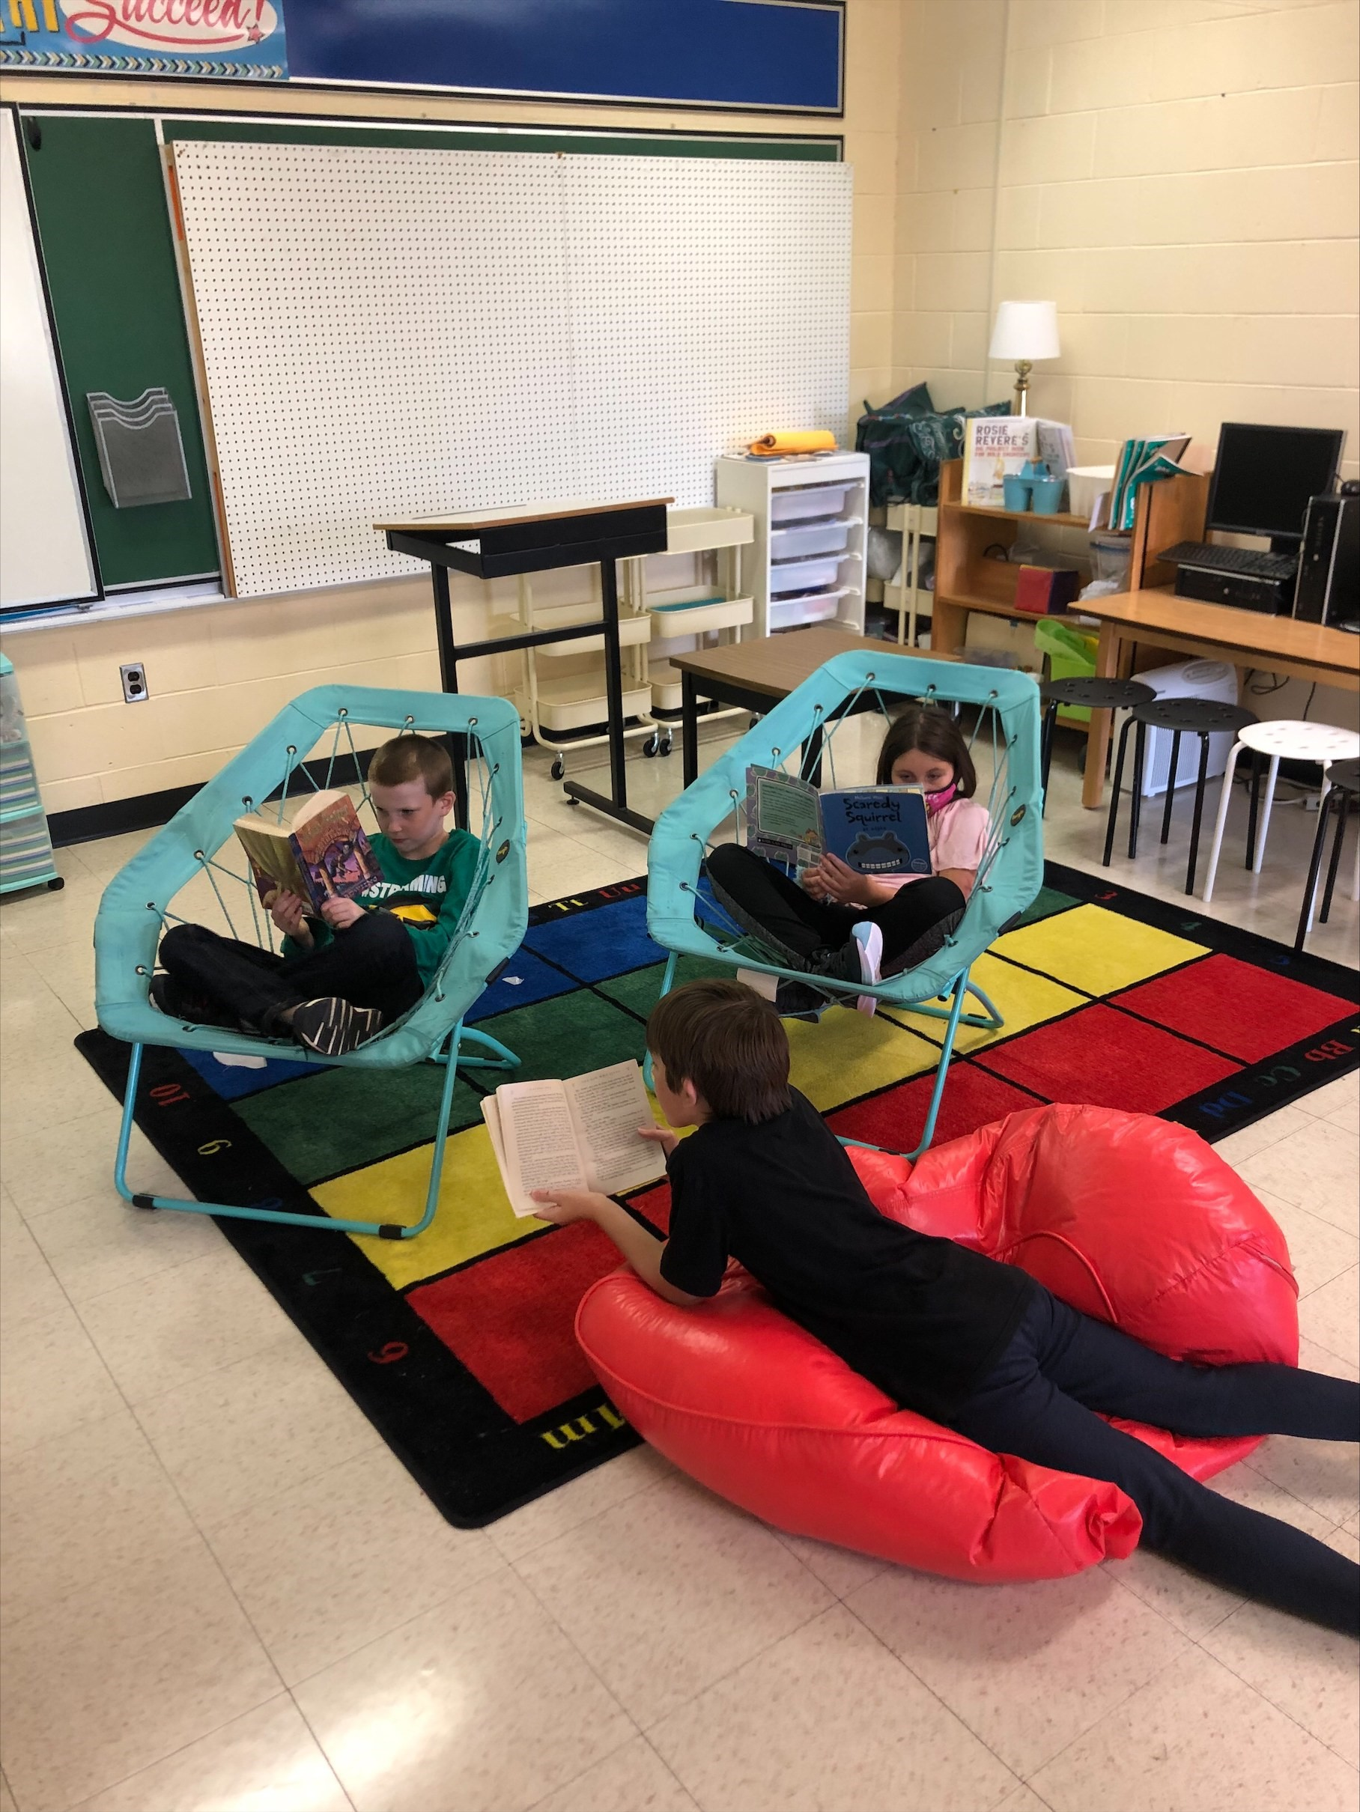
What we’ve been up to…
We’re back!
First day activities!
Getting lost in a book.

Slide 6
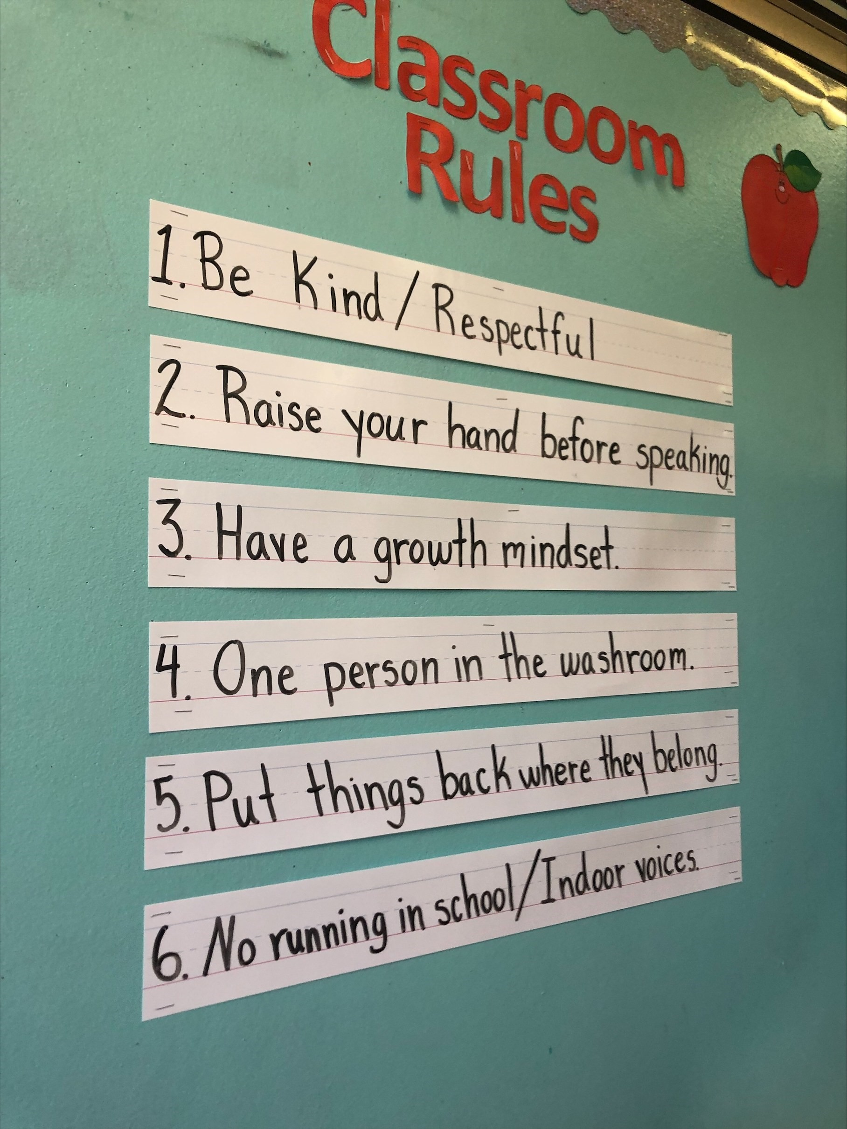
Our Class Rules and Expectation
Our classroom rules were created by your children, and they agree being kind and respectful are the most important rules to follow.

Slide 7
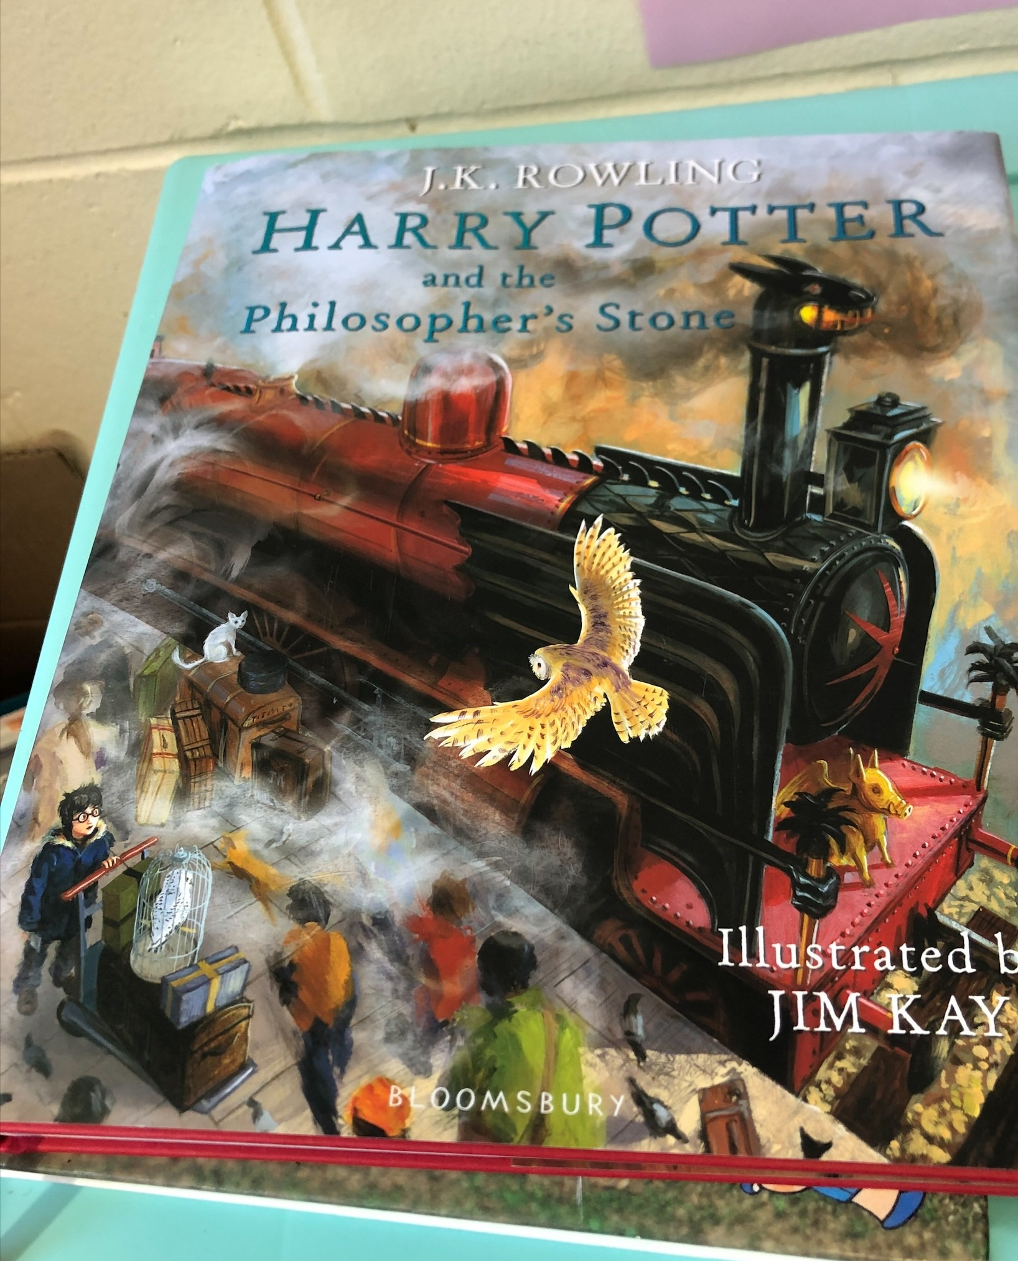
We are currently reading:
The kids voted on a few books and decided they wanted to read Harry Potter. This is exciting for me as it is a favorite of mine as well. Read aloud will be a part of our classroom routine throughout the year and it is a time for students to relax and have snack. It is also a great opportunity to have open discussions about what they notice about the writer’s strategies and what makes a good story. The more they read the better their own stories will be.

Slide 8
My Educational Beliefs
It is my belief that my job as an educator is to help students find and pursue their interests. They should read and write about what they are interested in and learn about topics that they want to learn about. That is why I try to let students guide our learning and listen to their interests so I can find resources they will enjoy.
I also want all my students to develop a growth mindset and I have already spoken to them about this. I want them to see education as getting a little bit better every day and to focus on the process of learning rather than the result. I want them to be comfortable with failing and to realize that is a part of the learning process. These are conversations I will have with them throughout the year, and they will never be punished for trying new things and stepping out of their comfort zone.
Lastly, I want students to want to come to school everyday and I know that they are not meant to sit in a desk all day. I will involve a lot of play and activities that require them to be active and move around. At the end of the day kids need to be kids.

Slide 9
Contact Info
- Email: tyler.lavigne@nbed.nb.ca
- School phone number: 506-547-2794
- Facebook messenger/Classroom Facebook page
Follow us at:
School website: je.nbed.nb.ca
Twitter: @janevilleschool
Facebook page: Janeville Elementary School
Parents/guardians of grade 4 and 5 are welcome to join my private page on Facebook. If you are not yet in the group, reach out through email and I will add you!

