Slide 1
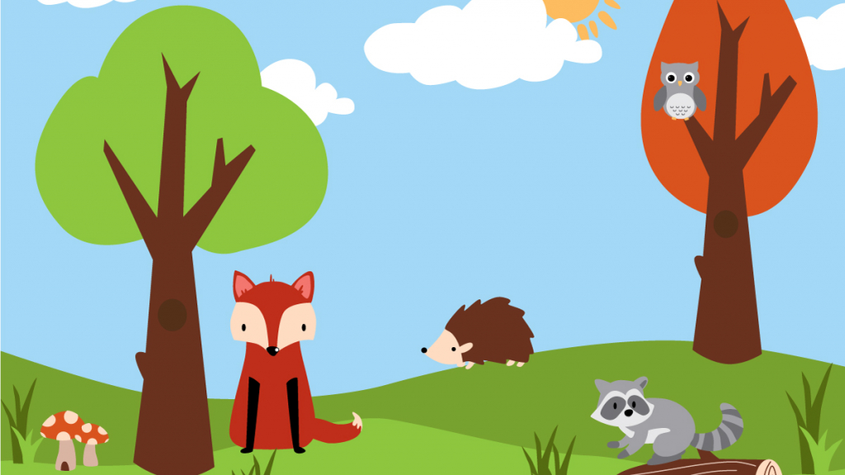
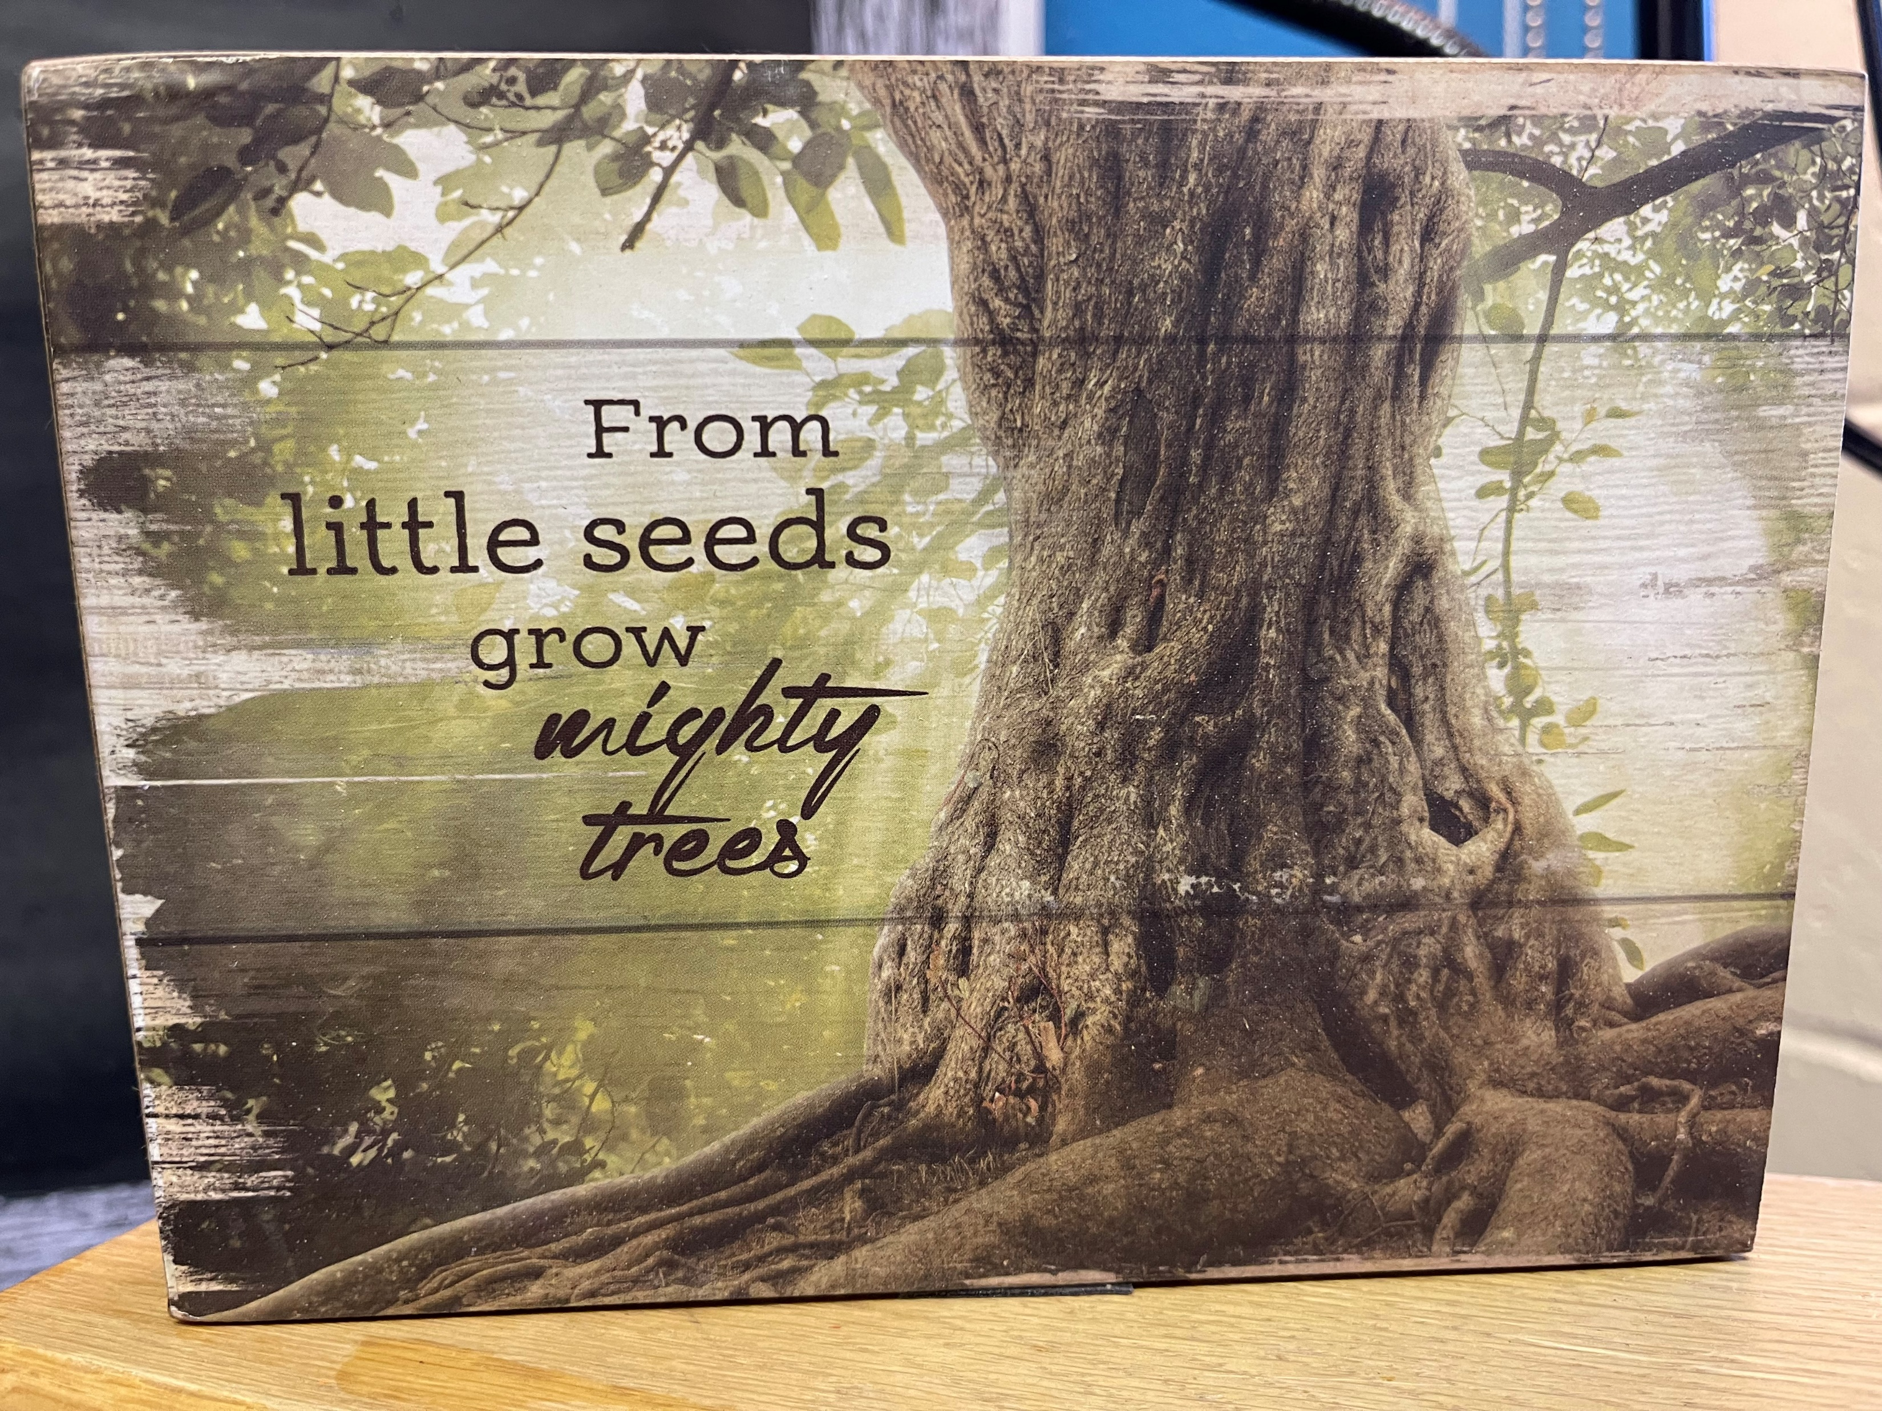
Welcome Back to School!!

Slide 2
Grade 2/3
2021-2022
Miss Jaimie Spriggs

Slide 3
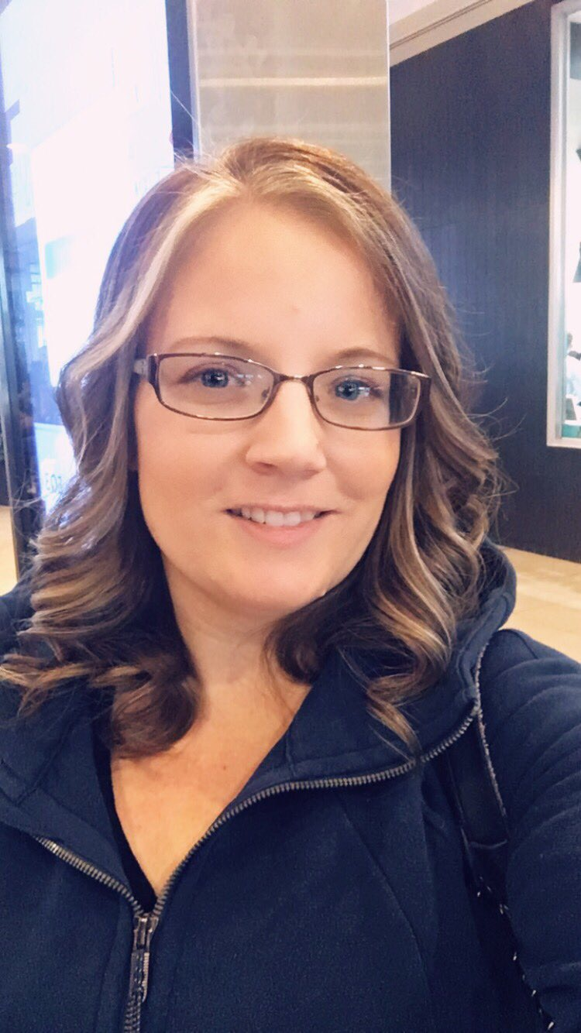
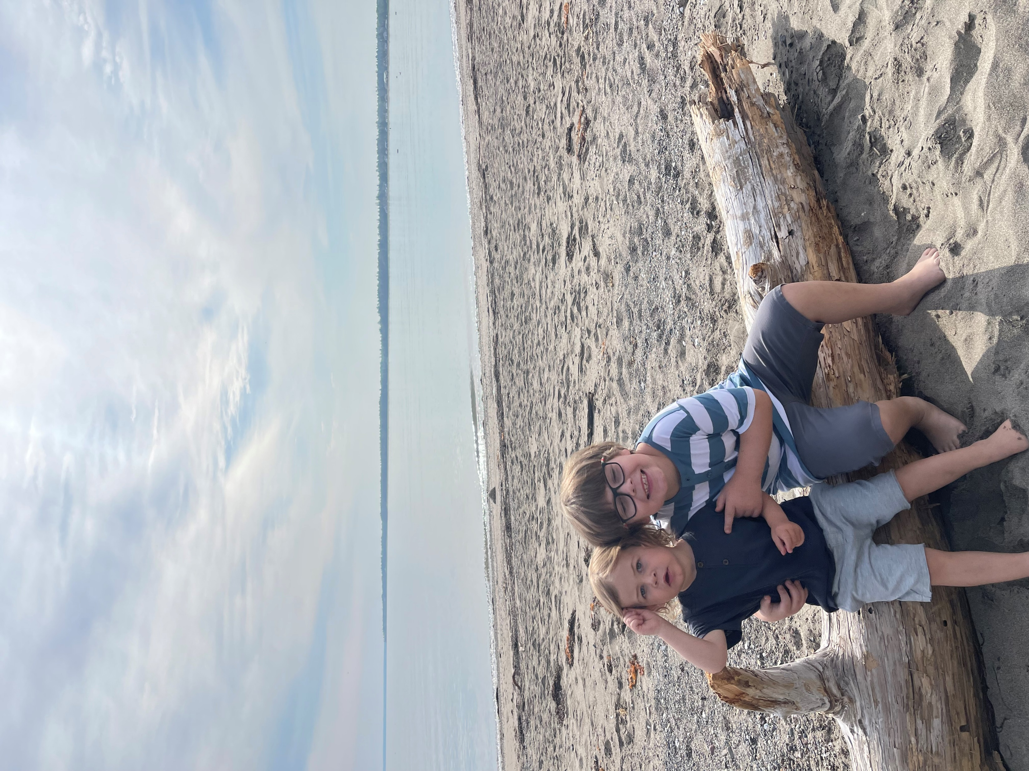
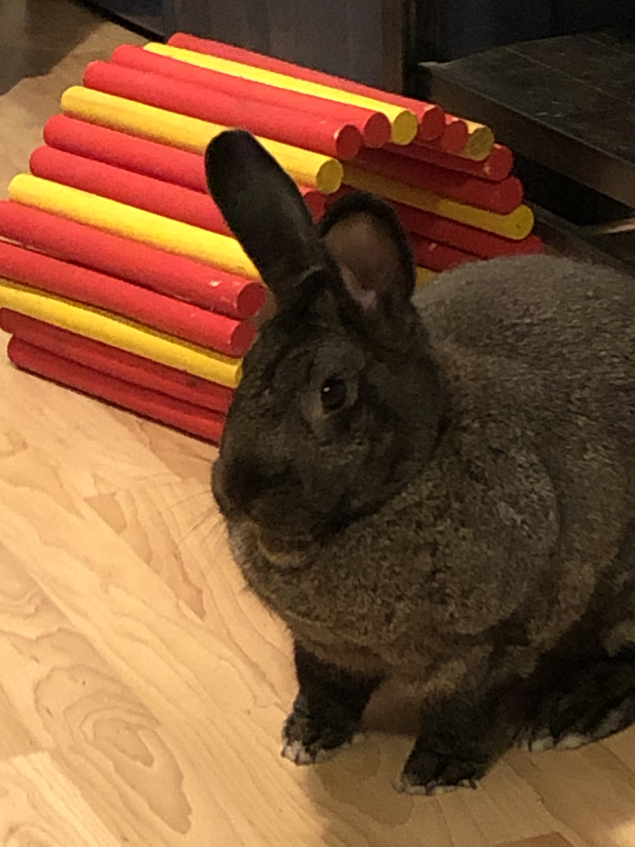
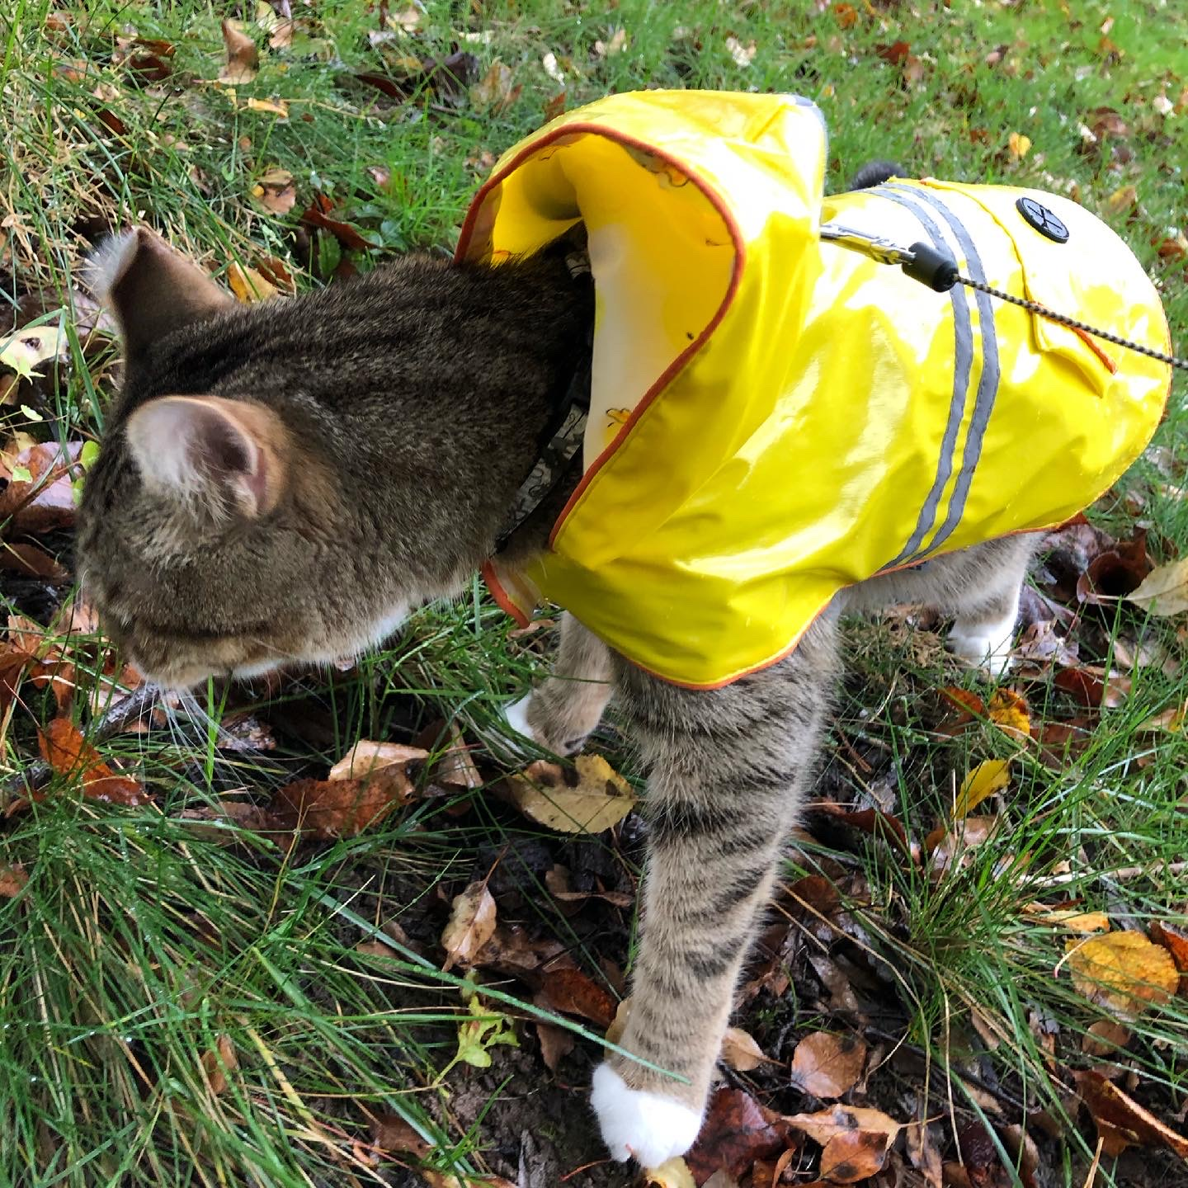
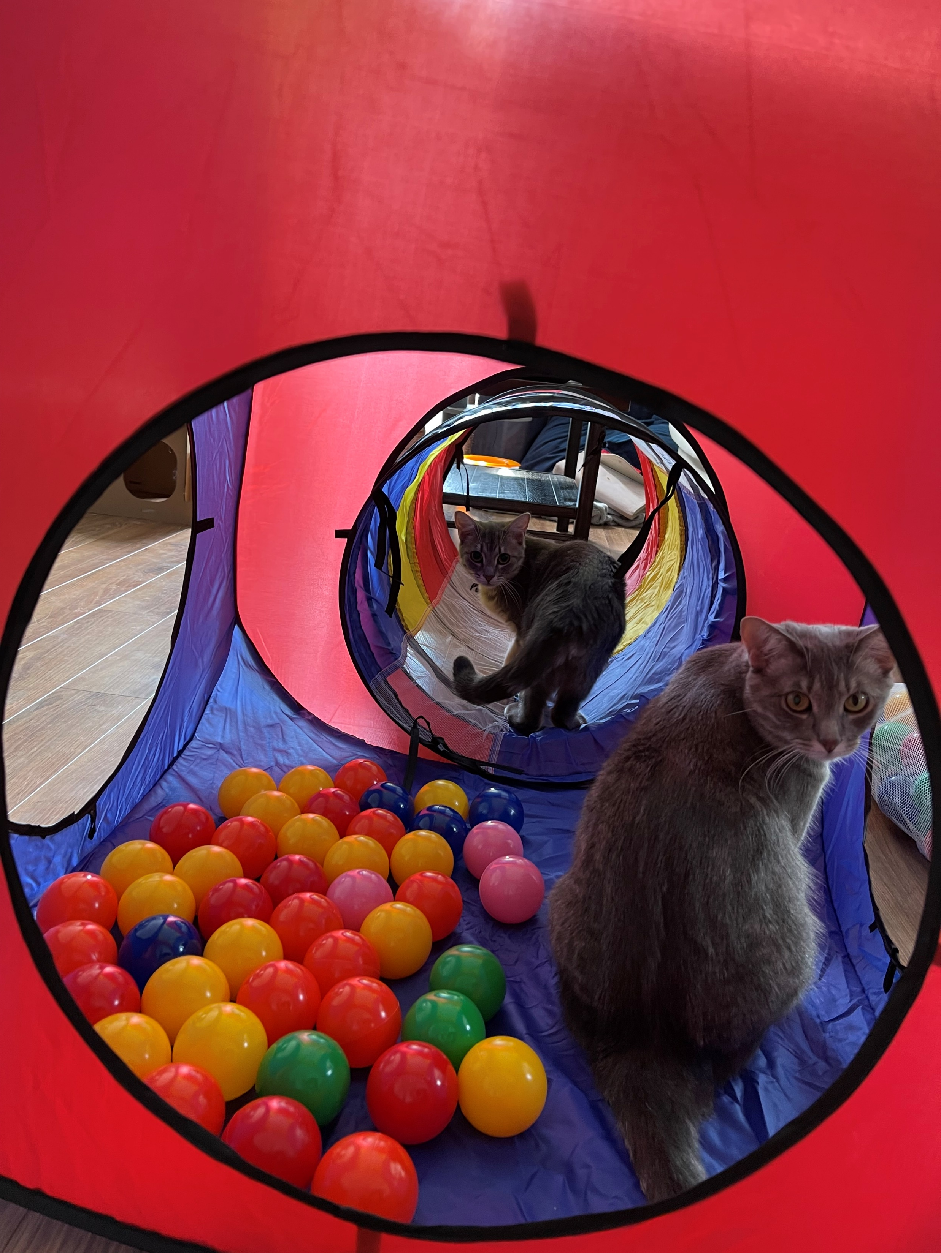
Meet the Teacher
Welcome to our virtual Open House!
My name is Jaimie Spriggs and I am the Grade 2/3 teacher this year! This is my fifth
year teaching. I am originally from Fredericton, NB and have been living in Bathurst since March 2020.
Before teaching I was an Educational Assistant. The job came available by chance and during those years I discovered my love for education and helping my students to learn. I believe that students reach their full potential with they have confidence in their abilities and are willing to “Get messy and make mistakes”!
In my time off I enjoy reading, biking, spending time with my godsons
Jackson and Riley, walking my cat Hunter (yes, walking… he demands it!)
and playing with my pet rabbit Clover (a former Grade 1 class bunny!).
I have 2 new additions to my fur family this year: Miss Juniper and Miss Piper!!
I hope we can meet in-person soon. Until then feel free to contact me
through Class Dojo, text, email, or the school number.
All are listed near the end of this slide show!
Jackson and Riley
Clover
Miss
Jaimie Spriggs
Hunter
Juniper & Piper

Slide 4
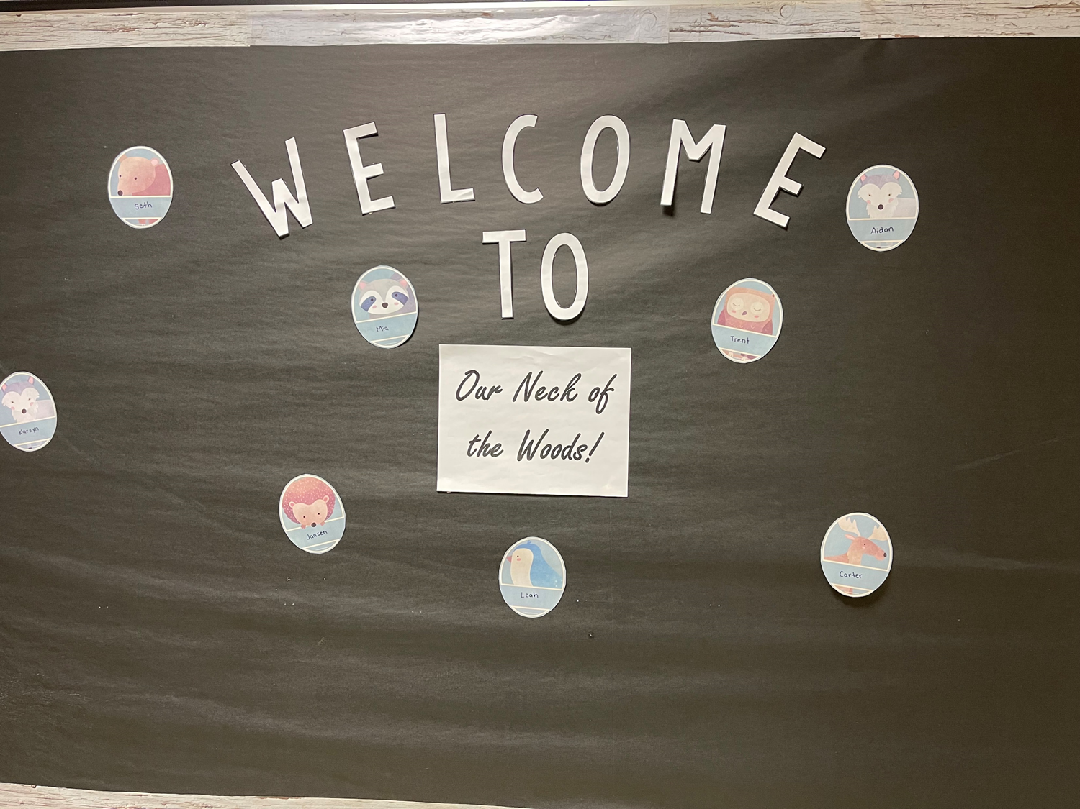

Slide 5
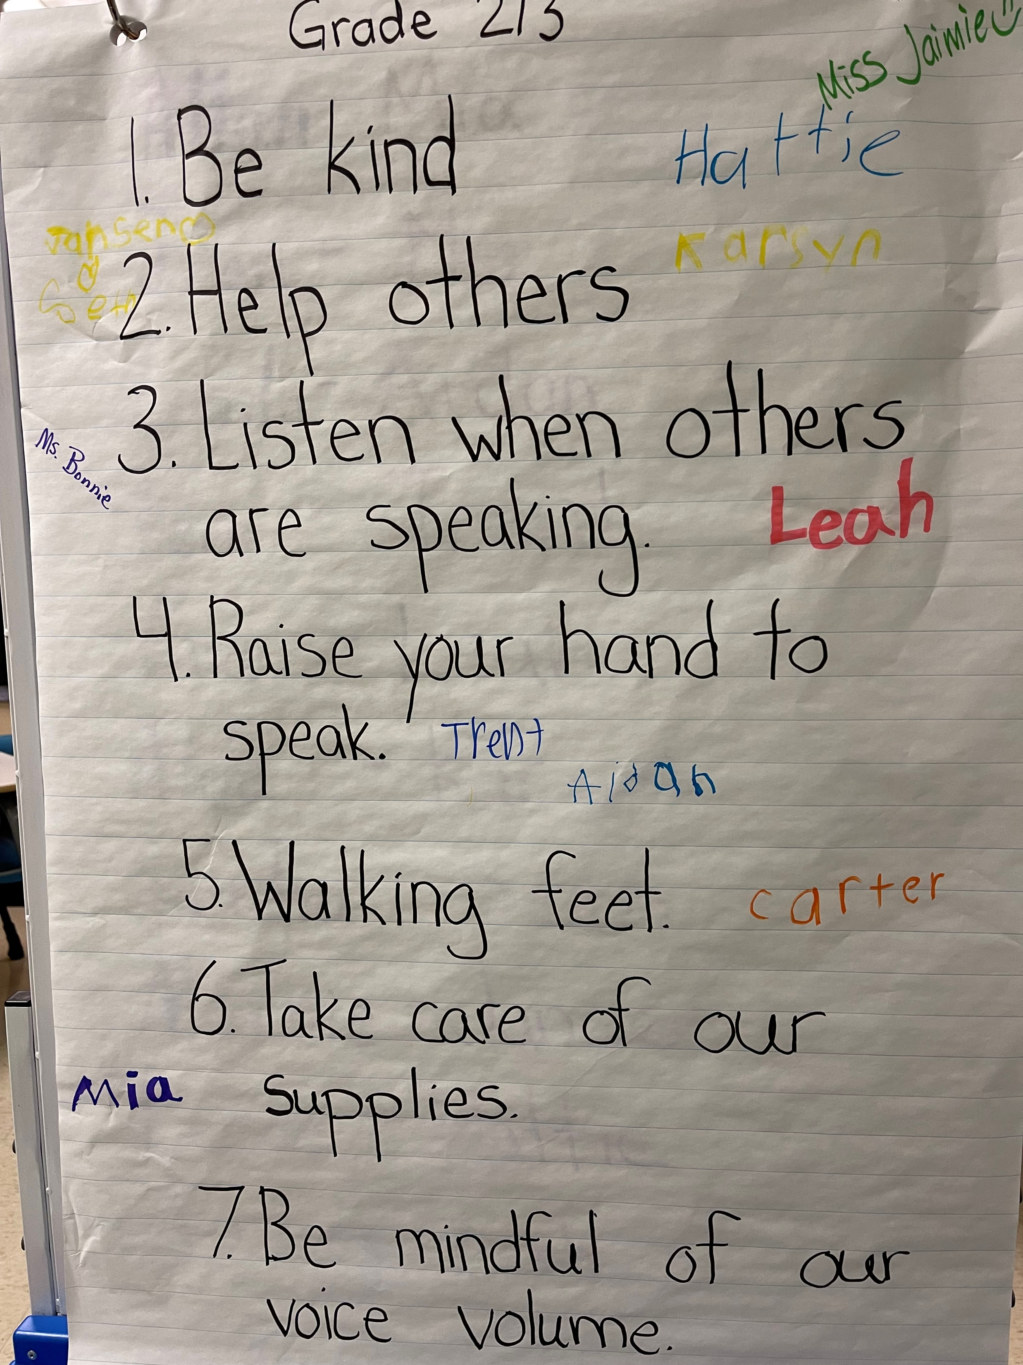
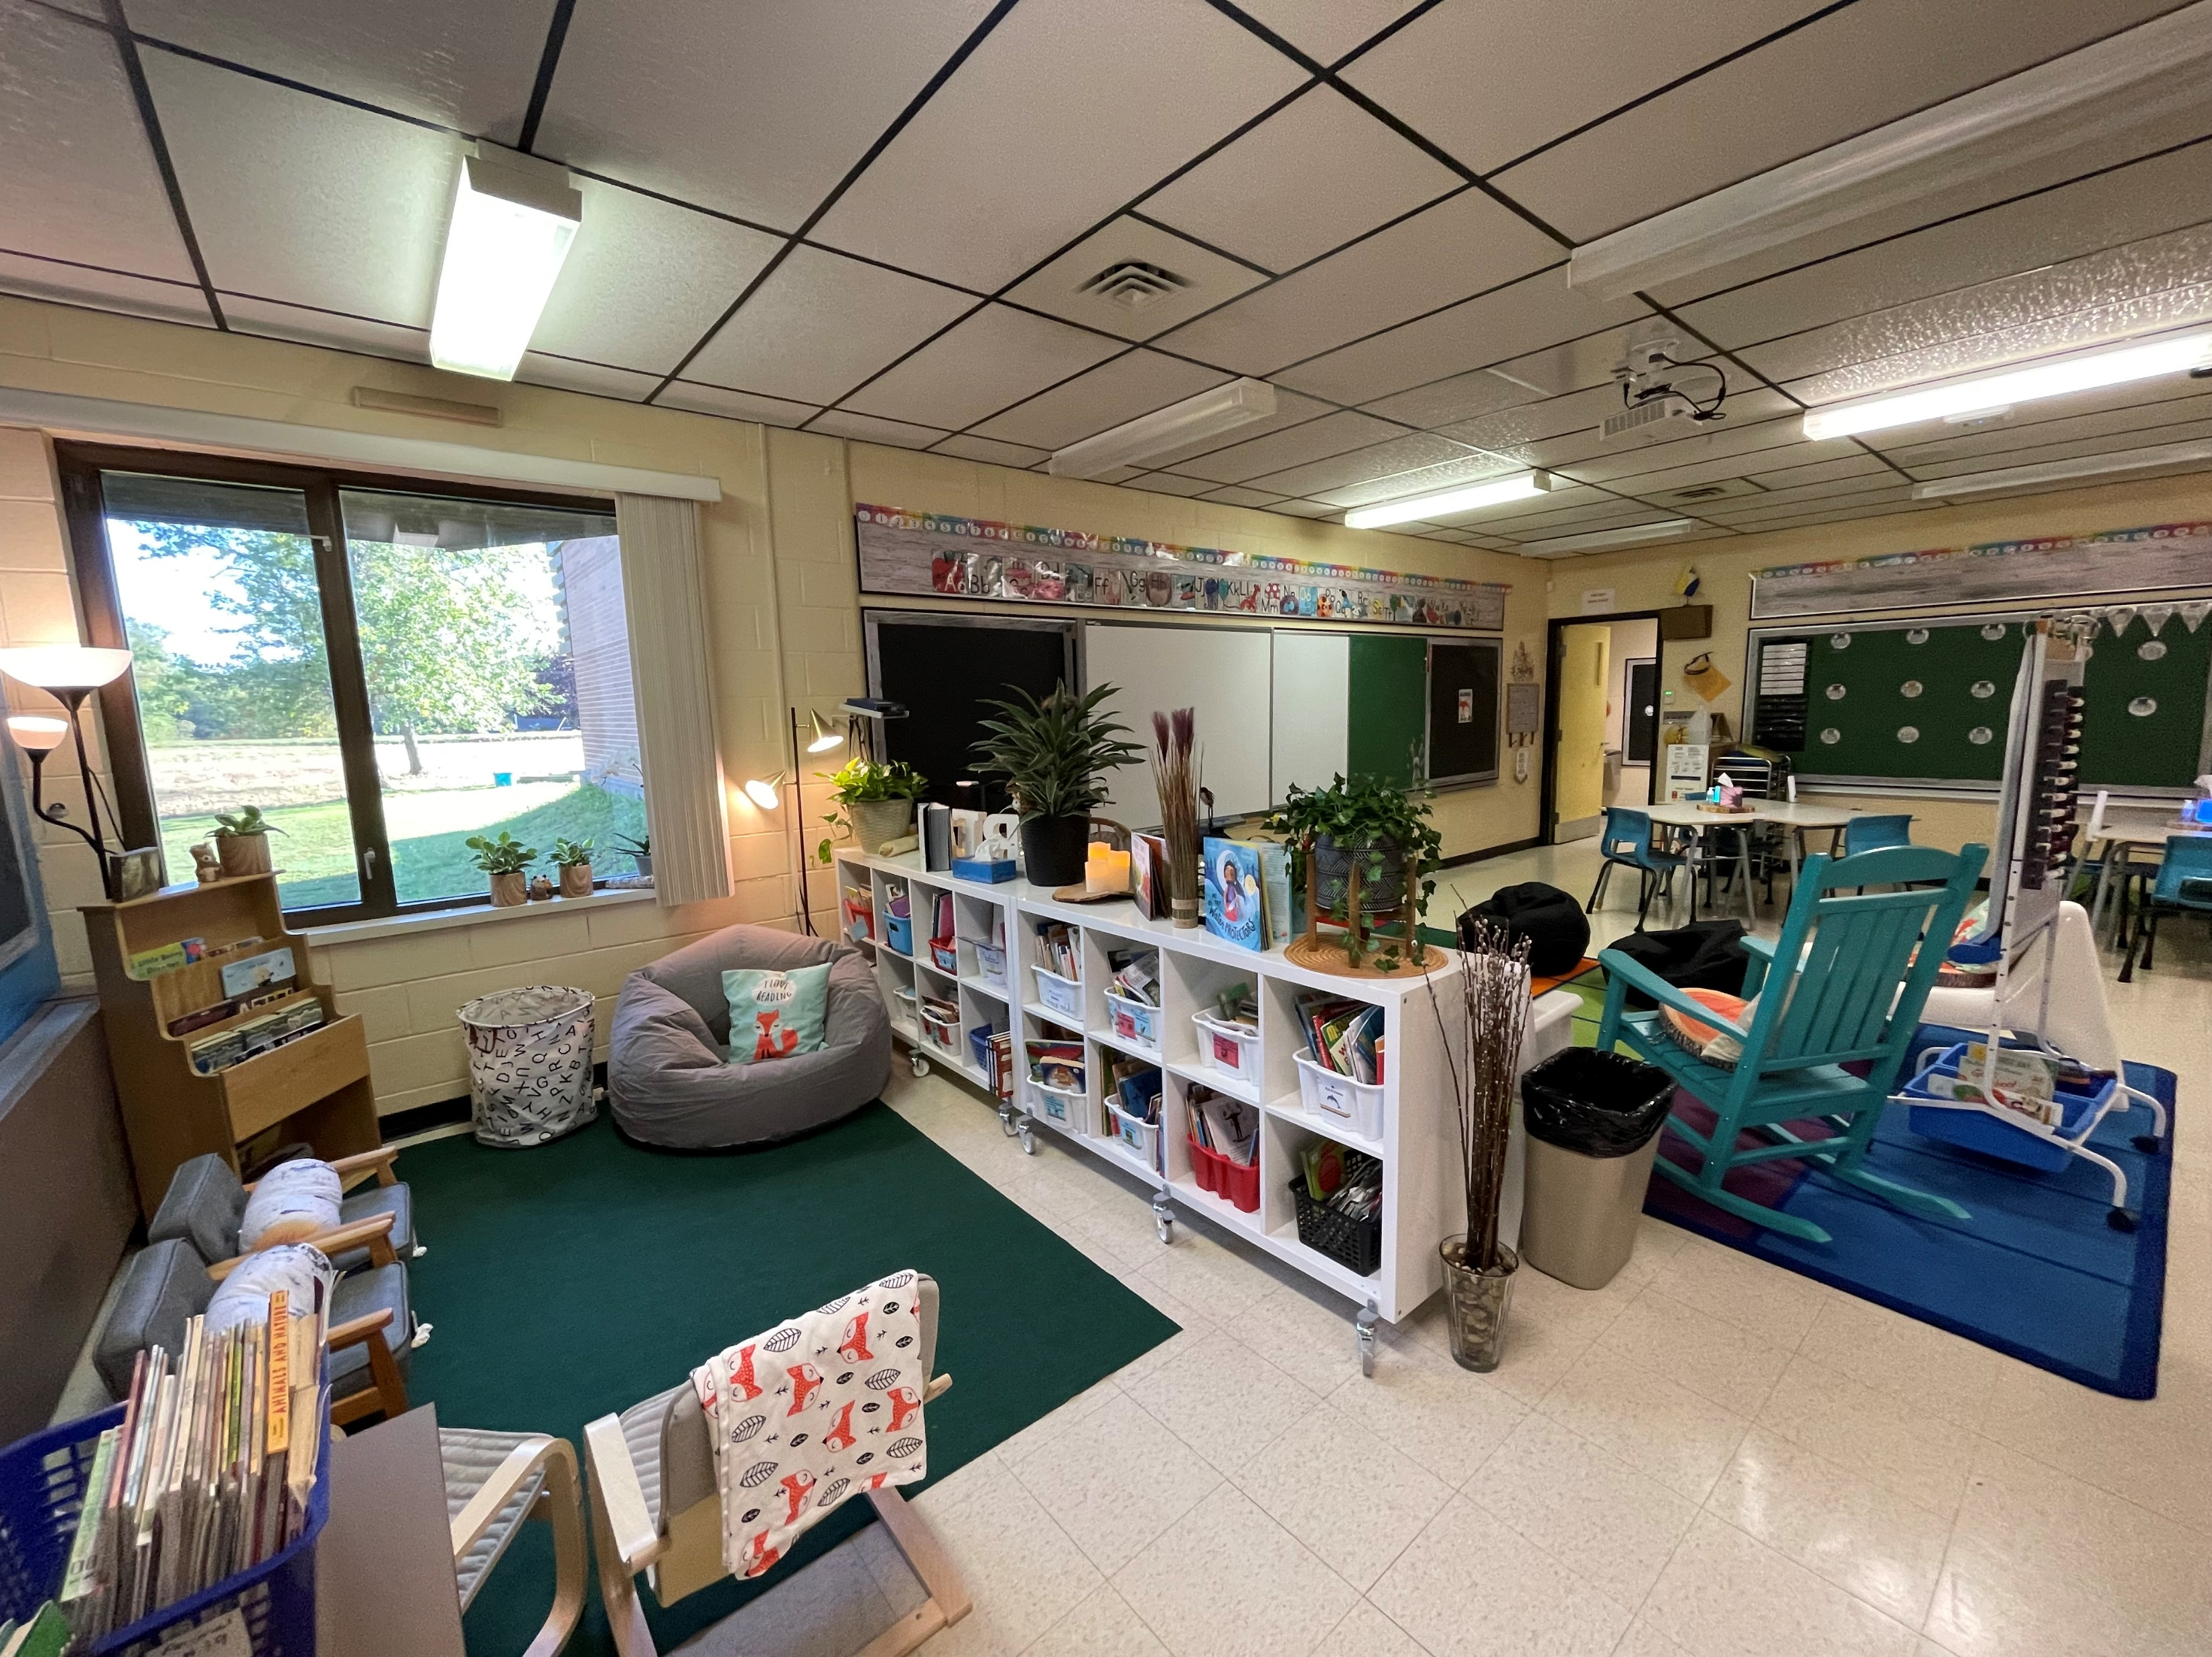
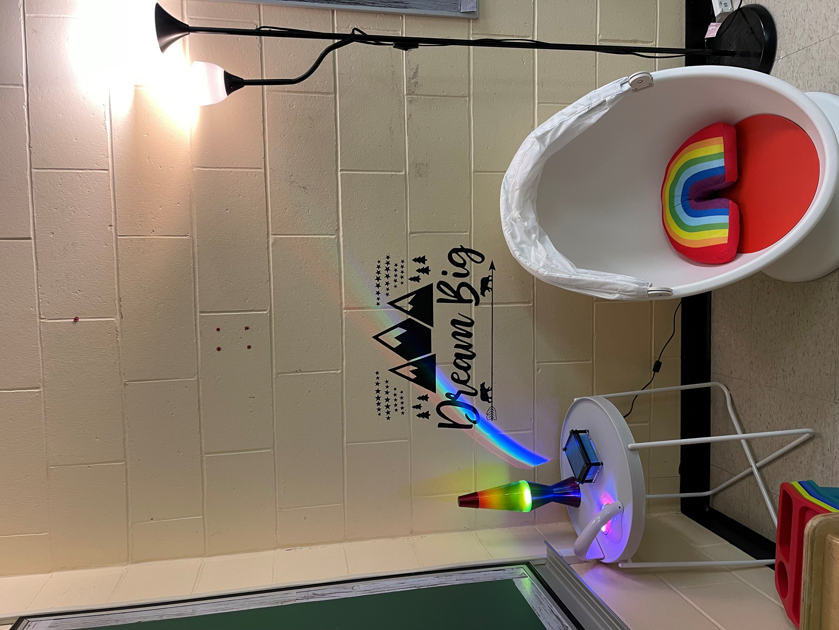
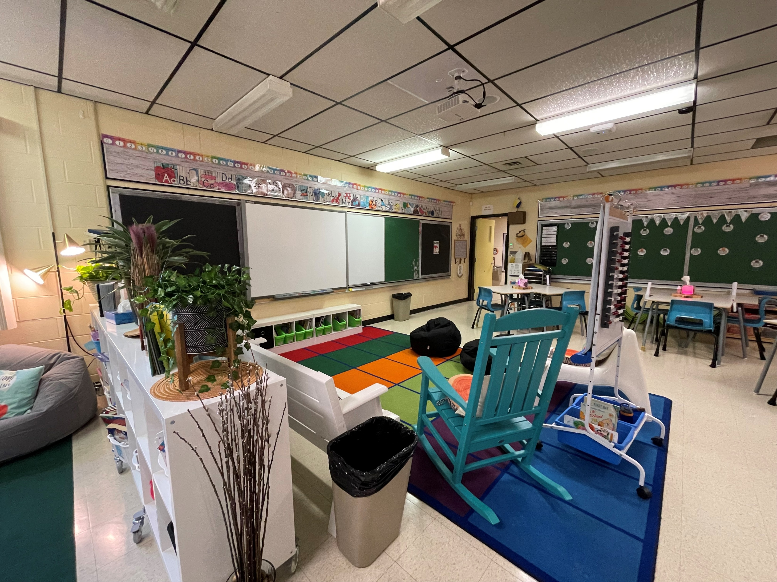
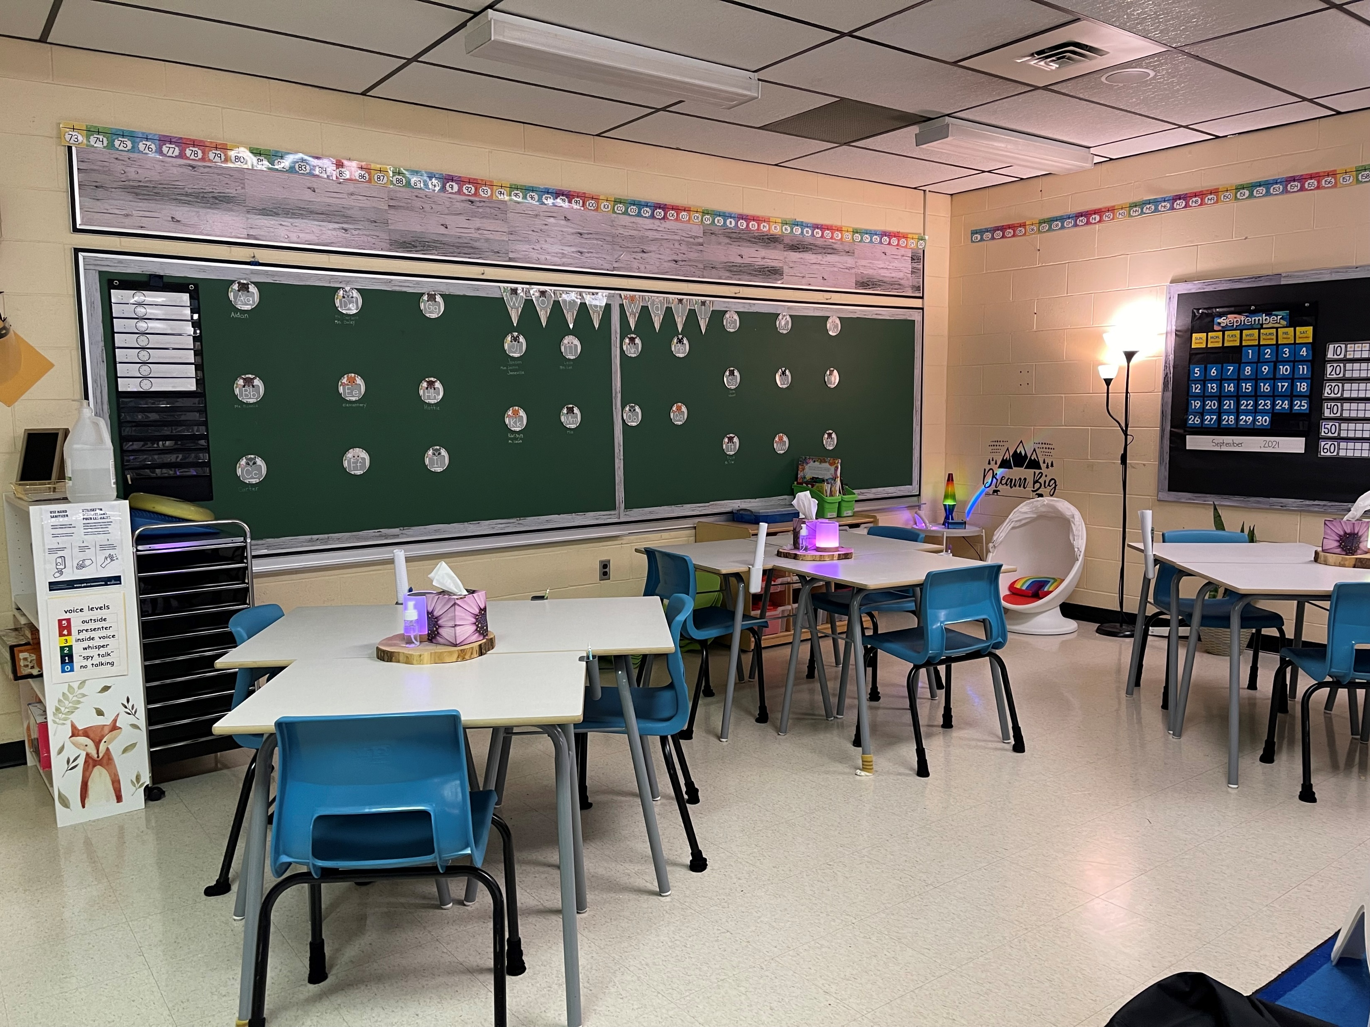
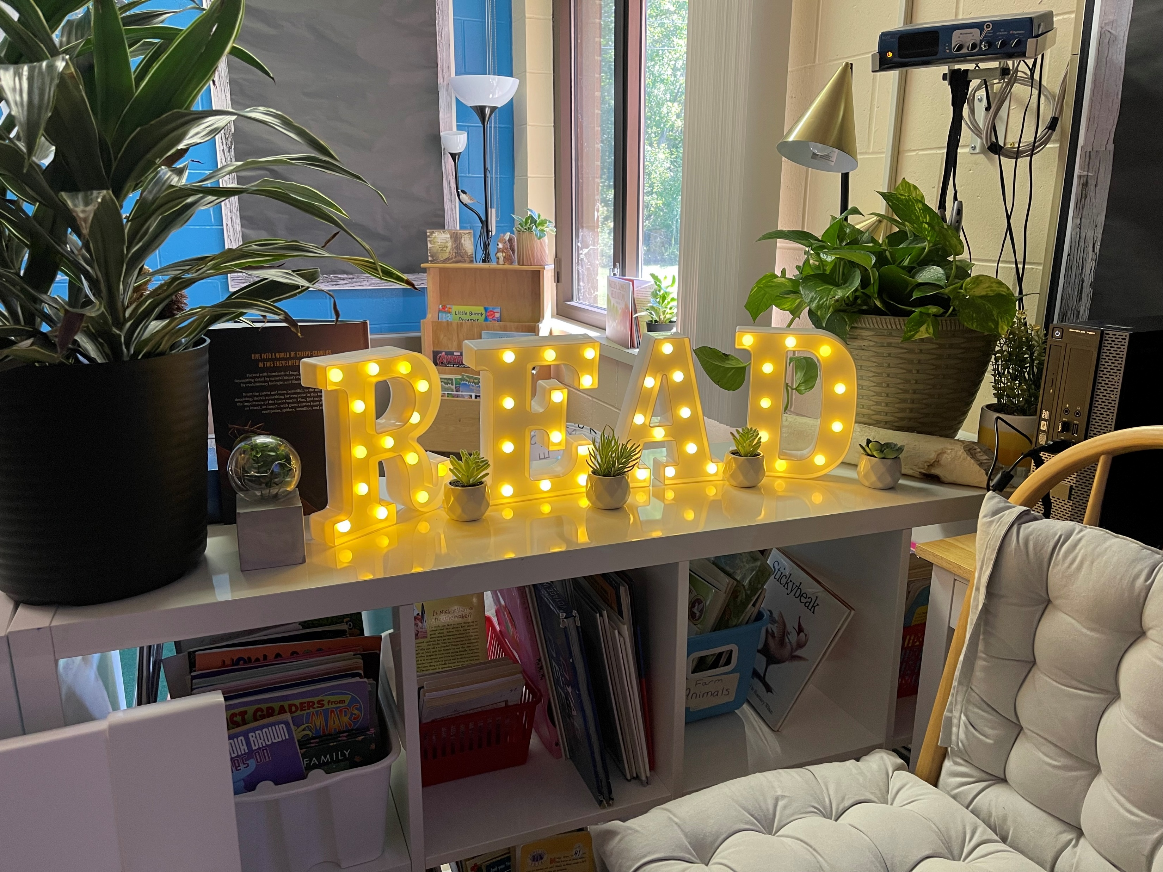
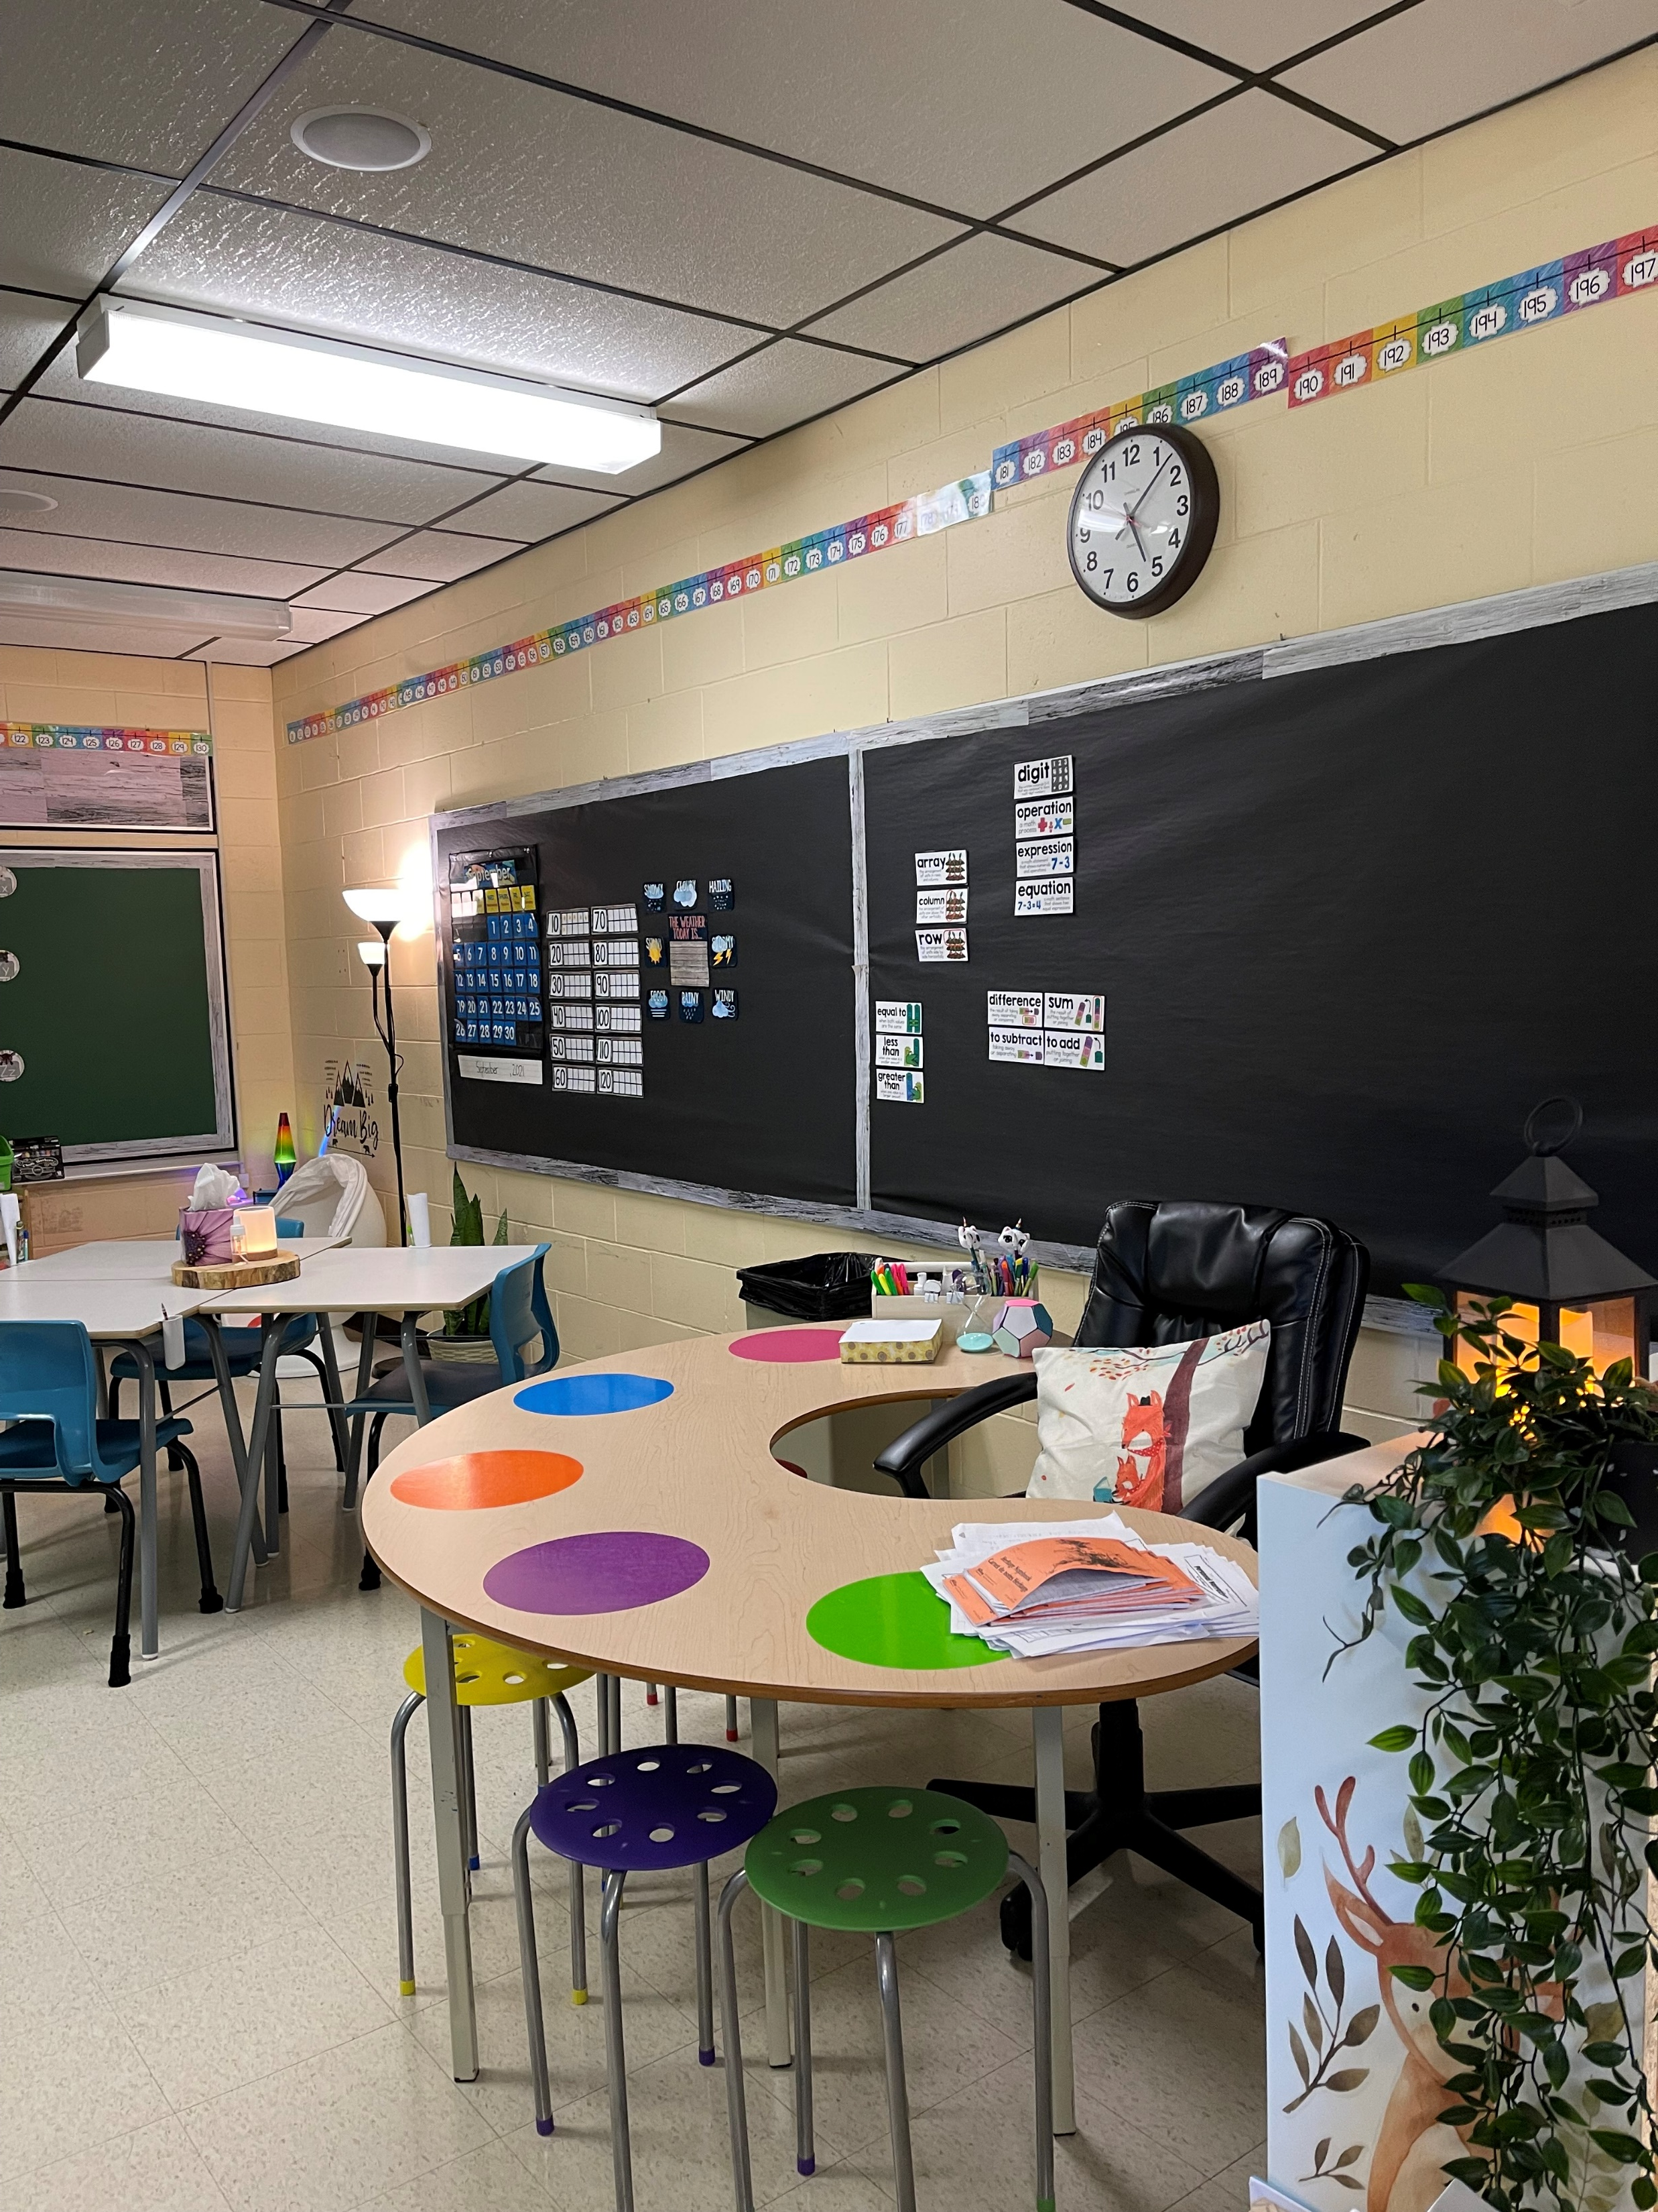
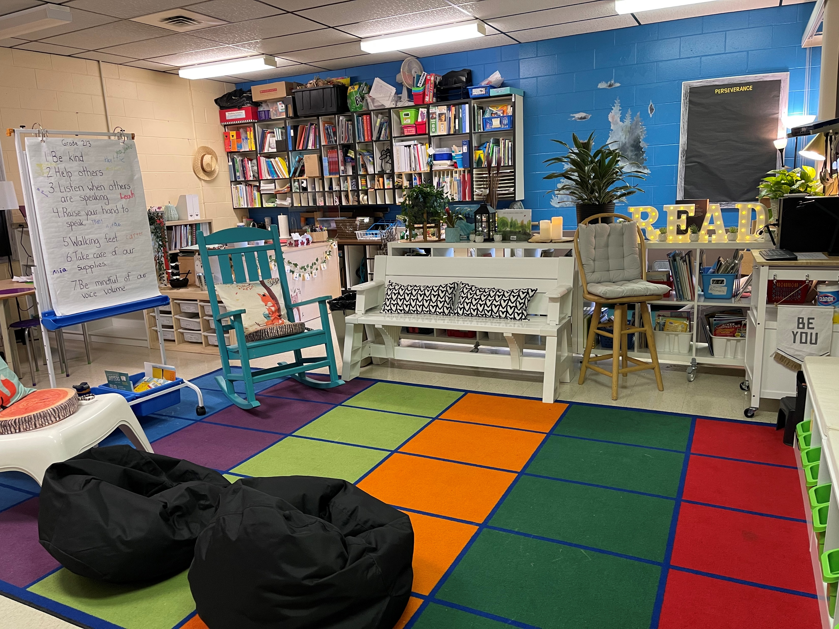
Story Corner
Break “Room”
Our
Classroom
Class Constitution

Slide 6
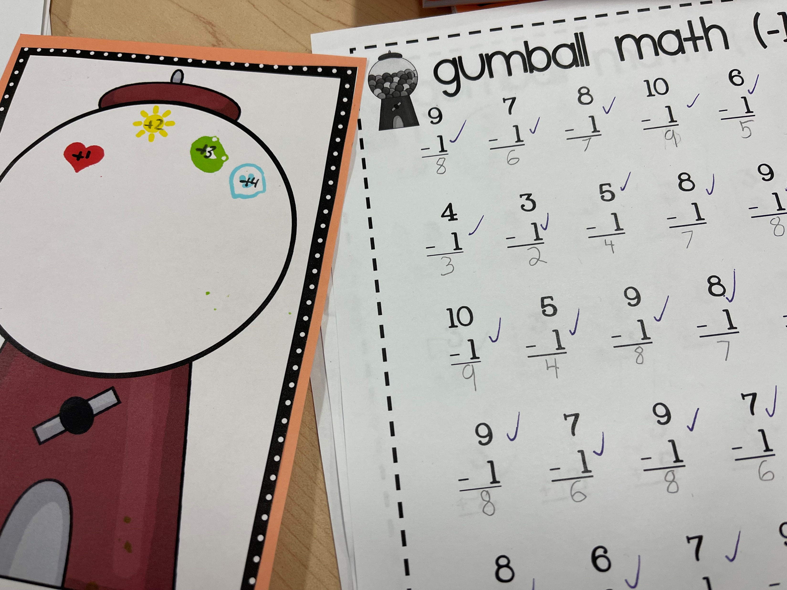
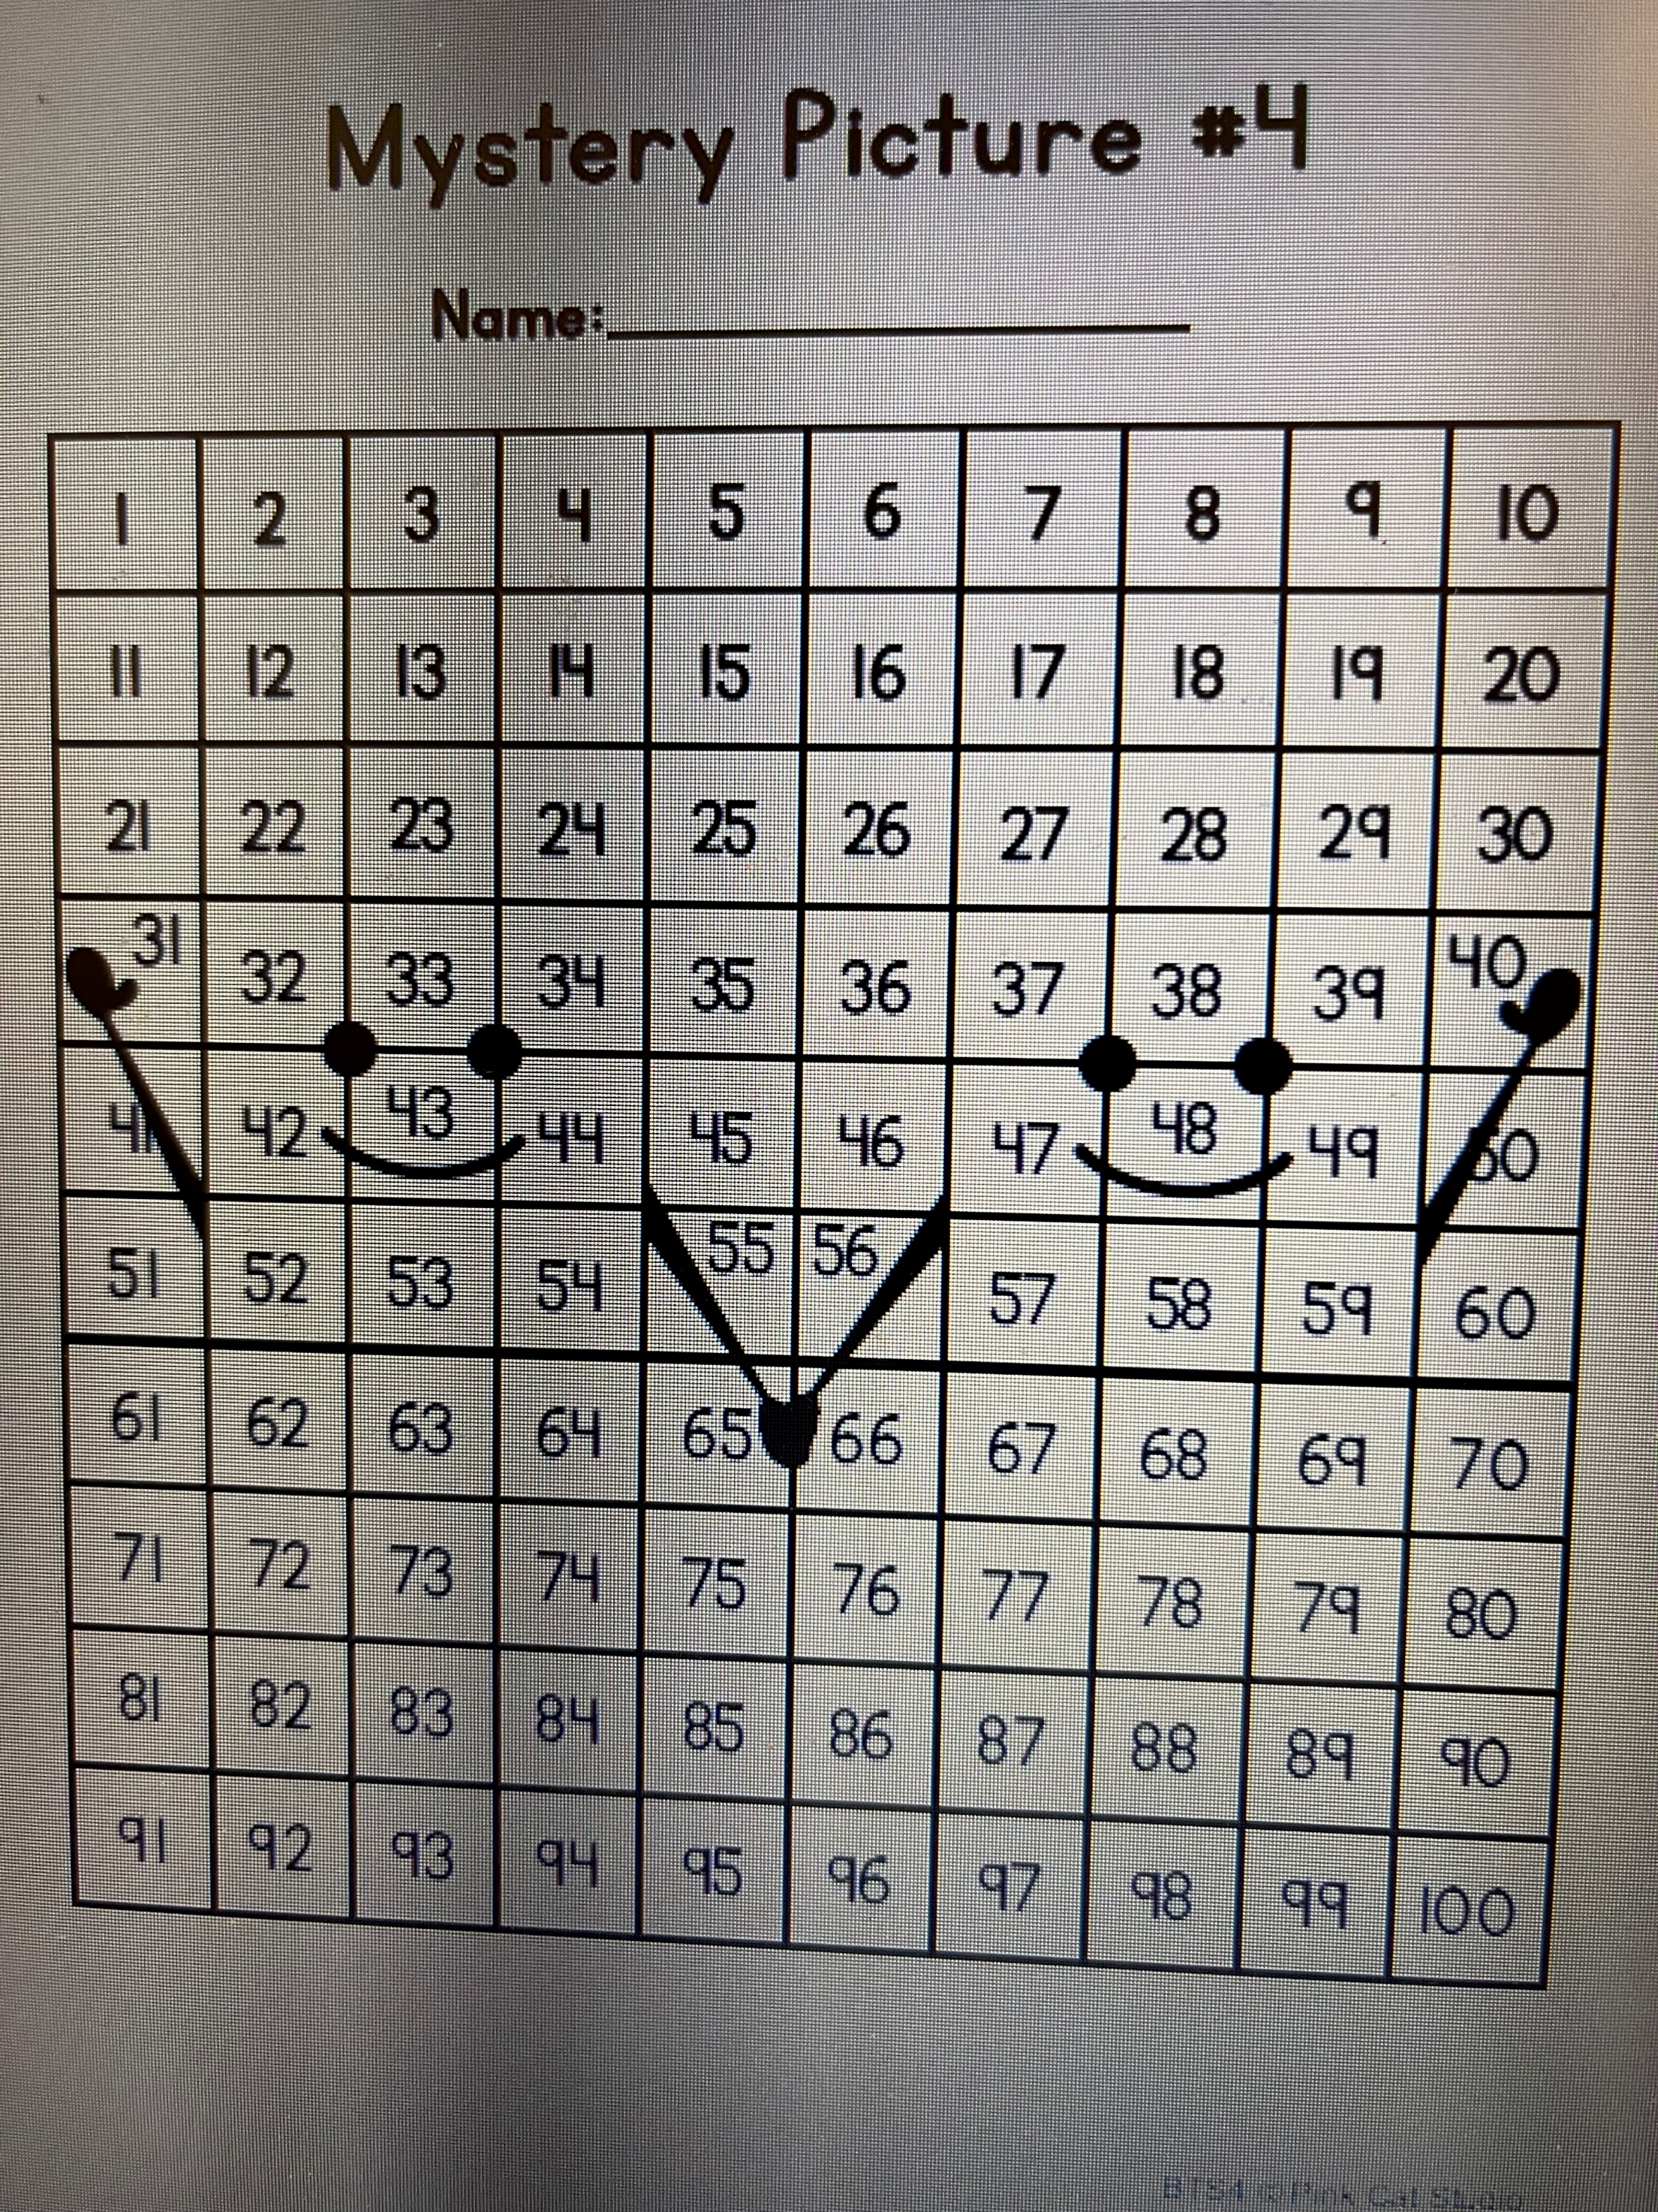
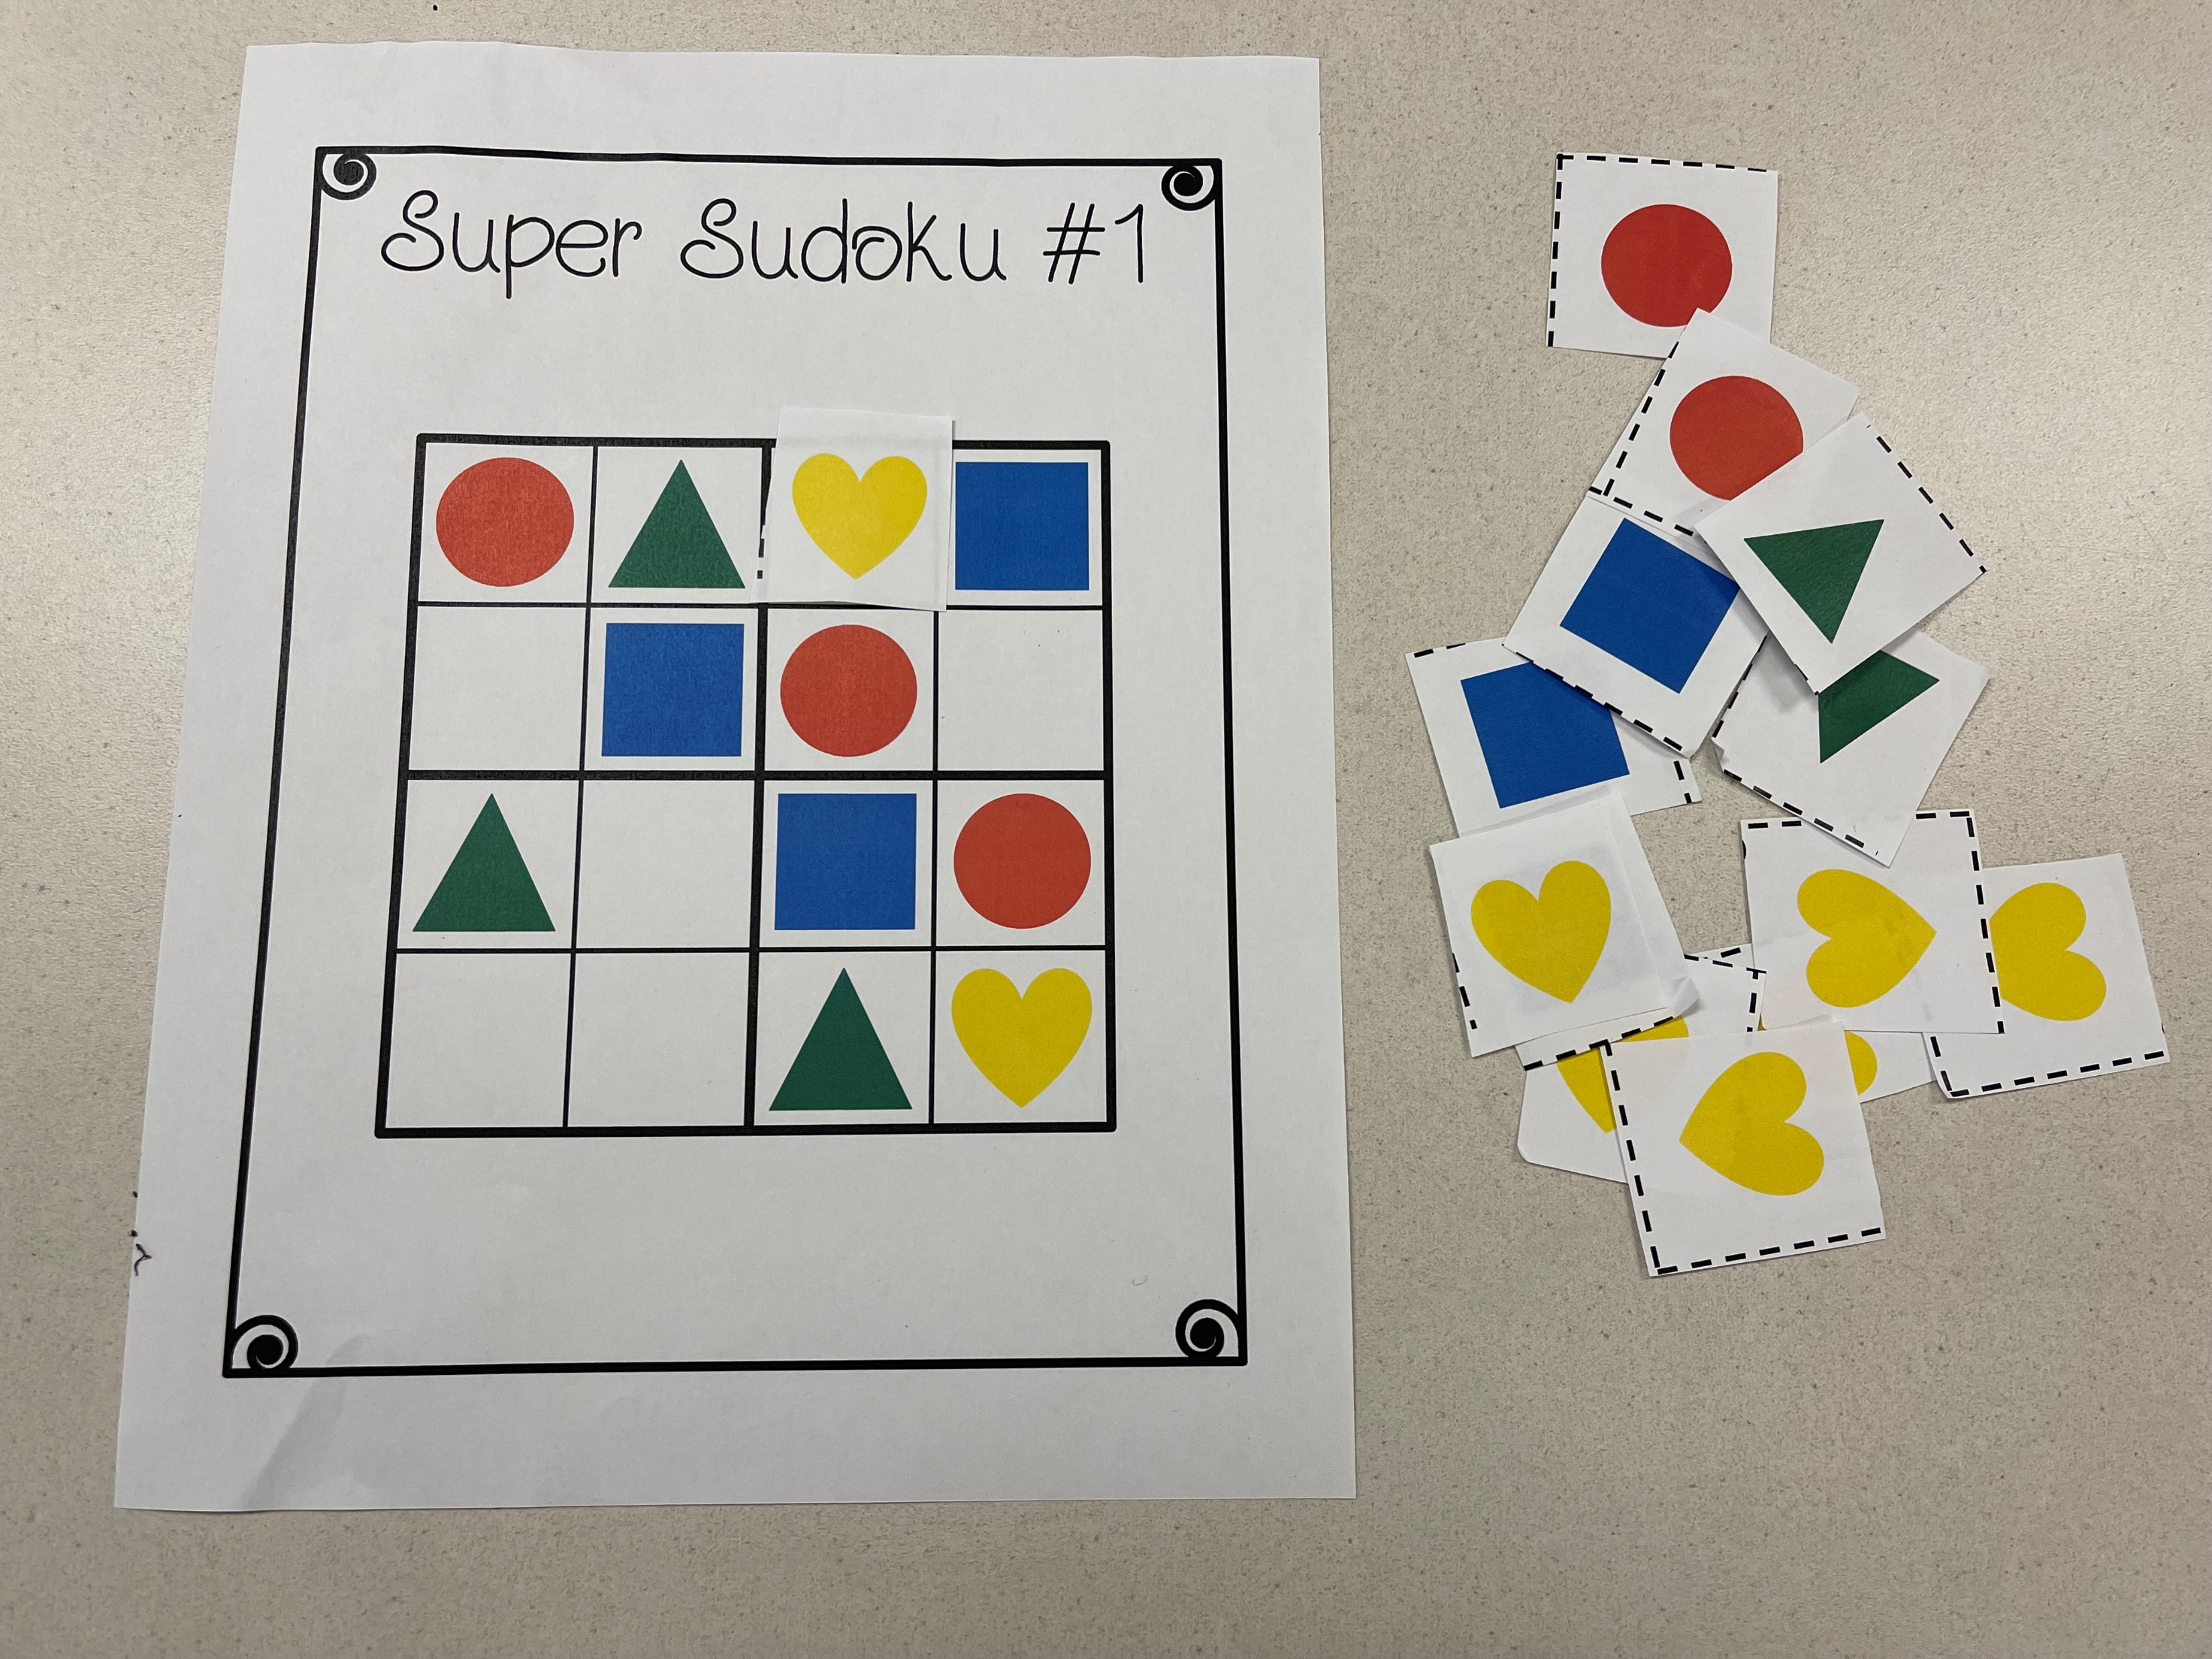
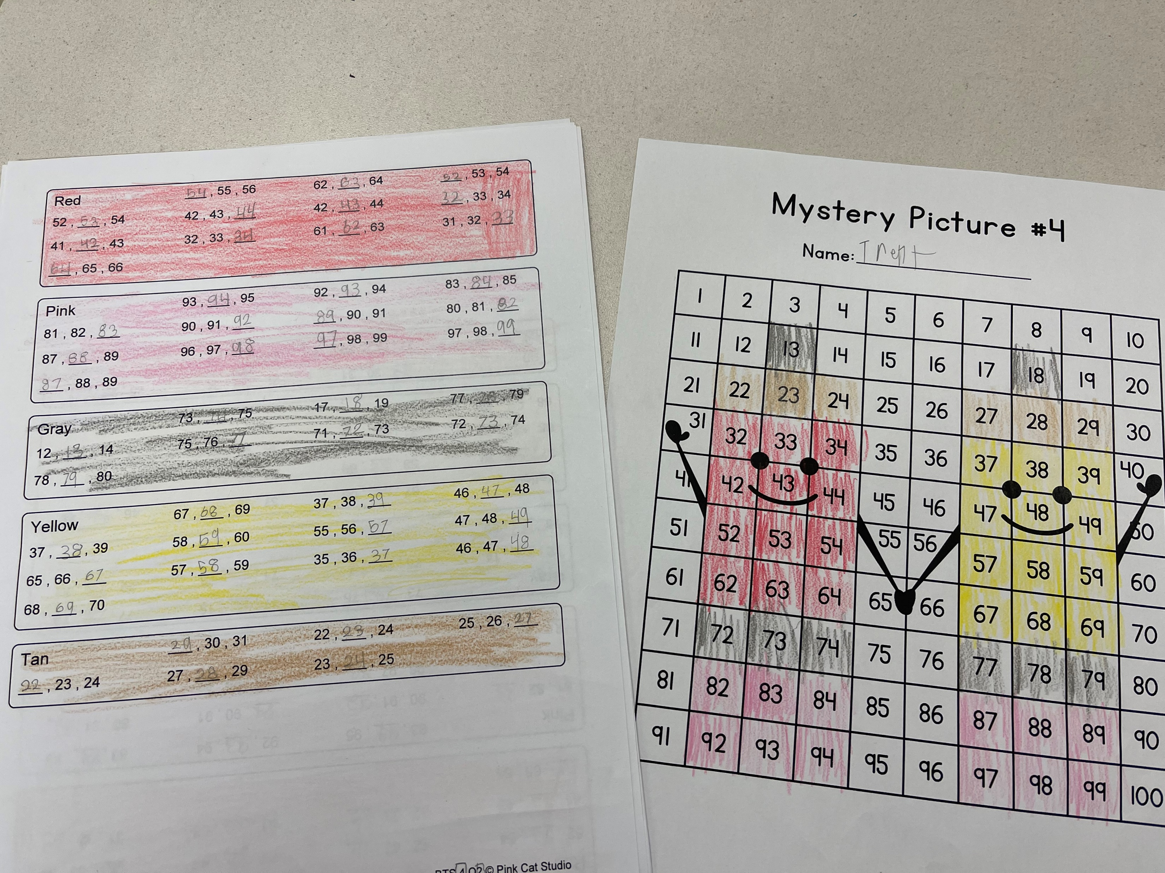
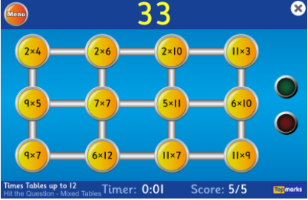
Math
Gumball Math
Mystery Pictures
Sudoku
Hit the Button!
https://www.topmarks.co.uk/maths-games/hit-the-button

Slide 7
Literacy
Novel Study:
Fenway and Hattie
By Victoria J. Coe
Fenway is an excitable and endlessly energetic Jack Russell terrier. He lives in the city with Food Lady, Fetch Man, and—of course—his beloved short human and best-friend-in-the-world, Hattie. But when his family moves to the suburbs, Fenway faces a world of changes. He’s pretty pleased with the huge Dog Park behind his new home, but he’s not so happy about the Evil Squirrels that taunt him from the trees, the super-slippery Wicked Floor in the Eating Room, and the changes that have come over Hattie lately. Rather than playing with Fenway, she seems more interested in her new short human friend and learning to play baseball. His friends in the Dog Park next door say Hattie is outgrowing him, but that can’t be right. And he’s going to prove it! Get a dog’s-eye view of the world in this heartwarming, enthusiastic “tail” about two best friends.

Slide 8
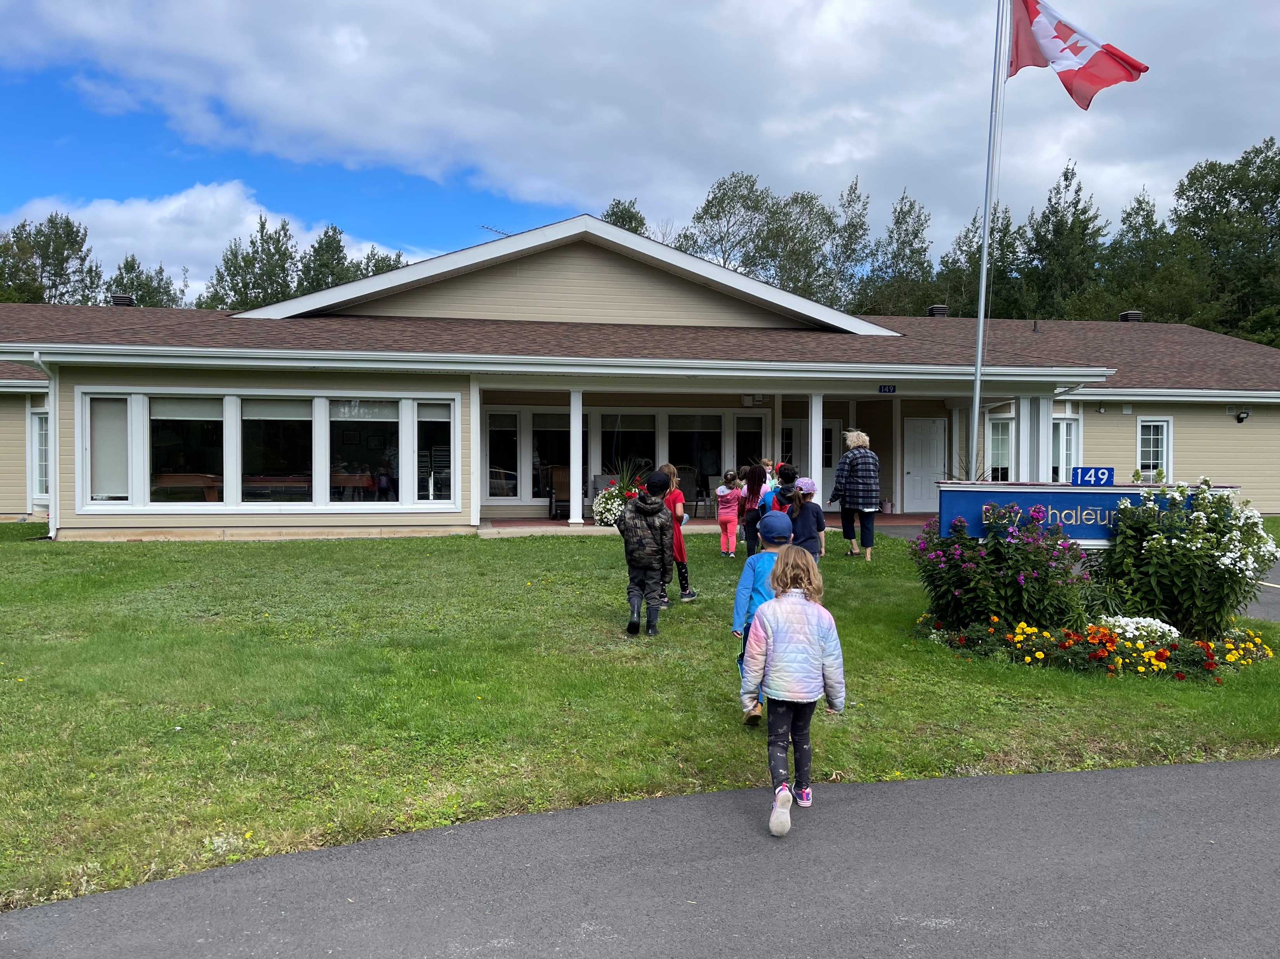
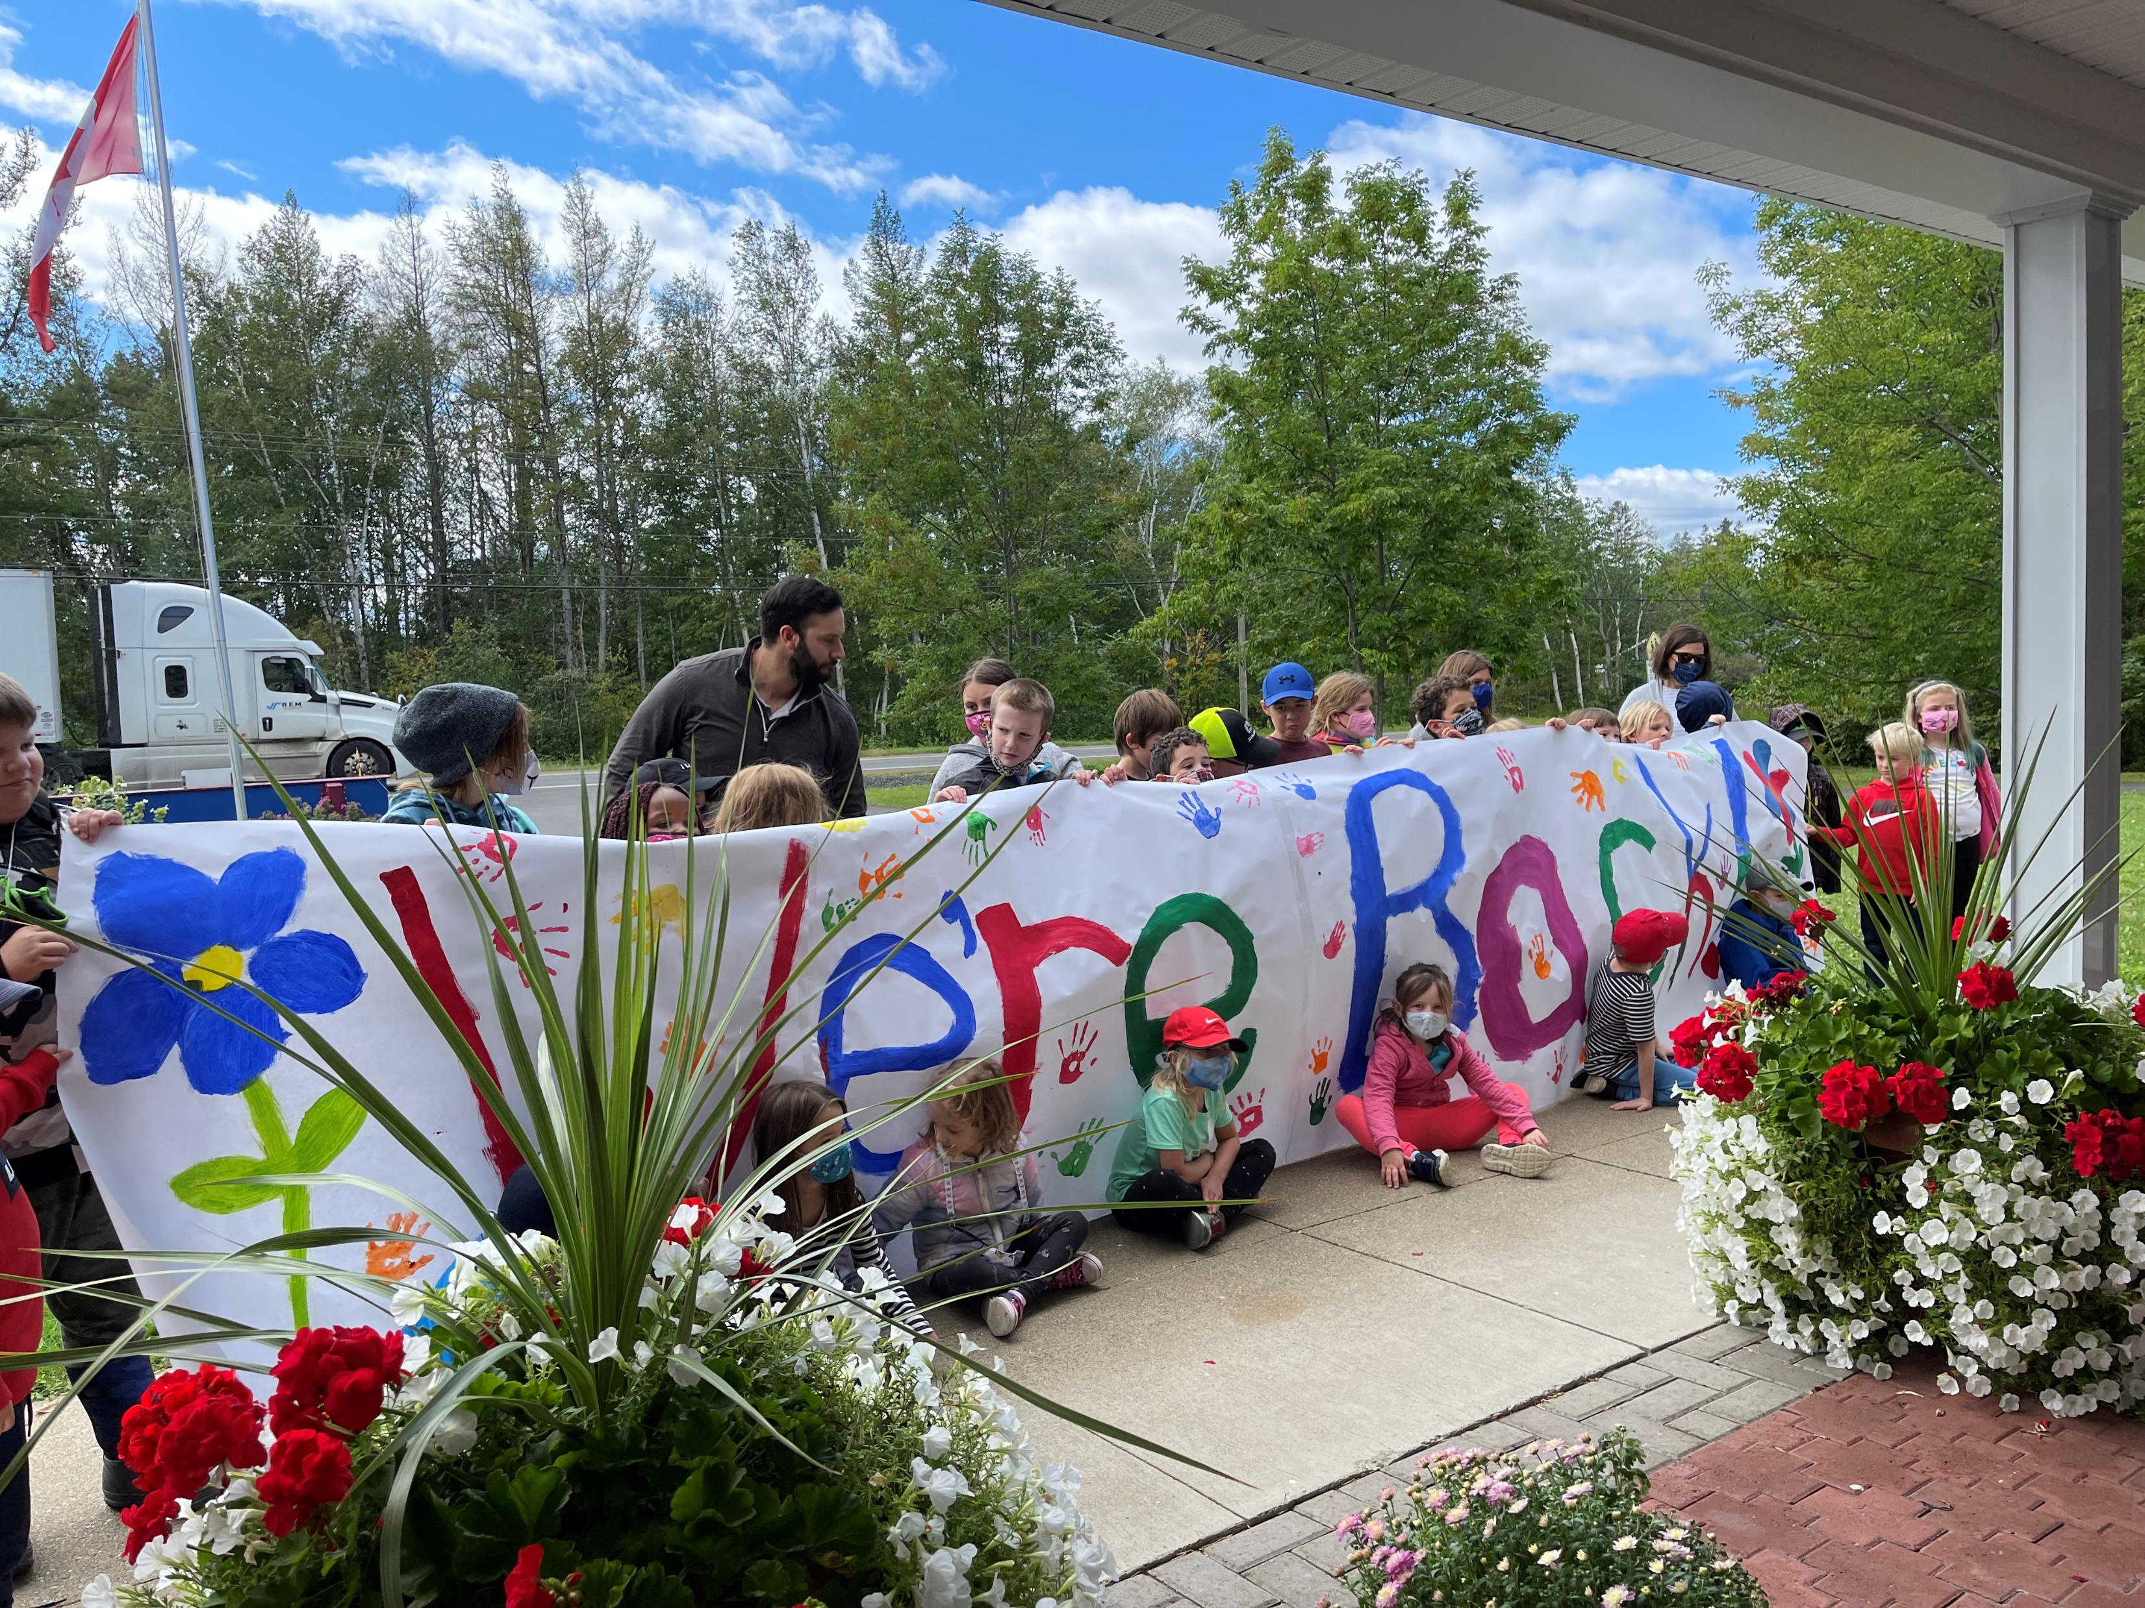
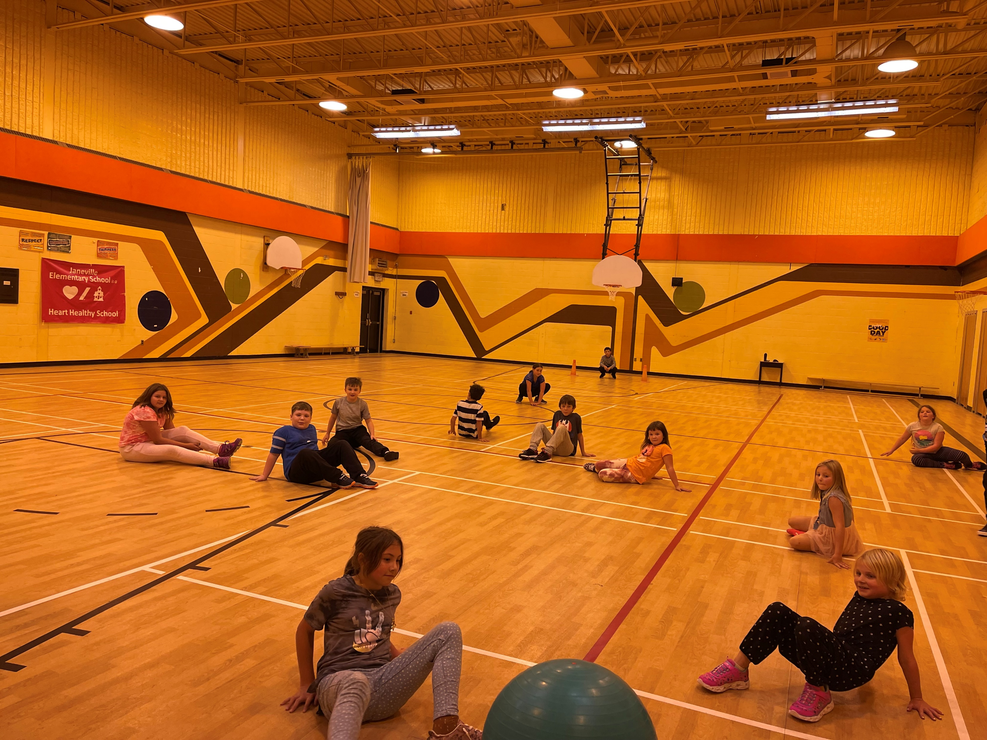
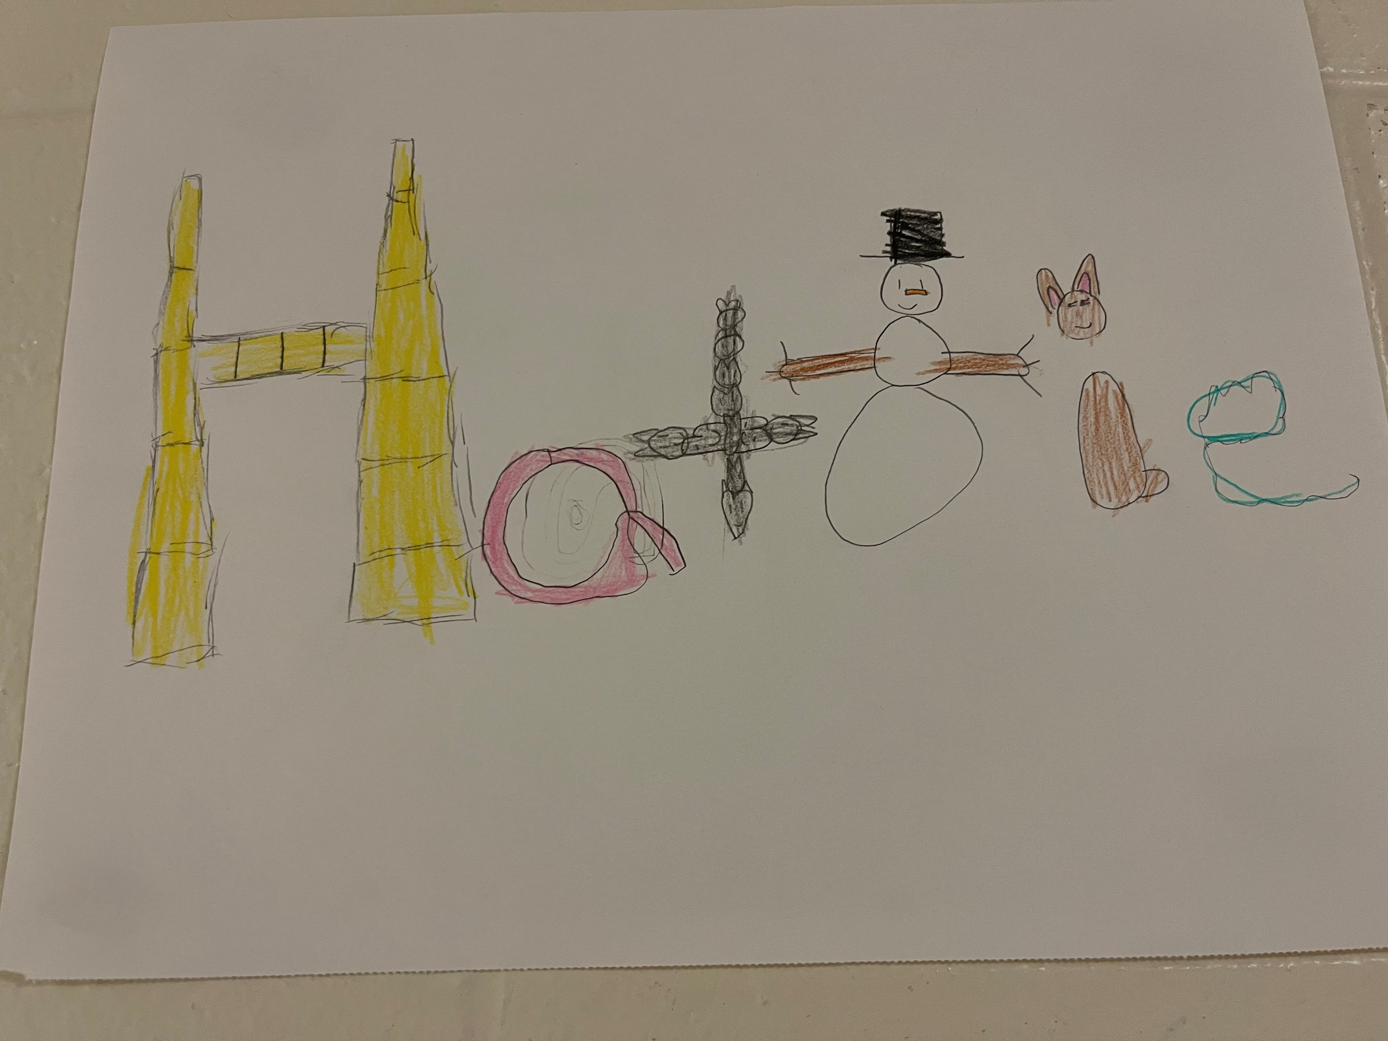
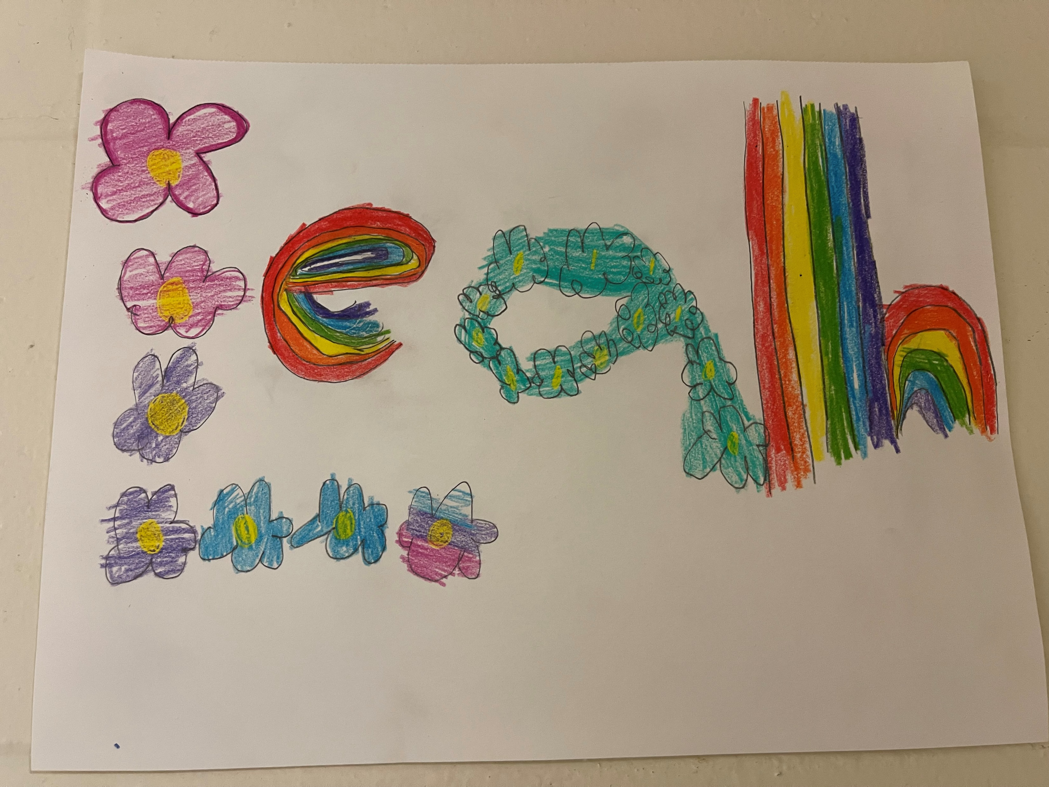
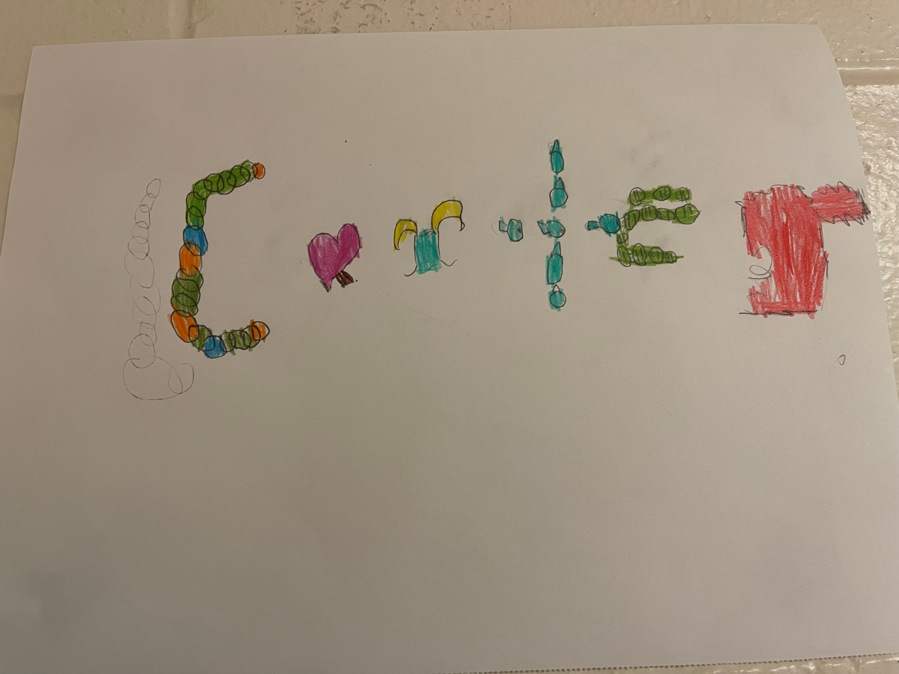
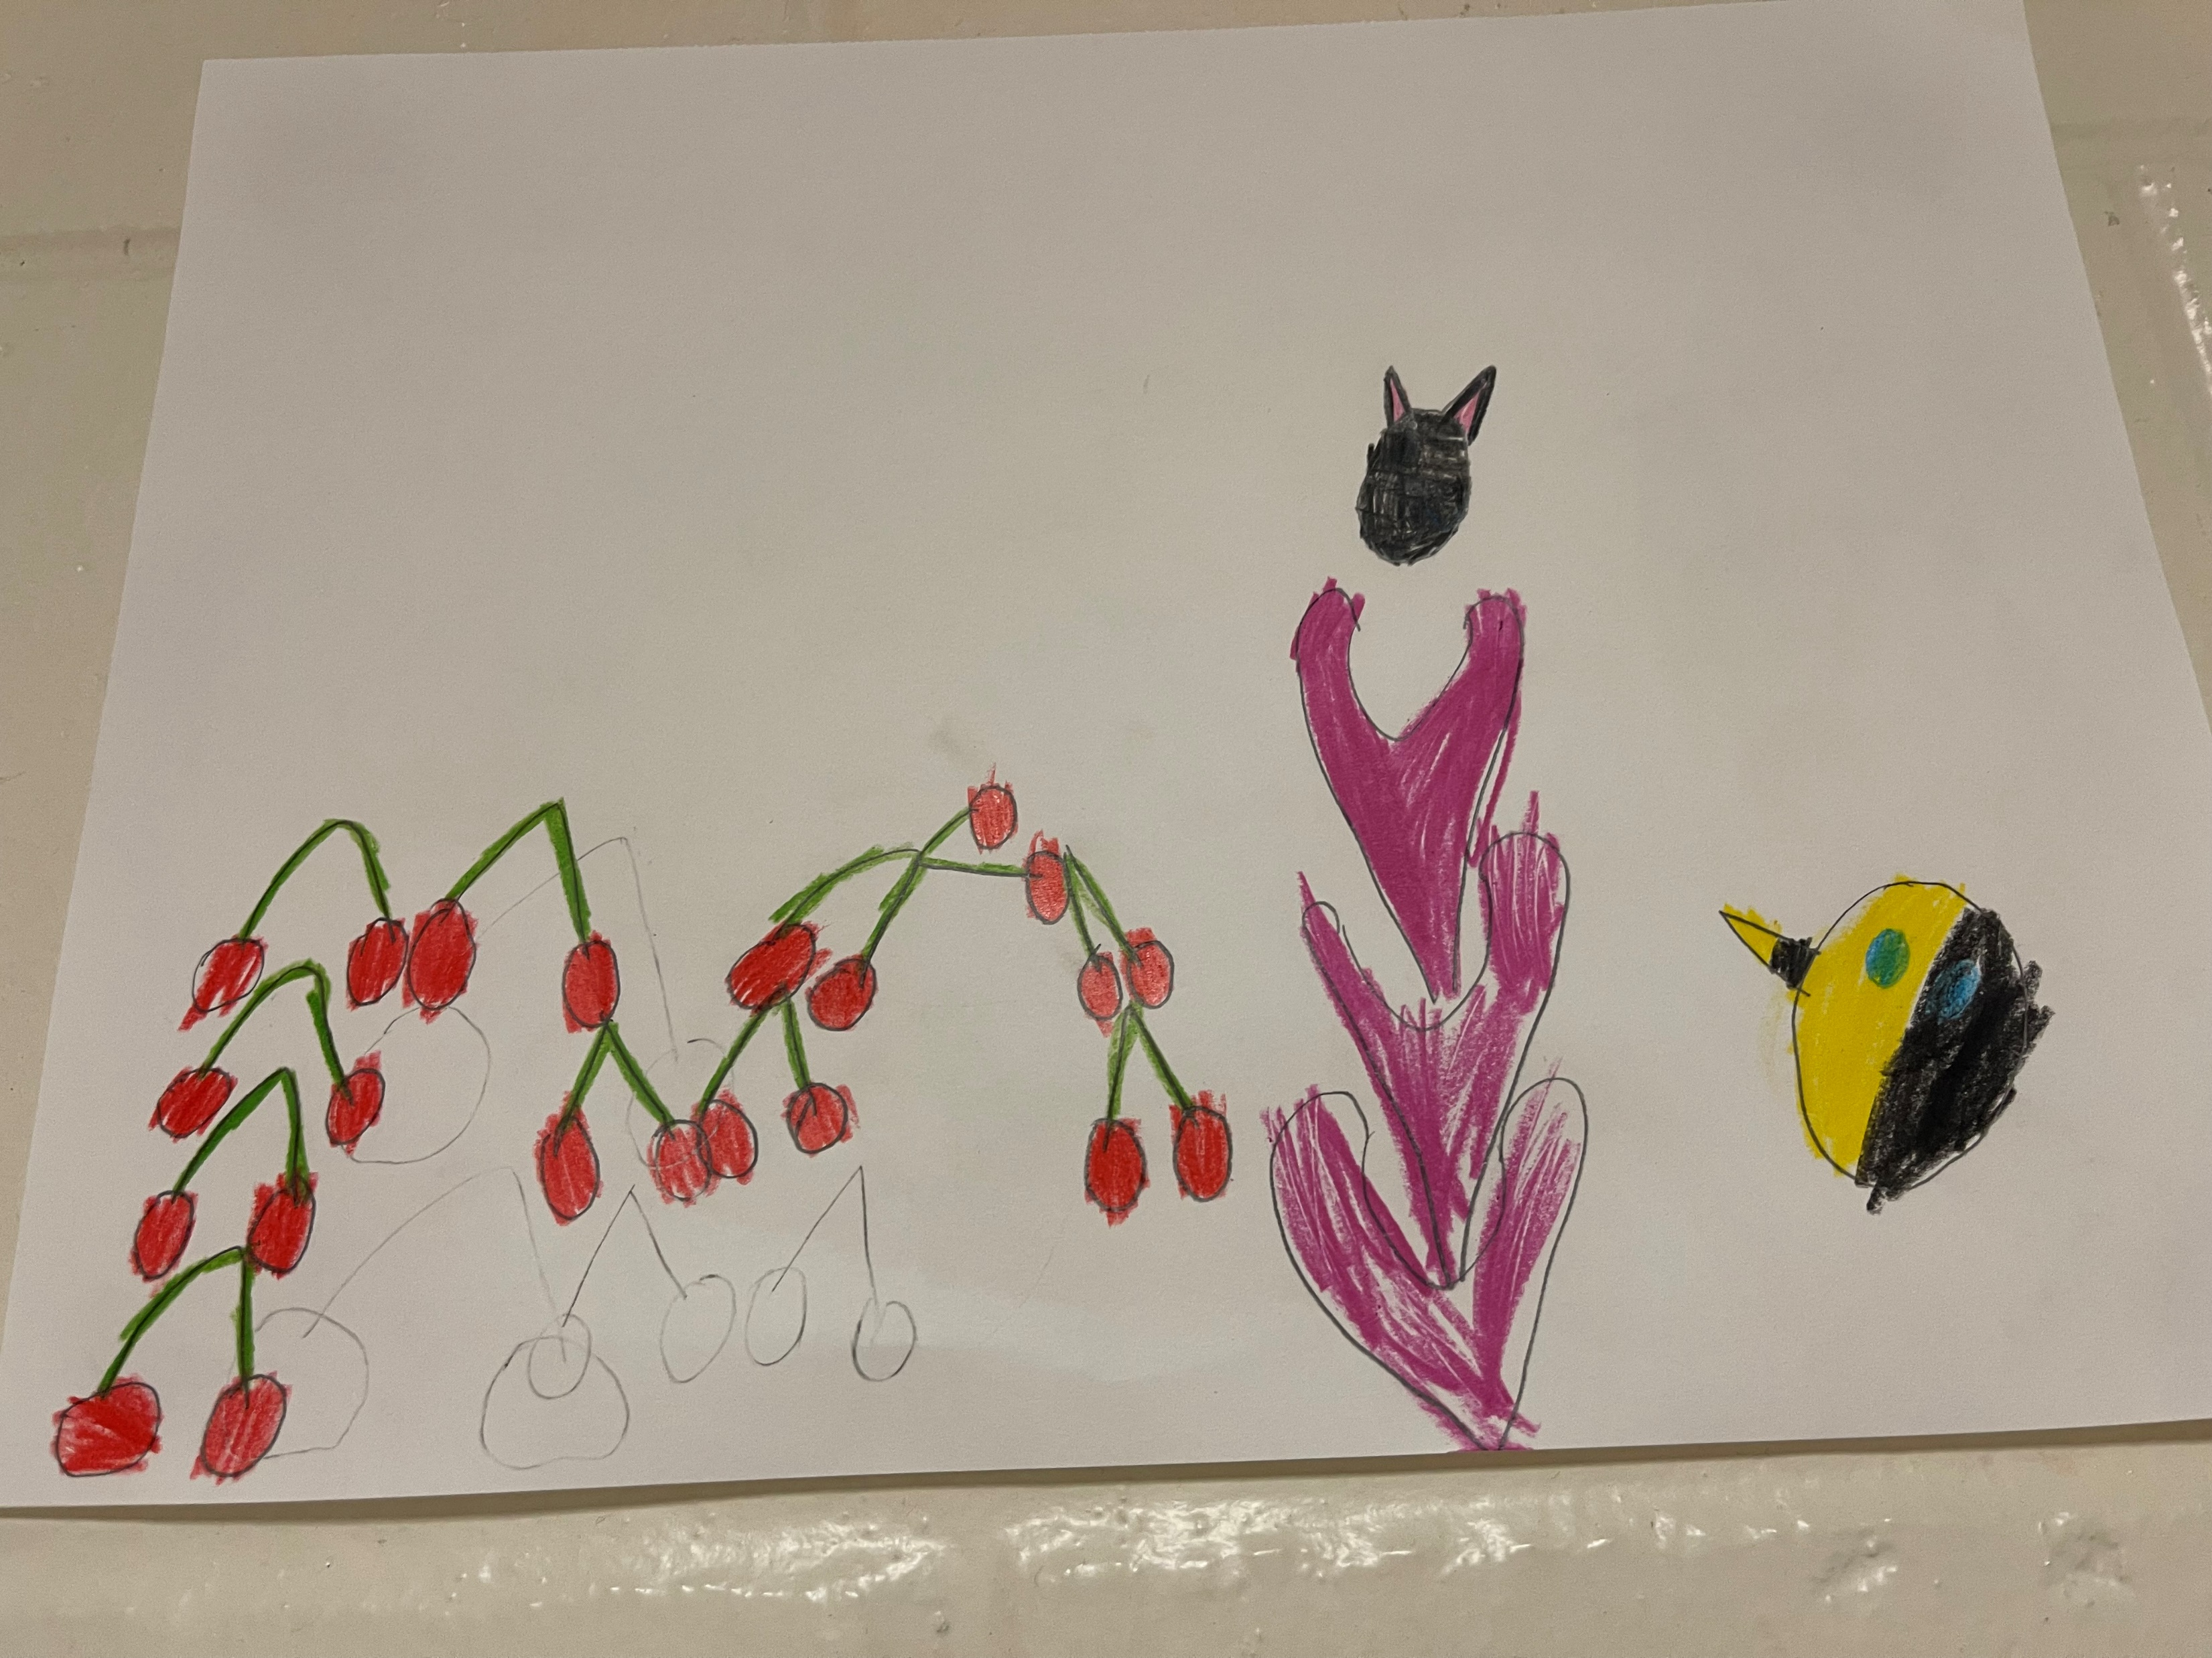
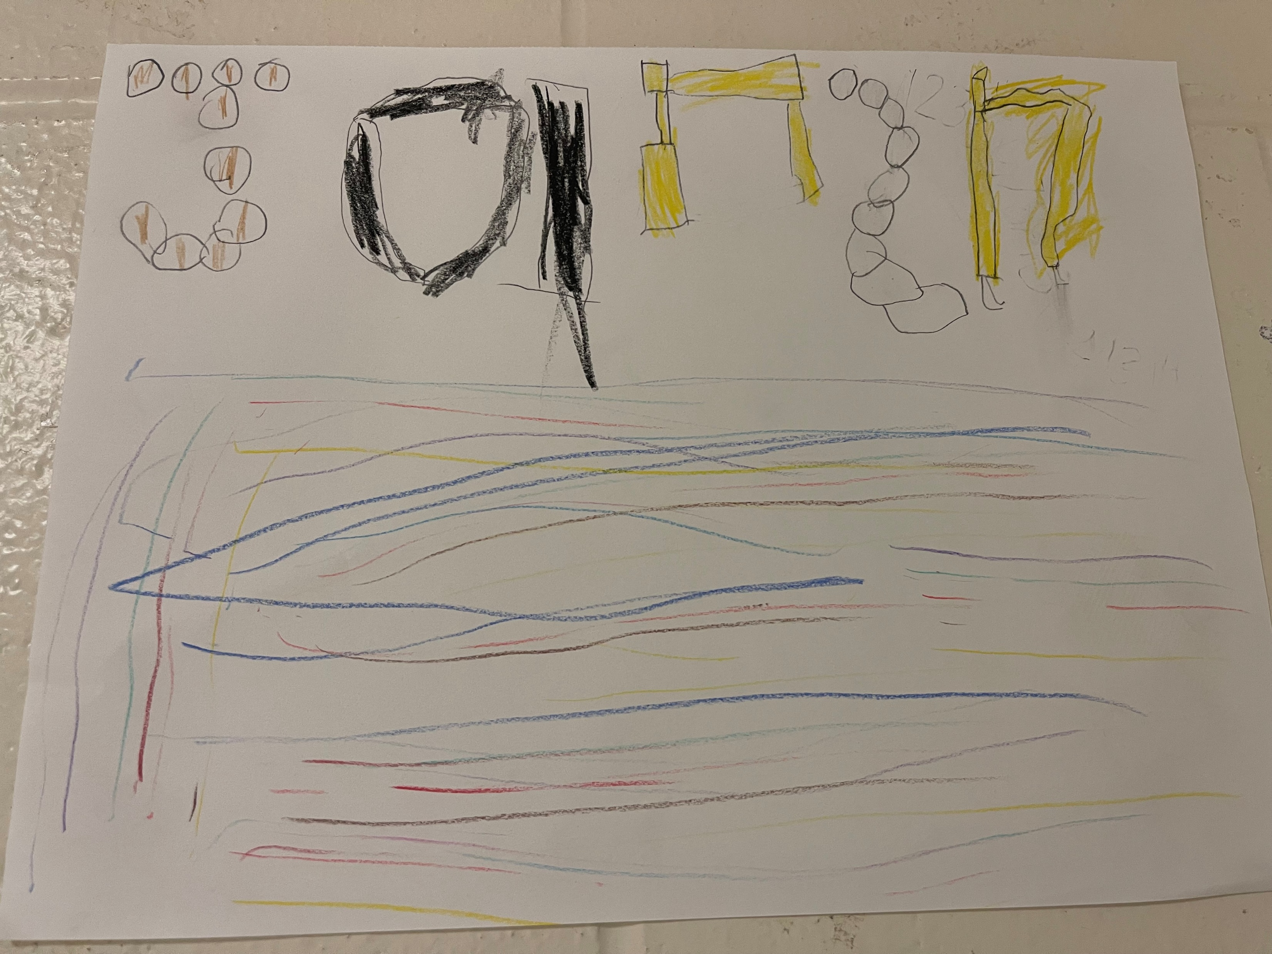
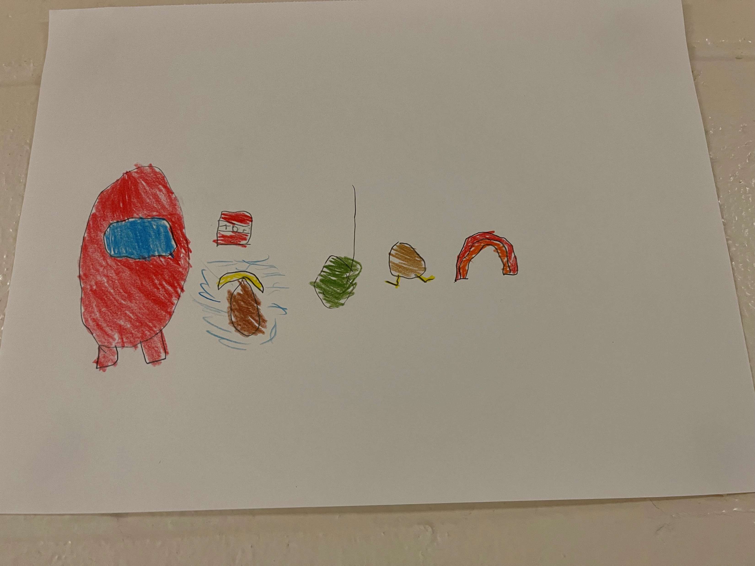
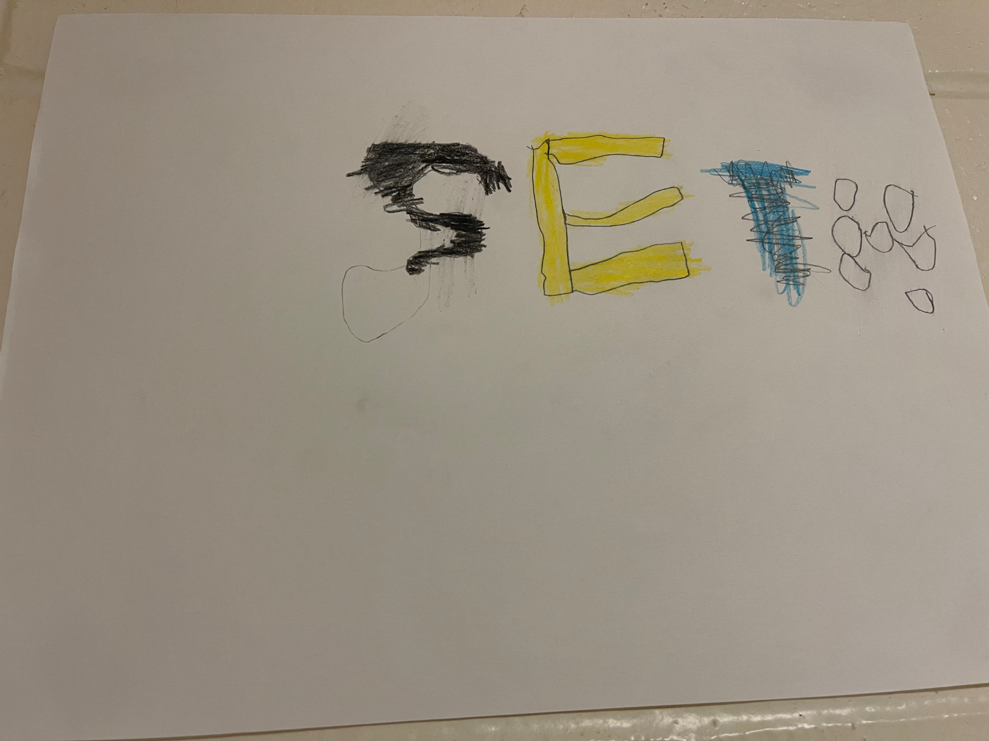
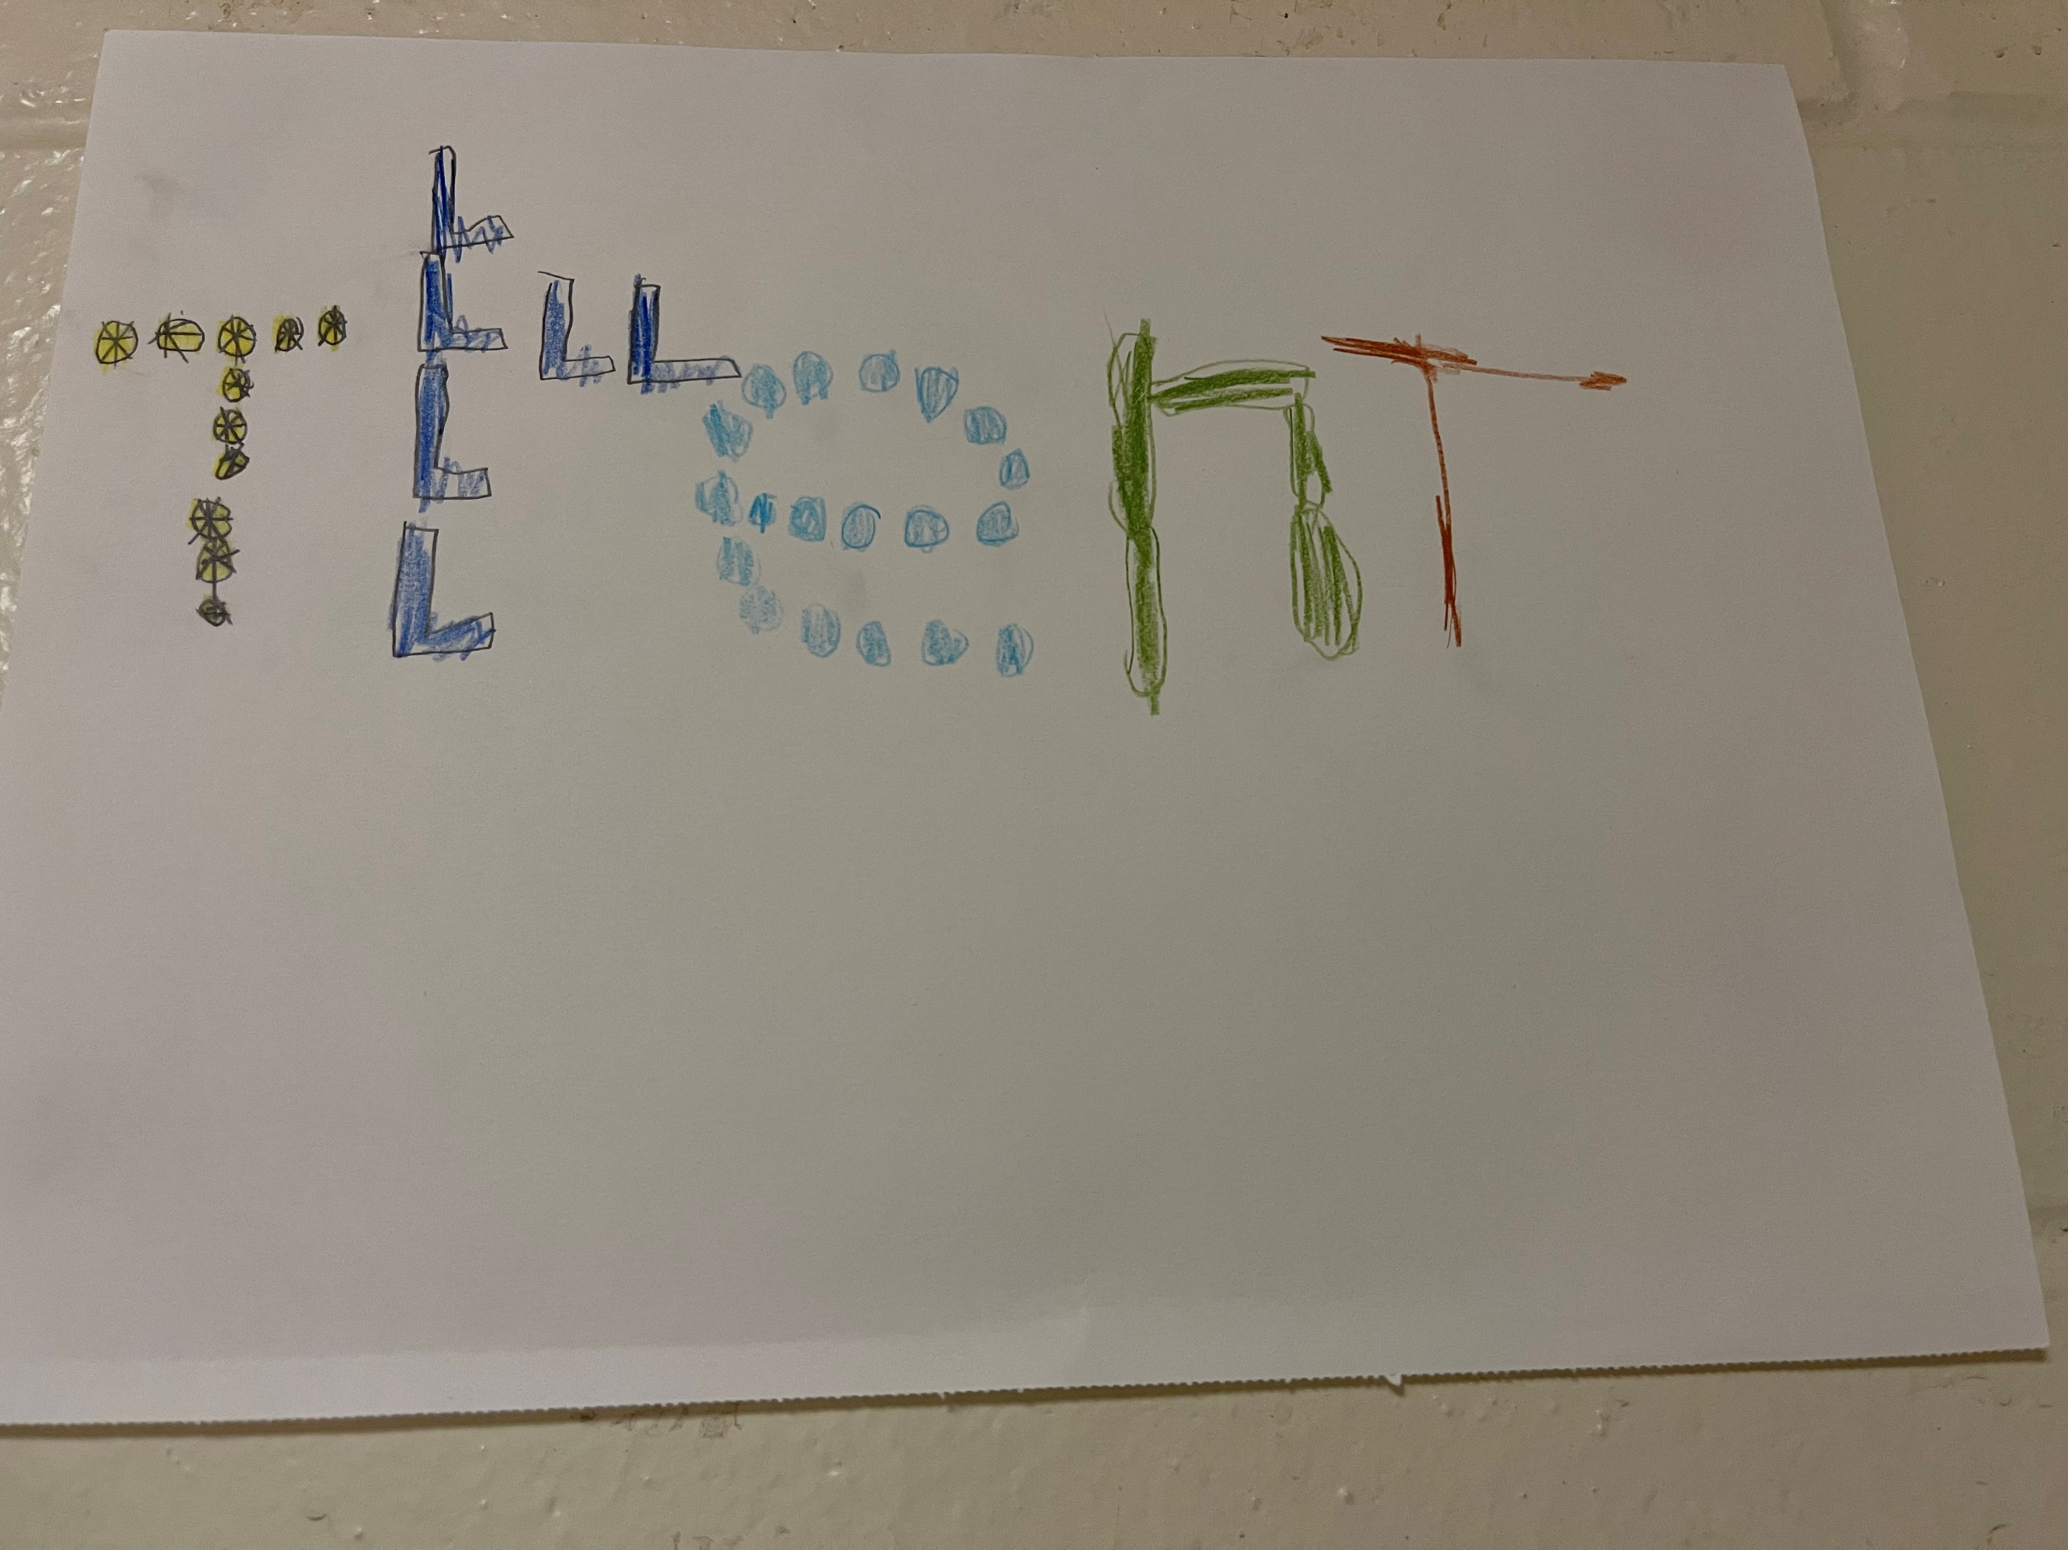
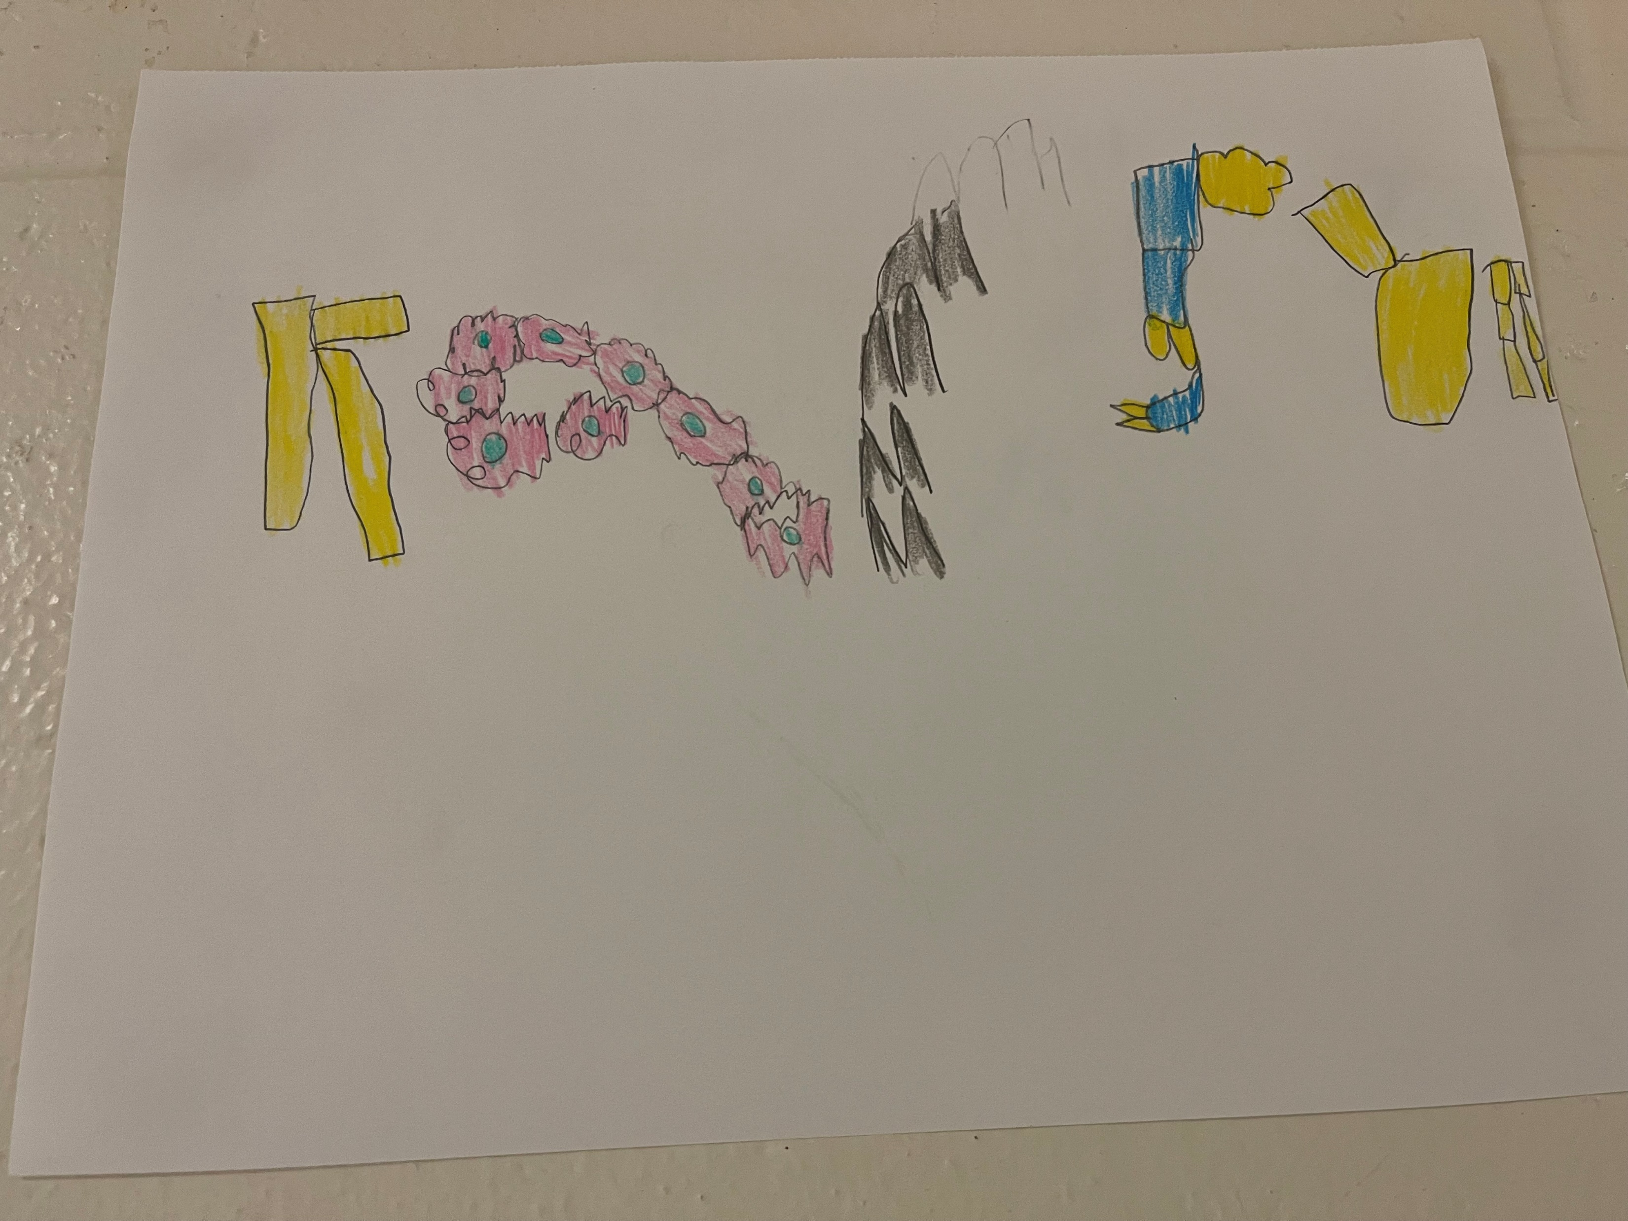
Our First Week

Slide 9
Contact Information:
Class Dojo!
School: (506) 547-7440
Cell: See weekly communicator for number
Email: jaimie.spriggs@nbed.nb.ca
Follow our adventures:
Website: je.nbed.nb.ca
Twitter: @janevilleschool
Facebook: Janeville Elementary School

Slide 10
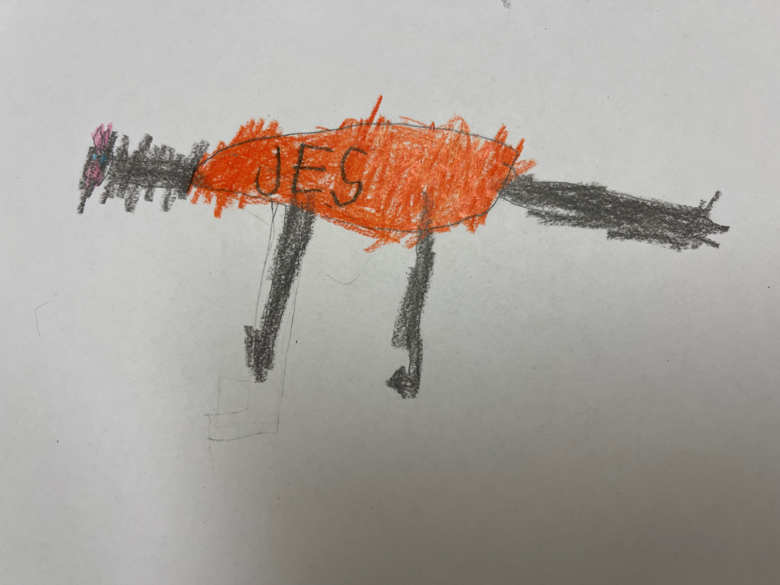
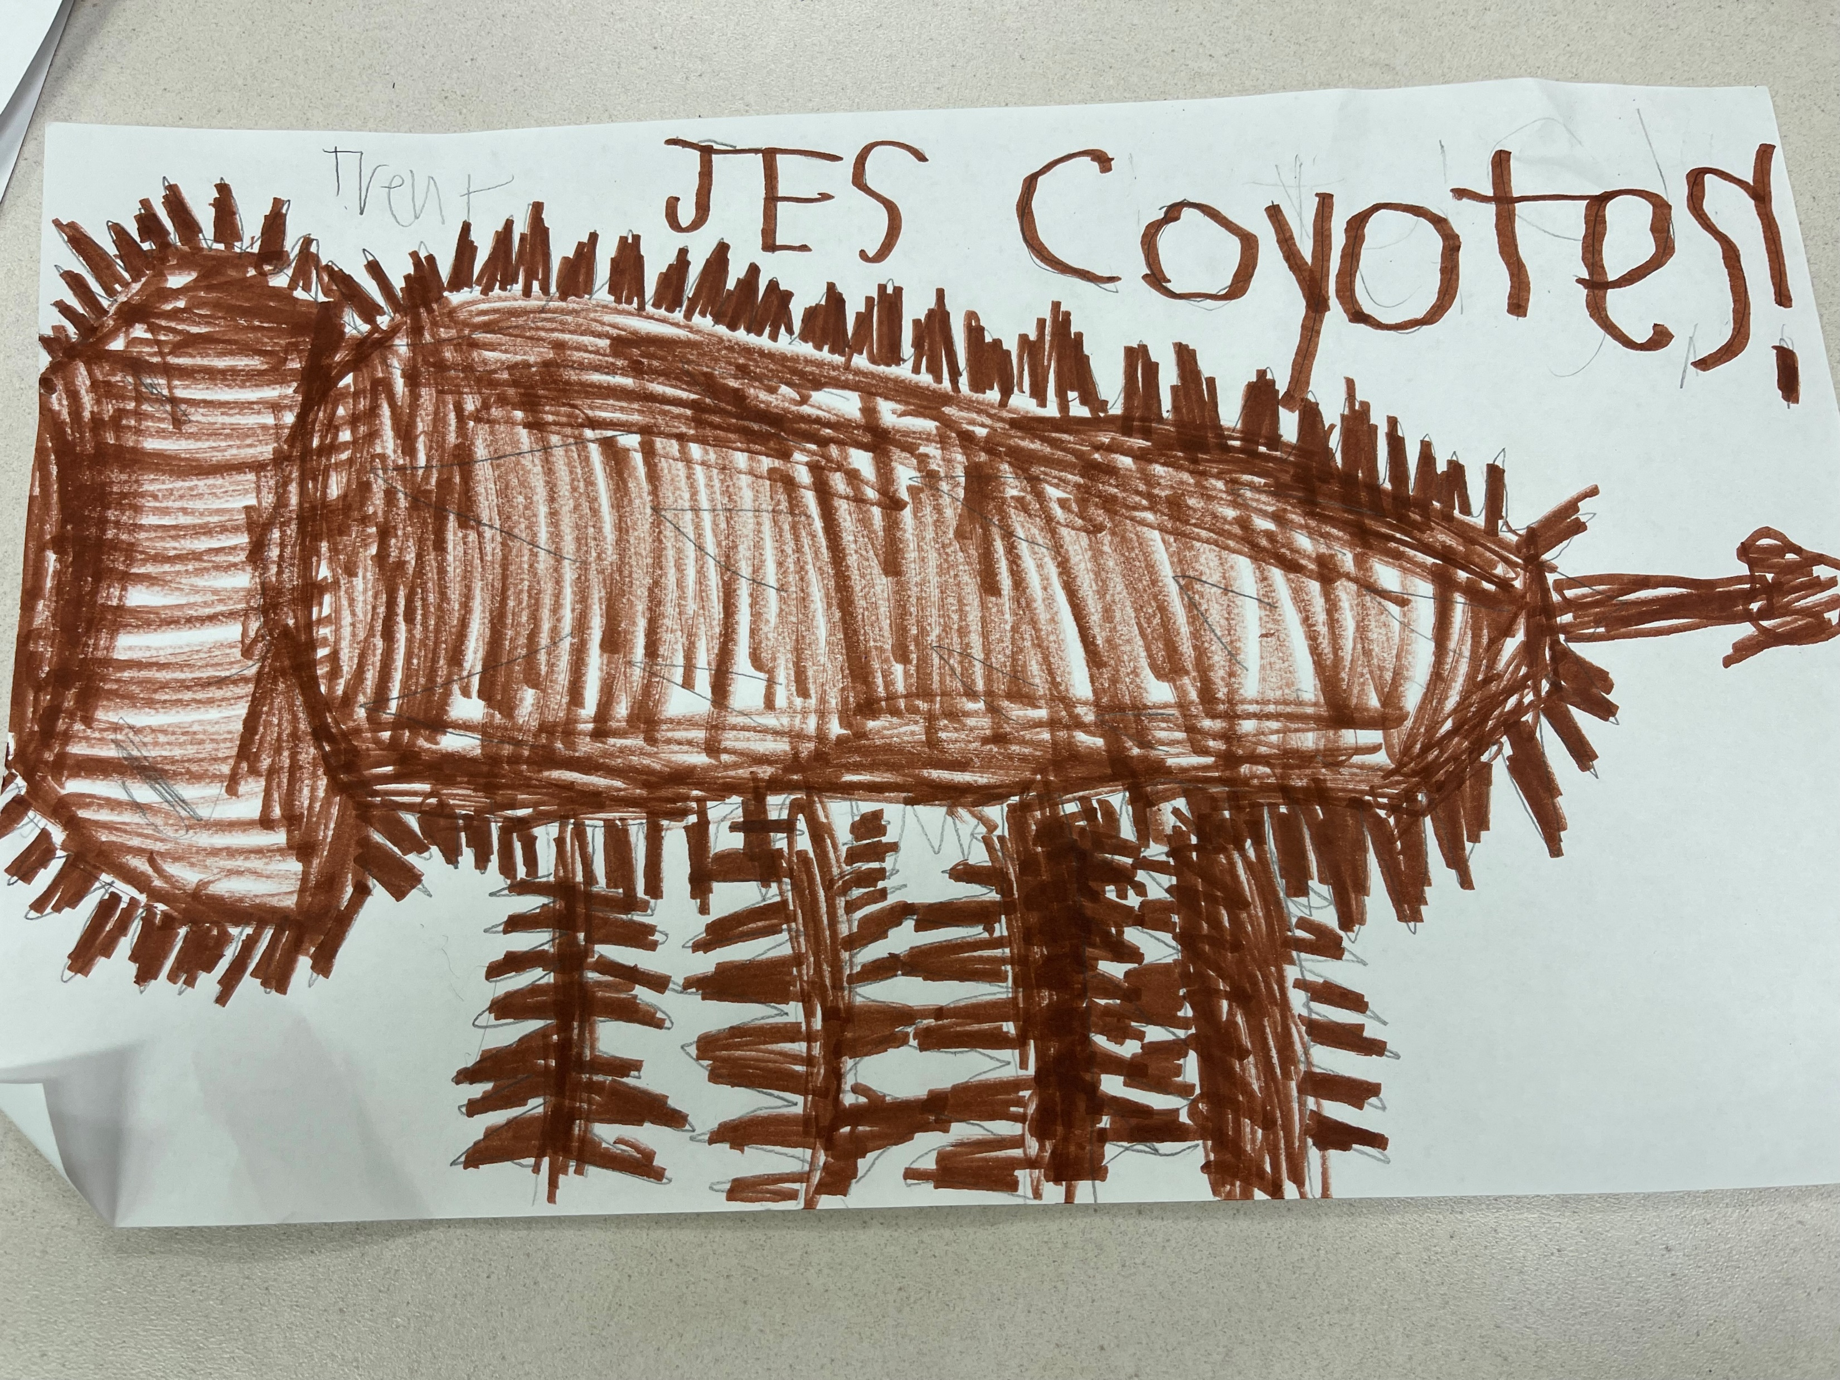
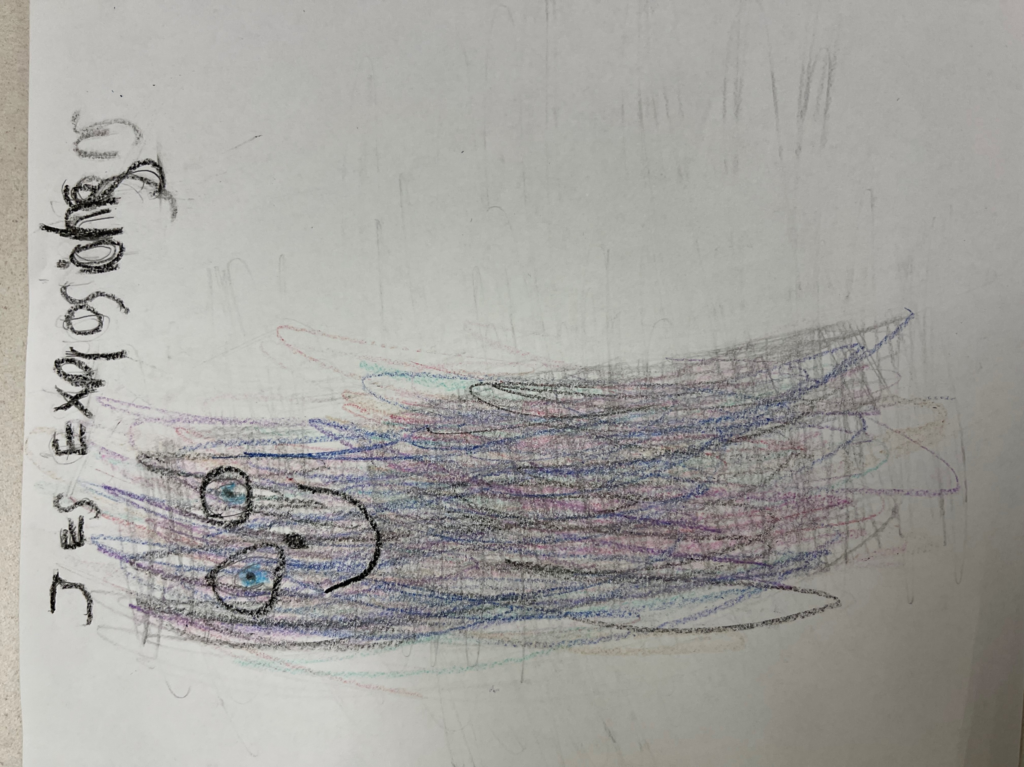
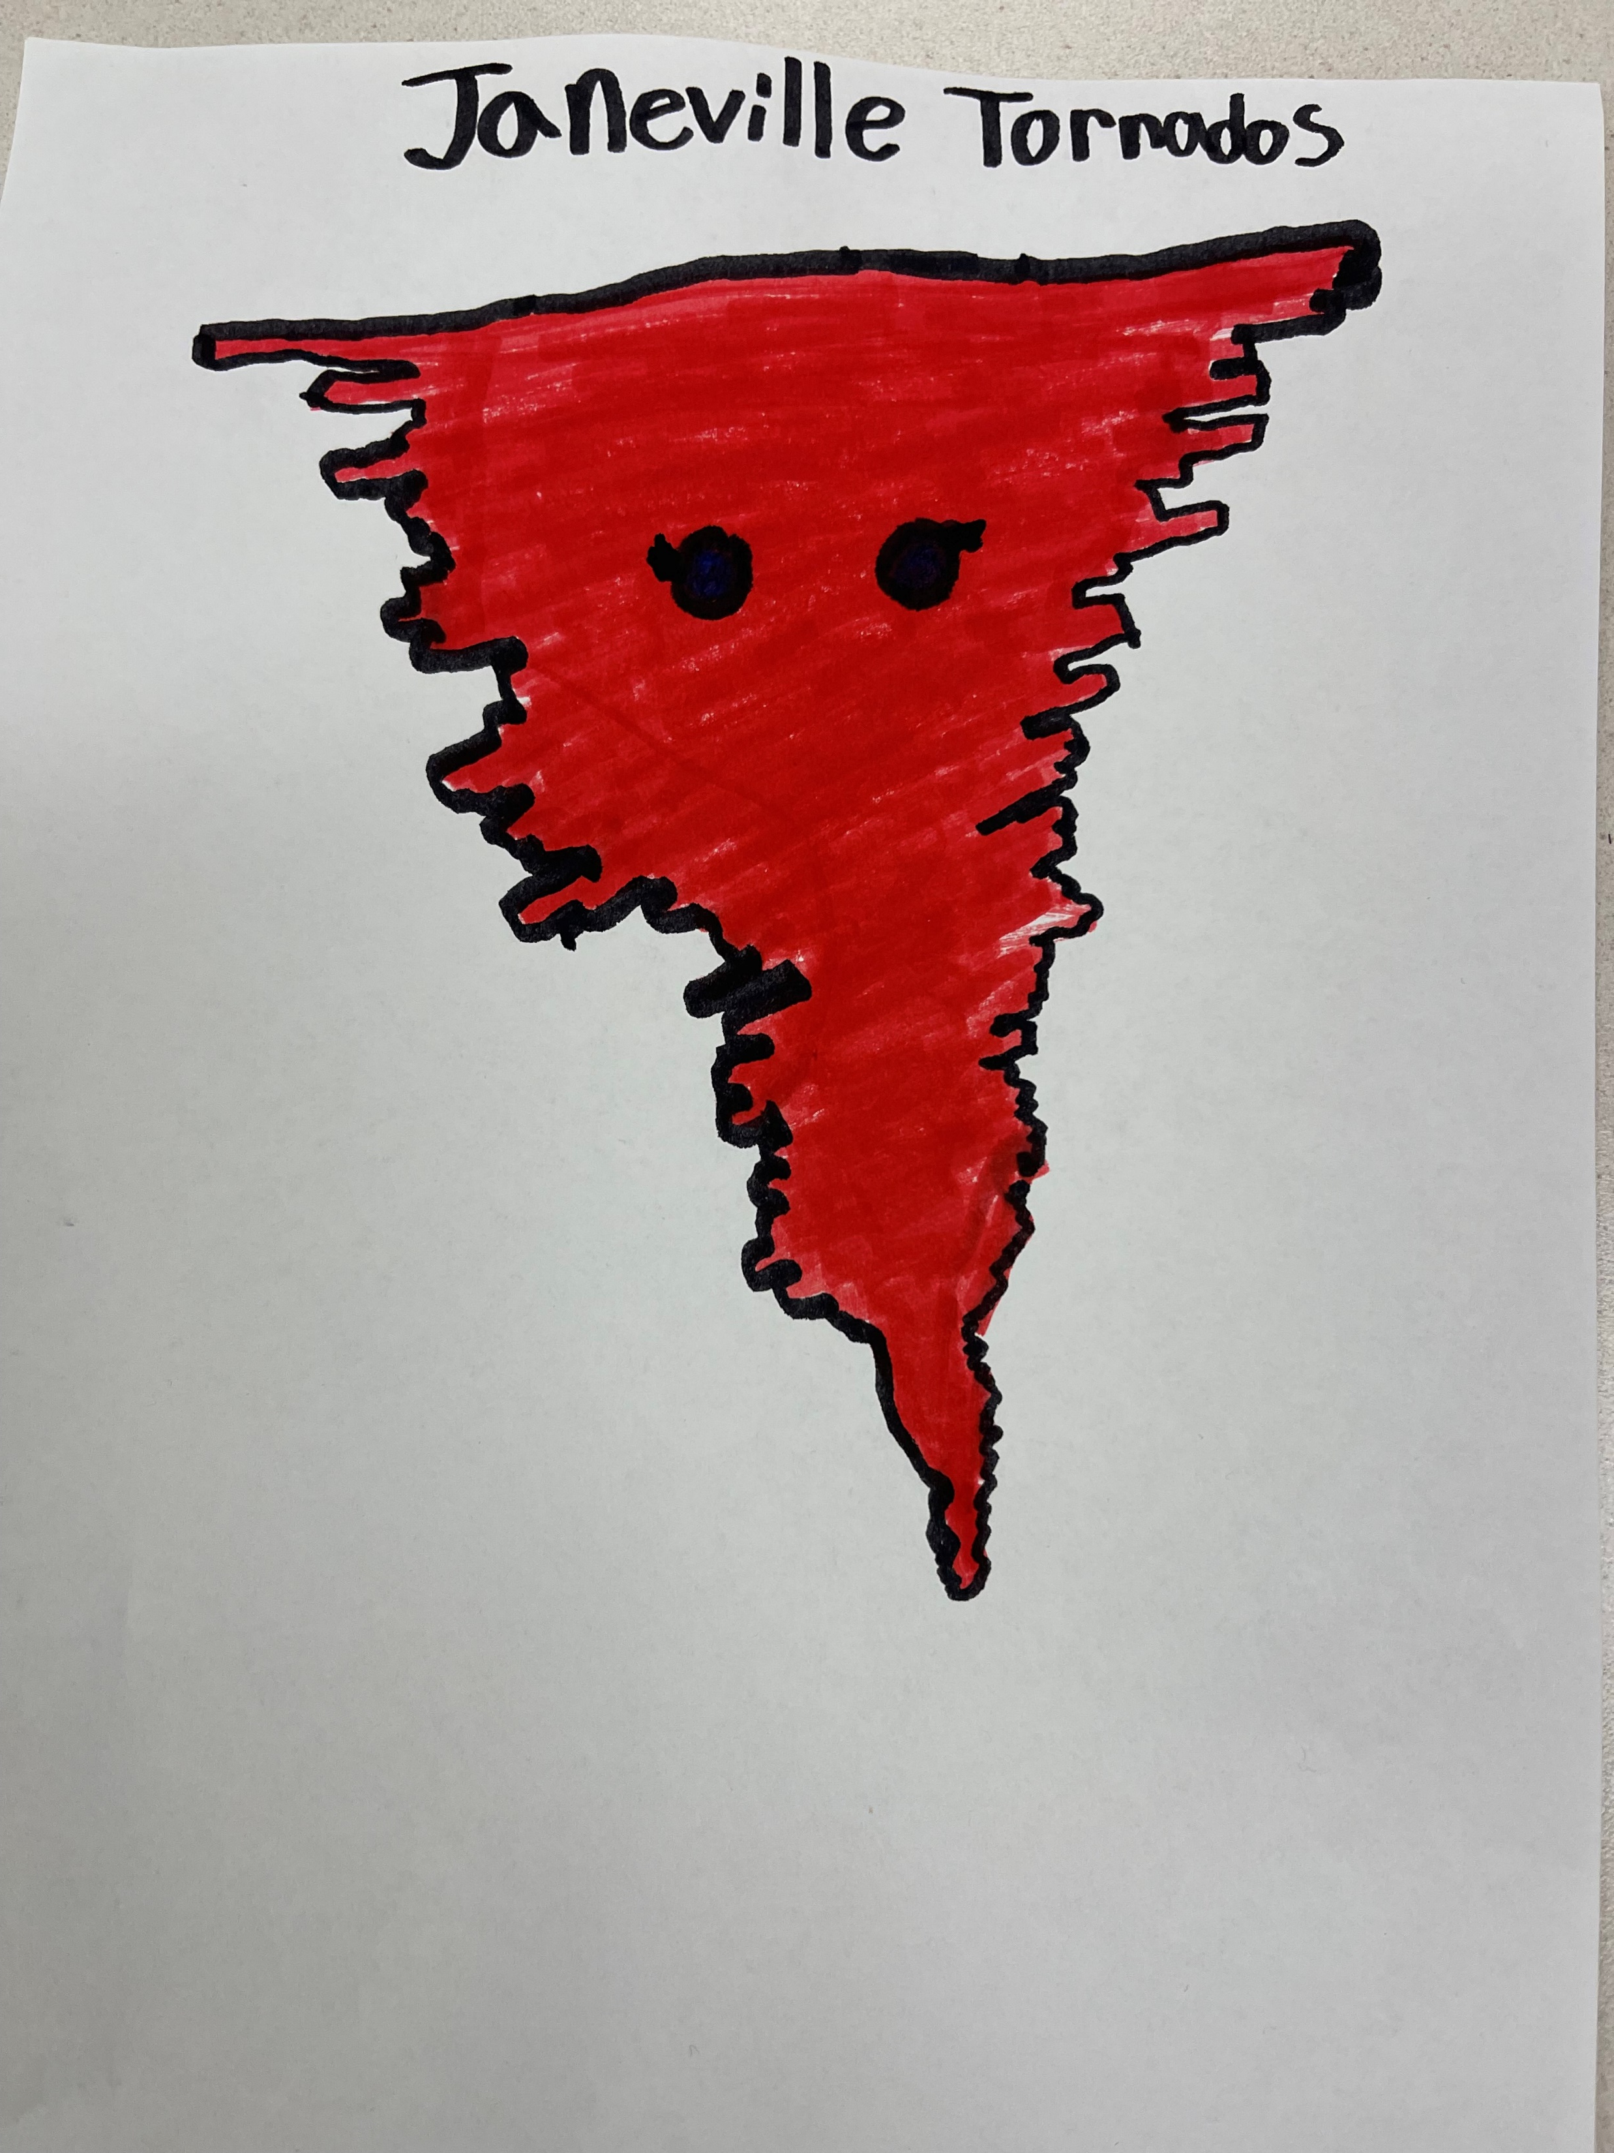
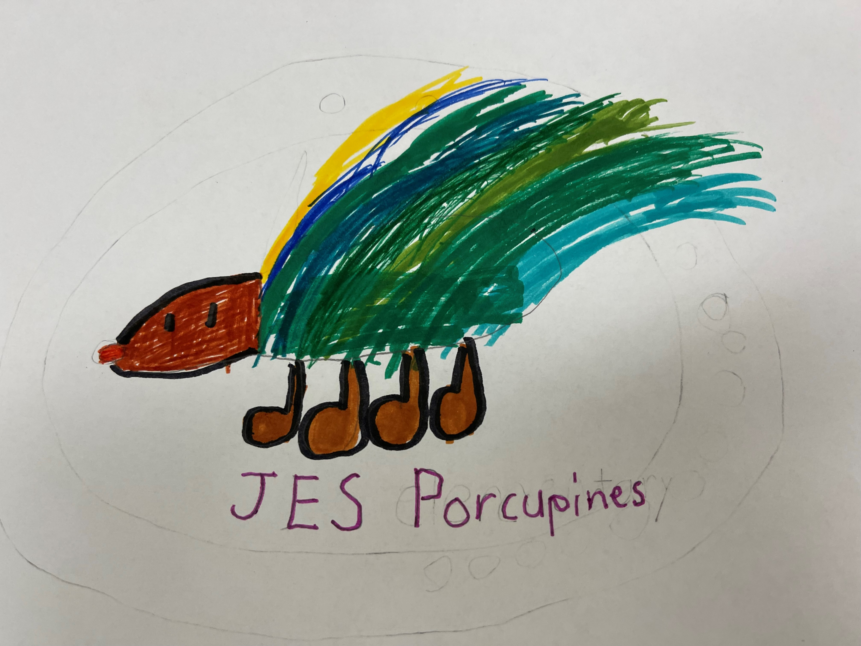
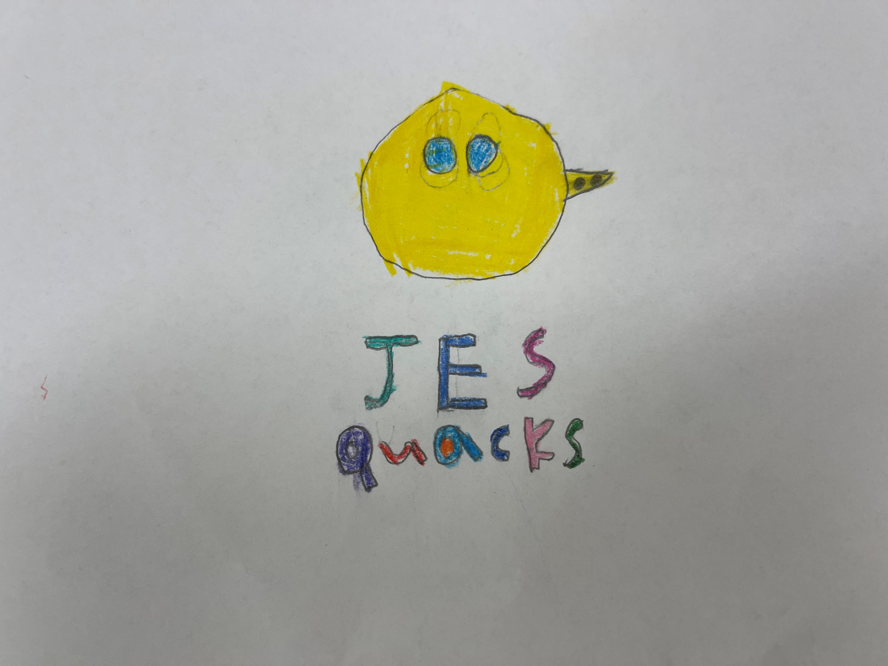
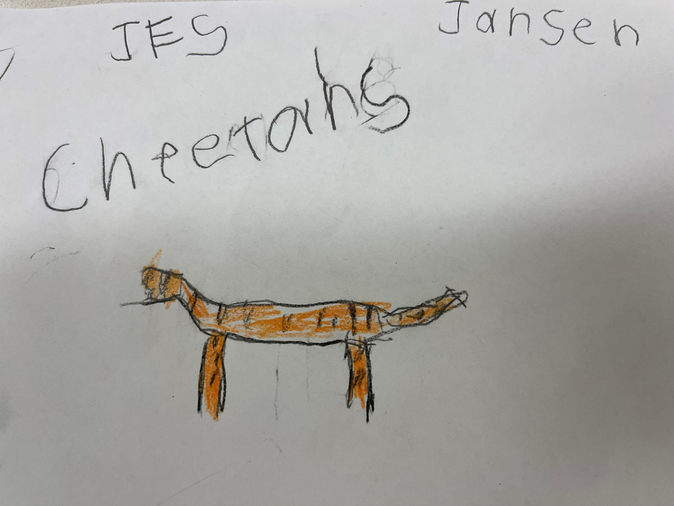
…

Slide 11
Stock Images: pixabay.com

